Slide 1
Production Ray Tracing of Feature Lines
Shinji Ogaki, Iliyan Georgiev
Notes:
Thank you for coming this early morning session. This presentation is about the feature line drawing algorithm we implemented in the Arnold production renderer.

Slide 2
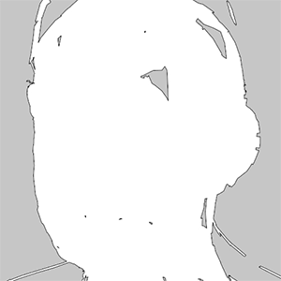
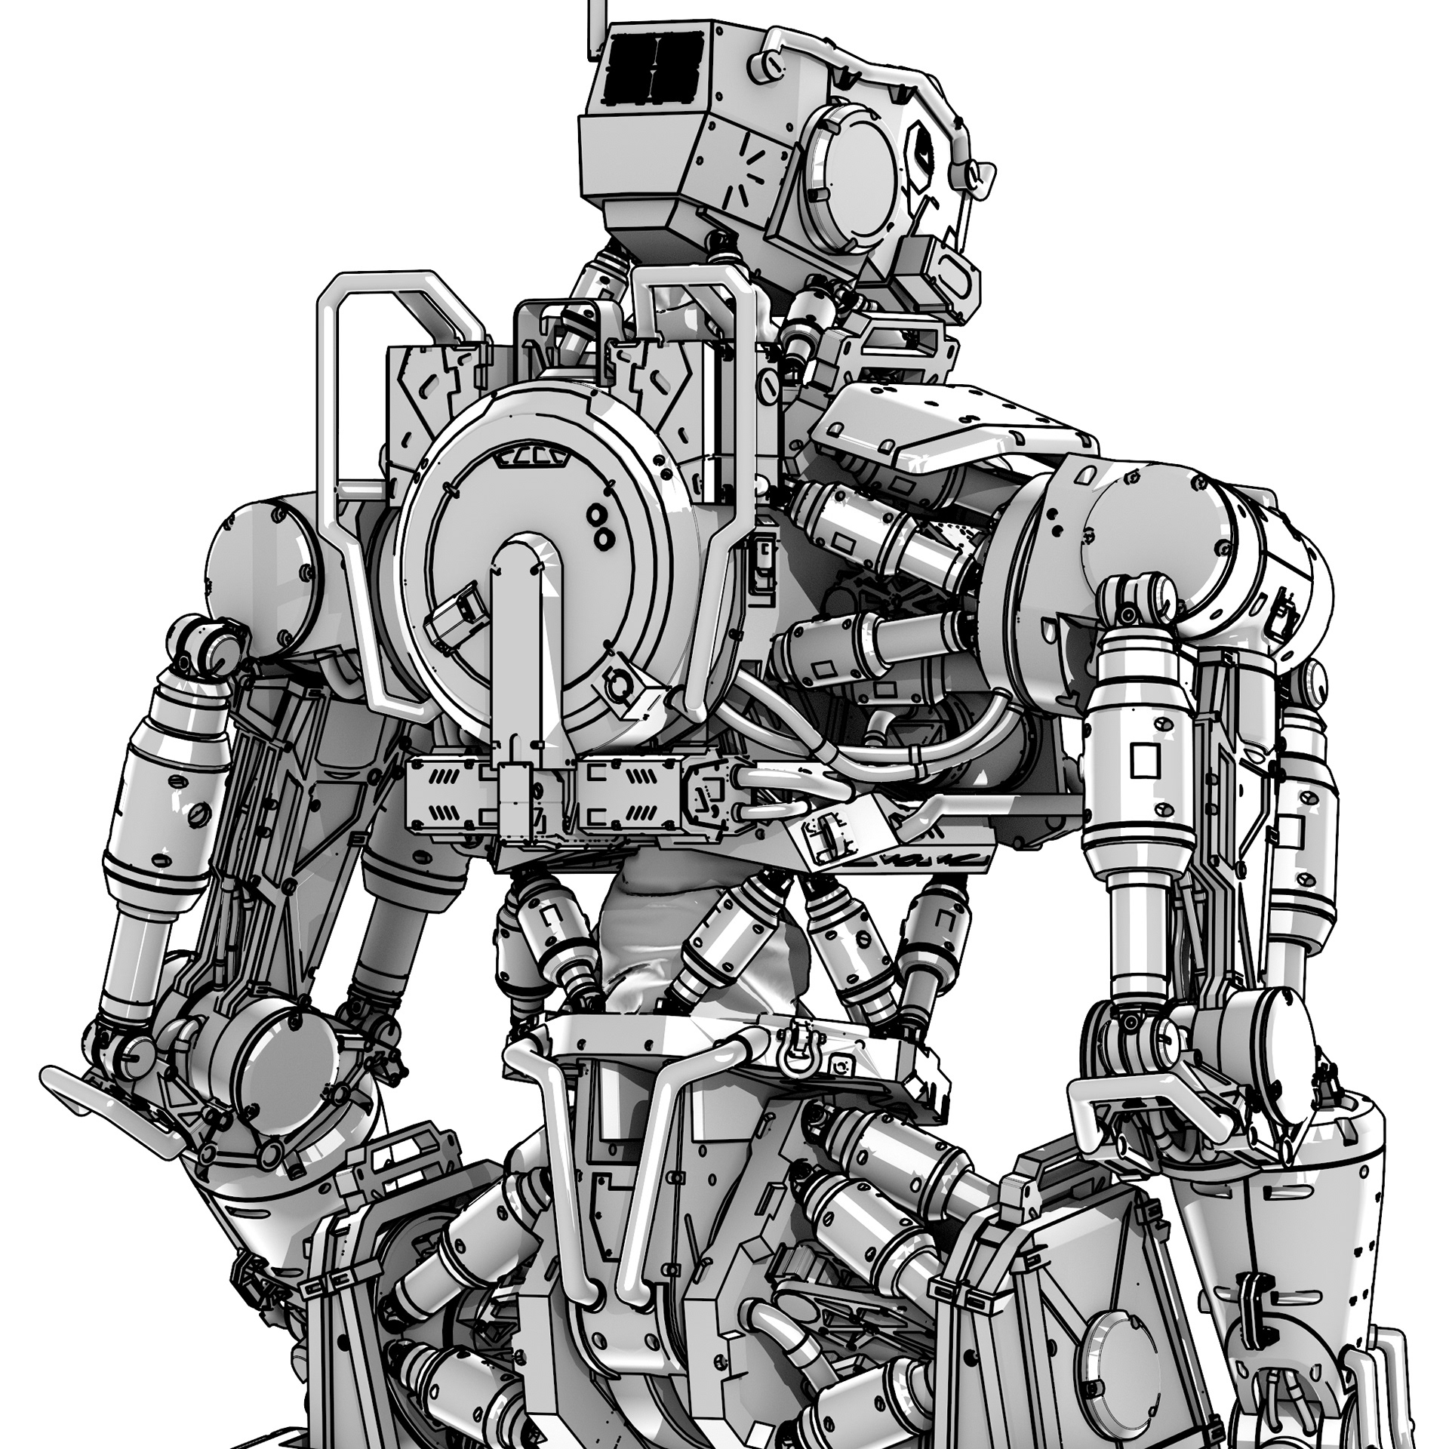
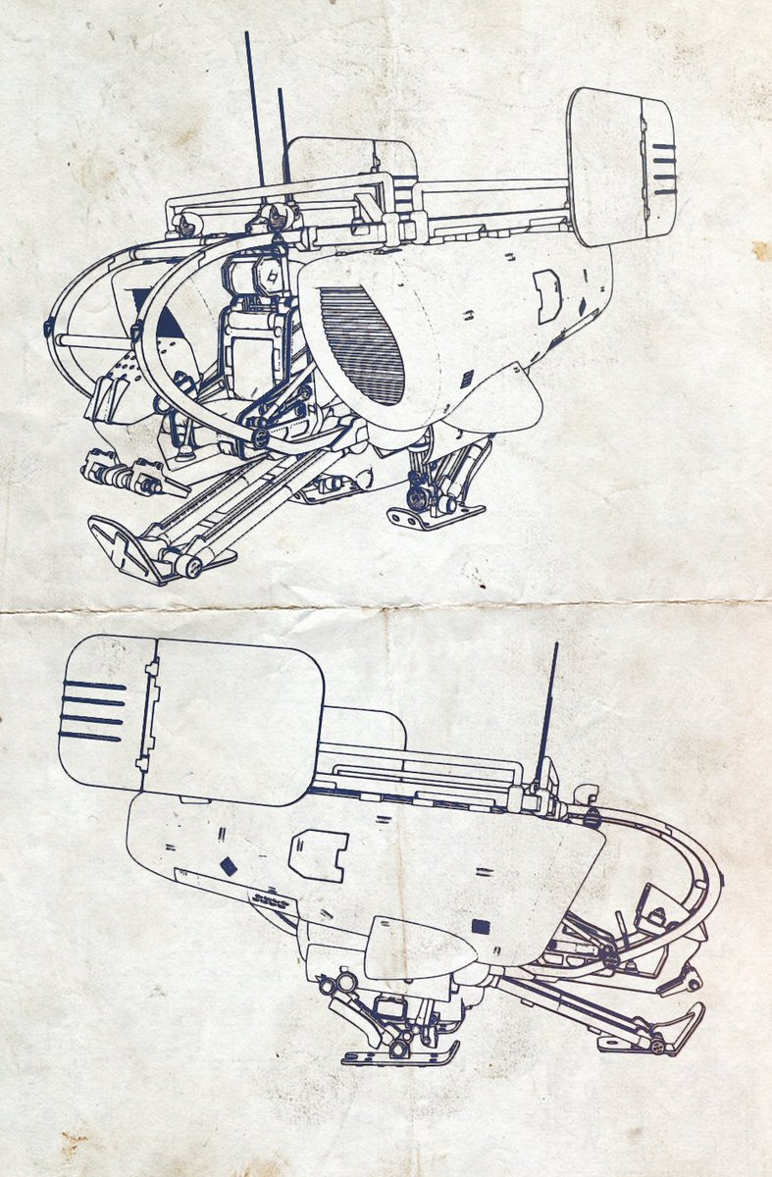
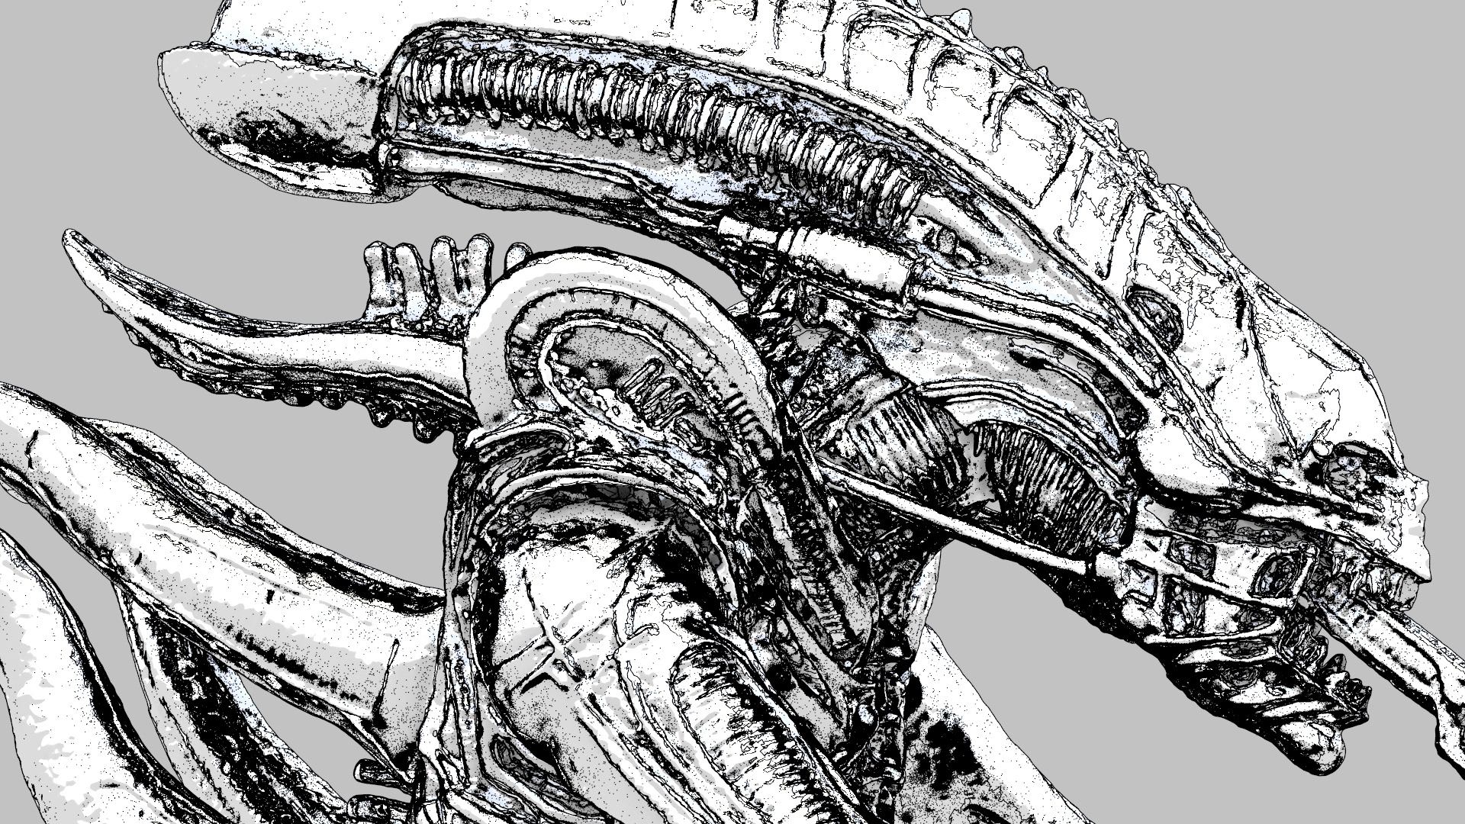
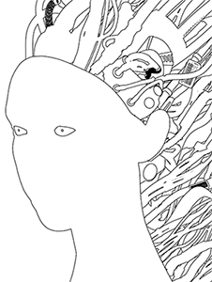
Motivation
Lee Griggs
Christophe Desse
Notes:
Arnold is known as a Monte Carlo ray tracing renderer that can create high quality photo realistic images. However, we were constantly requested to support non-photo realistic rendering especially from Japanese customers. So, we were in need of a feature detection and line drawing method that integrates naturally into a ray tracing renderer to generate pen and ink-drawn images like these.

Slide 3
Goals
Various line styles (width, color, etc.)
Reflection and refraction
Thin lines
Notes:
[click] Our goals are to support various line styles,
[click]
and to properly draw contour lines of reflected and refracted objects.
[click]
We also need to be able to render thin lines without using a large number of anti aliasing samples.

Slide 4
Object and Image Space Approaches
 | Thin Objects | Reflection and refraction | Arbitrary camera projection | Scale with the number of objects?
Object space | Easy | Hard | Hard | No
Image space | Hard | Easy | Easy | Yes
Notes:
We did quick research before starting development. Contour line drawing methods fall into two general categories, “object space approach” and “image space approach”, and both have advantages and disadvantages. I only put some important differences here. Object space approach is good at handling thin objects like hair but it’s not easy to support reflection/refraction and arbitrary camera projection. More importantly it doesn’t scale well with scene complexity. Image space approach is not suitable for thin objects. However, it has no problem in handling enormous amounts of geometry, which is often required for modern ray-tracing production renderers. So we decided to go with image space approach.

Slide 5
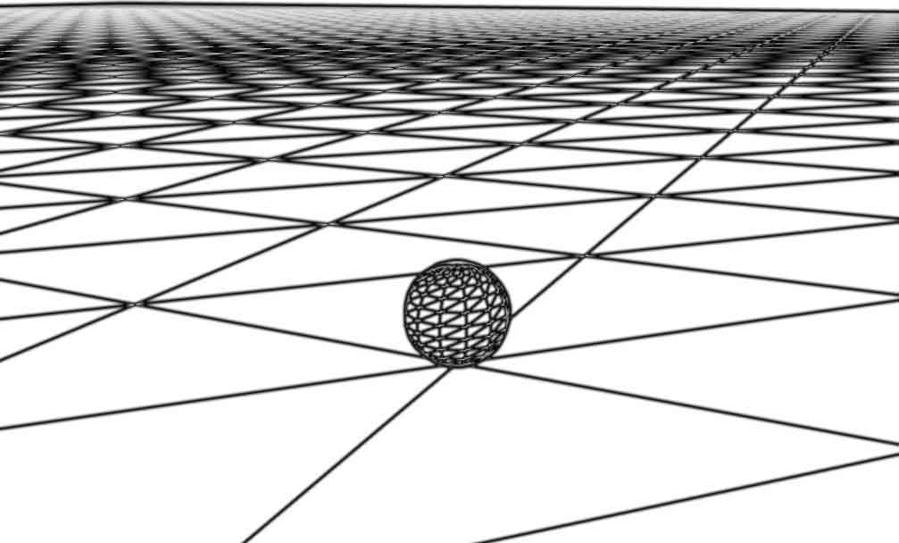
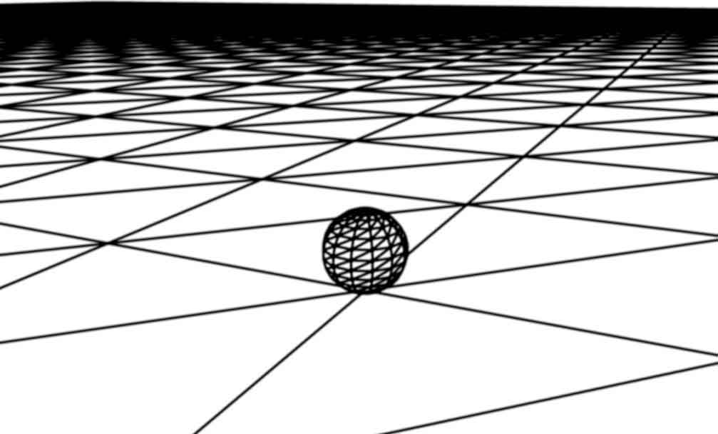
Previous Work - Image Space
Ray Tracing NPR-Style Feature Lines [Choudhury & Parker 2009]
Pros: simple, works with ray tracing
Cons: artifacts, constant line color & width
Choudhury & Parker
Ours
Notes:
There seem to be some software products that use image space approach, but, to our surprise, there are only a few papers describing a feature line drawing method that works in a ray tracing framework.
“Ray Tracing NPR-Style Feature Lines“ by Chaudhury et al. is a nice approach, and it is very easy to implement. Unfortunately, the edge metric function given in the paper only considers edges, and produces artifacts where multiple lines intersect as shown in the left image. Also this method only supports constant line width and color.

Slide 6
Previous Work - Image Space
A New Contour Method for Highly Detailed Geometry [Bauer 2017]
Pros: no flickering in animation
Cons: no details given, suboptimal contour fidelity
Notes:
Bauer gave a talk at SIGGRAPH last year. His method aims to suppress flickering in animation and works in a progressive manner. However, only a small subset of samples is used at each iteration and results in a suboptimal quality.

Slide 7
Terms - Stencil
Currently processed pixel
Notes:
Before diving into the details of our algorithm, let me introduce a couple of terms used in this presentation.
“Stencil” is a disc centered at a pixel sample.
[click]
Its diameter must be equal to the maximum line width. We use all samples in the stencil to check if this sample lies on a feature line.

Slide 8
Terms - Target Sample
Currently processed pixel
Notes:
The selected sample is called “target sample”.

Slide 9
Terms - Neighbor Samples
Currently processed pixel
Notes:
And the other samples in the stencil are called “neighbor samples”. Features are detected by comparing the target and neighbor samples.

Slide 10
Algorithm Overview
Cast rays and generate pixel samples
For each target sample
Create a list of target-neighbor sample pairs
Sort pairs based on priority
Test each pair until feature is detected
Notes:
Here is the overview of our algorithm.
[click]
First we cast rays and generate pixel samples.
[click]
For each target sample,
[click]
we create a list of target-neighbor sample pairs, then
[click]
we sort them based on priority.
[click]
We process pairs one by one until feature is detected.

Slide 11
Pixel Sample
Notes:
In the first step, we generate pixel samples by casting rays. Each ray can potentially hit a different object. Here different colors mean different objects.

Slide 12
Pixel Sample
Line Color
Line Width
Object ID
Shader ID
Texture Coord
Normal
Mask Color
Distance
User Set Priority
…
Generated during shading
Notes:
The pixel sample data structure stores not only sub-pixel sample location but also a variety of attributes
[click]
used for feature detection (like blue ones) and to determine the style of line (like green ones). These data are generated during shading.
[click]
Features are detected by finding changes in feature attributes
[click]
of the adjacent pixel samples.
Basically we use all available pixel samples to make lines as high quality as possible, so you might wonder if storing these data consumes too much memory. In practical implementation, we utilize bucket rendering and it greatly reduces memory consumption.

Slide 13
Sample Pair
…
…
…
…
…
Notes:
Now let’s assume that we are trying to check if this target sample
[click]
is on a feature line. In order to detect feature, we first create a list of target-neighbor sample pairs.
[click]
One of the two samples of a pair should take priority in specifying the line attributes
[click]

Slide 14
Sample Pair
…
…
…
…
…
Priority samples
Notes:
, and by default this is the one with the shorter ray hit distance.

Slide 15
Sample Pair
…
…
…
…
…
…
…
…
…
…
Sort by priority sample
Notes:
Then we iterate over these pairs in order of decreasing priority, i.e. by the depth of priority sample,
[click]
to make sure that lines are tested in front-to-back order. As soon as a valid feature line is detected, we terminate the search and set the color of the target sample to the line color of the pair’s priority sample, then proceed to the next target sample.

Slide 16
Sample Pair
…
…
…
…
…
…
…
…
…
…
Notes:
For example, to detect this feature line, we start from this pair.
[click]
If the line width of the blue sample is very thin, we proceed to the next pair.

Slide 17
Sample Pair
…
…
…
…
…
…
…
…
…
…
Notes:
If the length of pair is longer than half the line width, we have to skip this.
[click]

Slide 18
Sample Pair
…
…
…
…
…
…
…
…
…
…
Notes:
The length of this pair is shorter than half the pixel width, so we terminate the search.
[click]

Slide 19
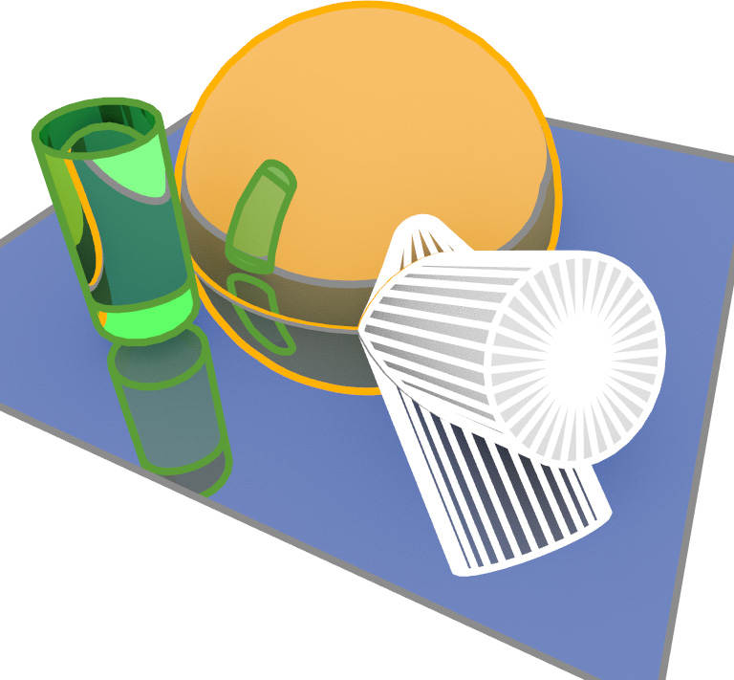
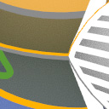
User Specified Priority
Notes:
Determining priority only by distance can result in a dual-color line. For instance, if two samples hit different objects but they have the same (or almost the same) distance, we can’t determine which sample takes precedence. To handle such case, user specified priority is supported.
[click]
This is also useful for better artistic control.

Slide 20
Reflection and Refraction
Tree of reflection/refraction events
Root[E]
Reflection[R]
Refraction[T]
E
R
T
RR
RT
TR
TT
Notes:
Drawing edges of reflected or refracted objects is straightforward. We create an AOV (Arbitrary Output Variable) for each node of the tree of reflection and refraction events. Reflected rays write pixel sample attributes into an AOV specifically allocated for specular reflection.
[click]
Similarly refracted rays write into another buffer allocated for specular transmission.
[click]
[click] [click]..
We first run our feature detection algorithm on the attributes at the root node of every target sample.
Then, we identify the samples that have not yet intersected a line and run the same process again only for those samples, this time considering the primary reflection attributes.
We then repeat the process by considering the refraction attributes, and so on.
In this way, the attribute trees of all samples are traversed in breadth-first order. The lines of reflected objects cover those of refracted objects and this gives plausible results.

Slide 21
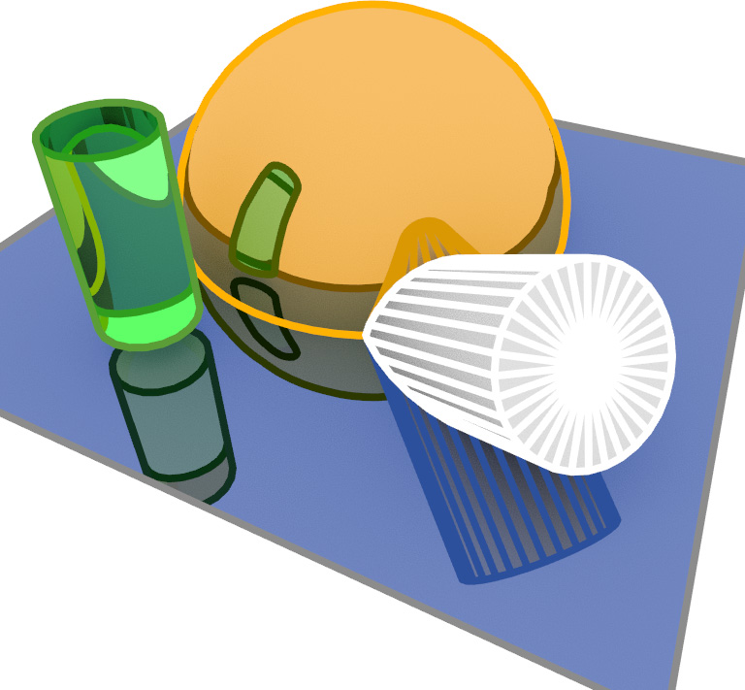
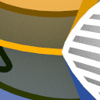
Reflection and Refraction
Notes:
While feature detection is performed entirely in image space, by caching the throughput of the corresponding ray paths in the tree nodes, the line colors can be additionally tinted to make them appear reflected or refracted.
[click]
This gives more realistic results.

Slide 22
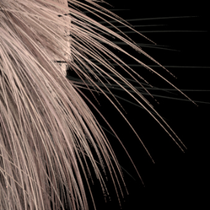
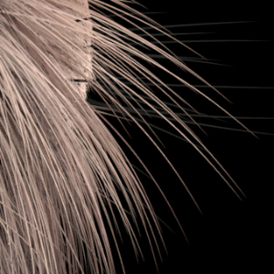
Thin Lines
Minimum pixel width technique
Originally for rendering thin curves
Applicable to contour drawing
on
off
Notes:
Drawing very thin lines without noise is not an easy task. We overcome this problem by using a minimum pixel width technique. This technique is typically used to prevent aliasing of thin hair or grass curves by expanding their width so that they cover at least a specified distance across a pixel, and compensating for this expansion by making the curves proportionately more transparent.
[click]
This is directly applicable to our feature line drawing.

Slide 23
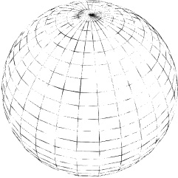
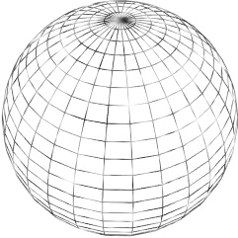
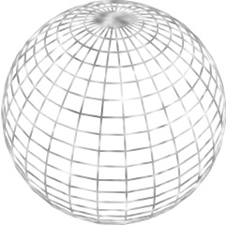
Thin Lines
min_line_width 0
min_line_width 0.5
min_line_width 1
Notes:
Excessive widening of the lines changes the look, so instead of exposing the minimum line width as a user parameter, we fix it to half the pixel size.

Slide 24
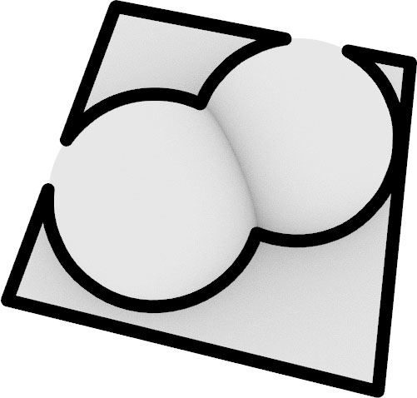
Limitation
Notes:
Our method has a minor limitation. Lines can be missed when a no-line object is placed in front of a thick-line object and their silhouettes overlap. The issue could be addressed by computing the intersections of multiple objects along every ray instead of just the closest one.

Slide 25
Open Problems
Stochastic sampling
Glossy reflection/refraction, DOF, motion blur, etc.
Distance-varying style
Dashed-lines, etc.
Stereo
Viewing discomfort?
Notes:
Our method is incompatible with blurry effects like glossy reflection/refraction, depth of field, and motion blur. In the presence of such effects, neighbor samples can have very different attributes and our algorithm ends up finding features everywhere. In fact, meaningfully defining contours for such effects remains an open problem.
Drawing dashed lines or lines with distance-varying style requires the ability to identify the lines’ endpoints and to measure distances along them. This is something we would like to look into.
Lastly, for stereoscopic viewing we render the left- and right-eye images completely independently. While we have not yet experienced serious issues with this simple approach, it is prone to causing viewing discomfort.

Slide 26
Conclusion
Simple and robust contour line drawing method
Supports a variety of artistic styles
Temporarily stable
Notes:
To conclude, we introduced a simple feature line drawing technique that supports a wide variety of artistic styles. Although we didn’t aim to suppress flickering, our method is temporarily stable since we exploit all available pixel samples. The presented method is available in Arnold version 5.1 or higher.

Slide 27
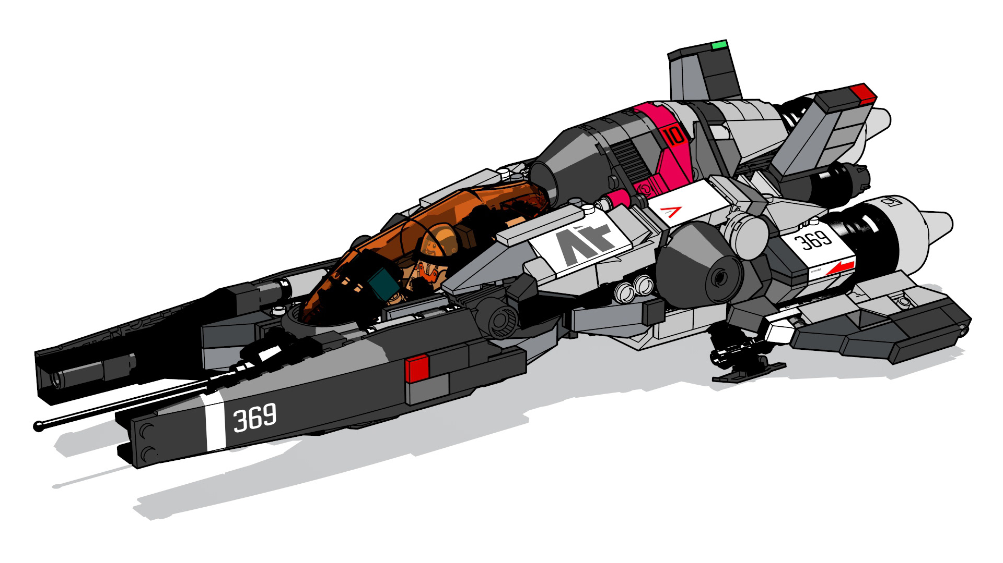
Lee Griggs

Slide 28
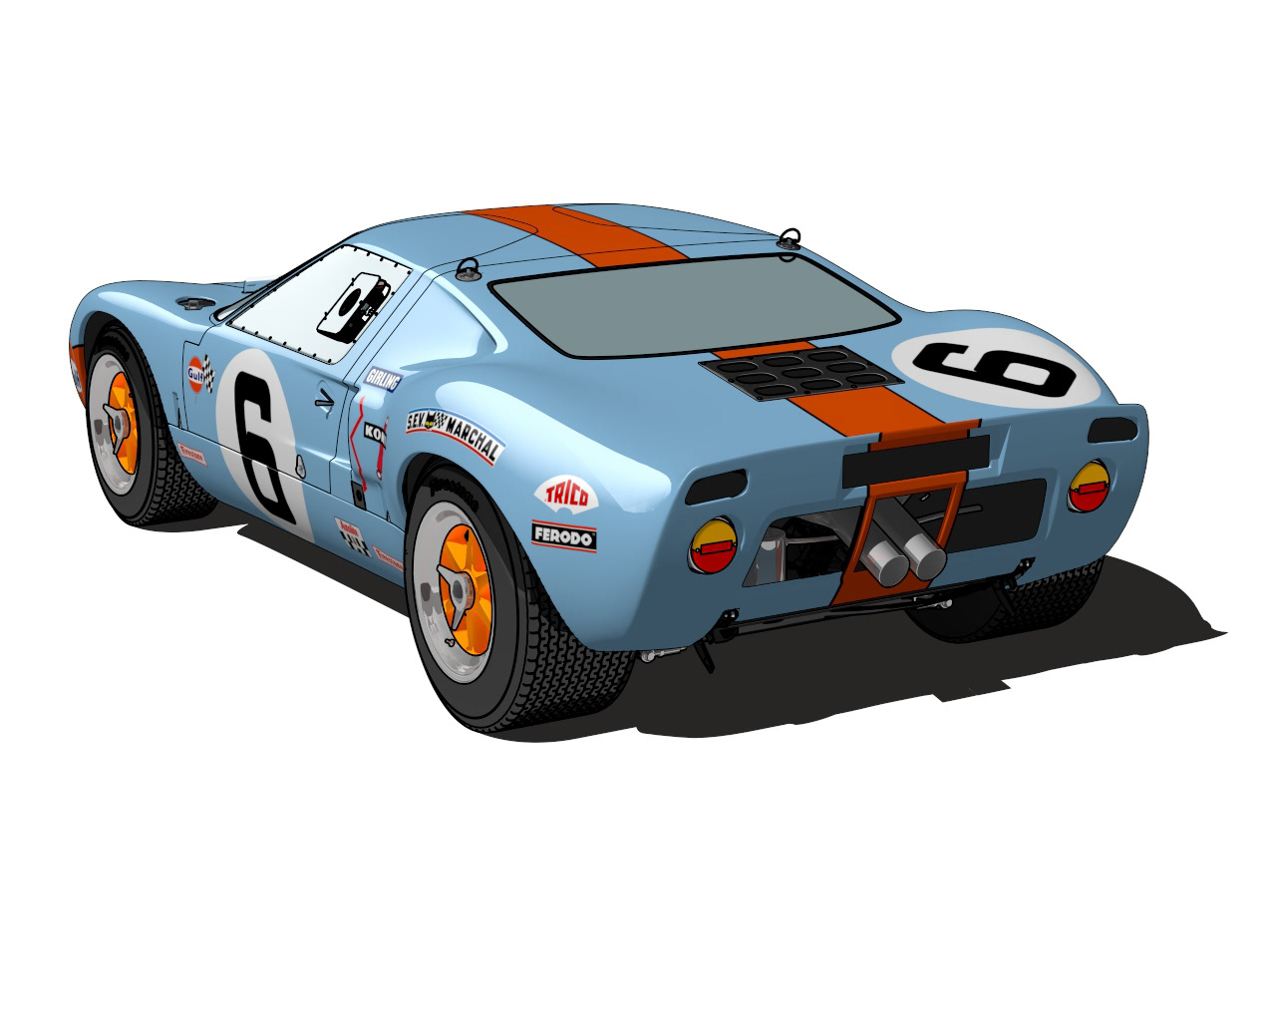
Lee Griggs

Slide 29
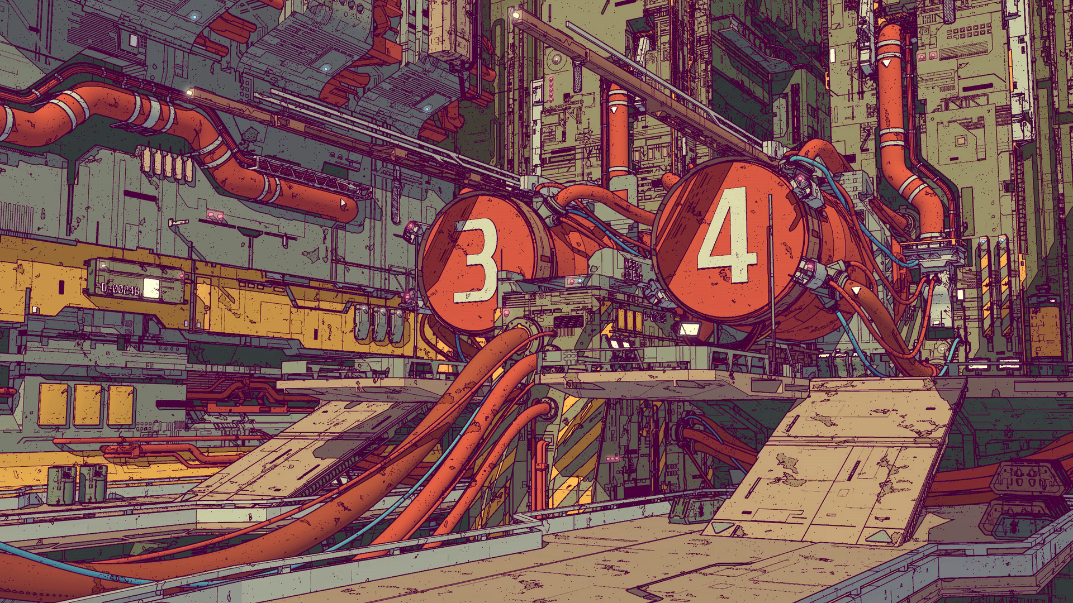
Calder Moore

Slide 30
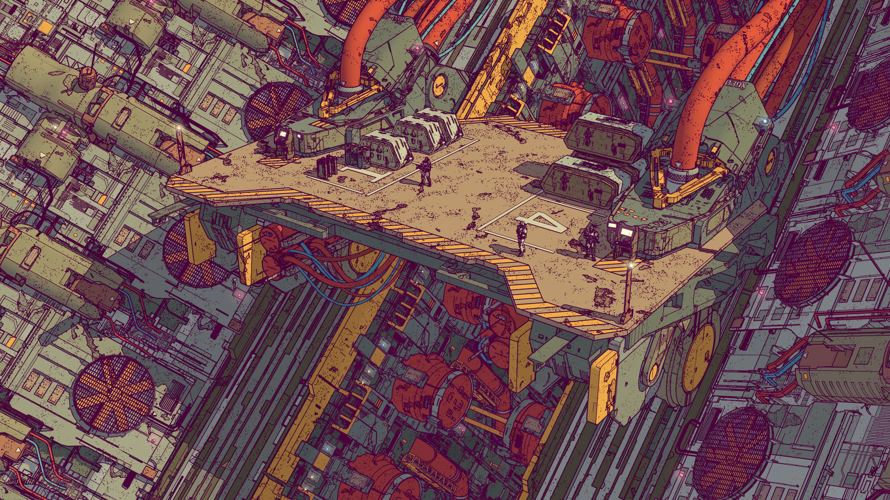
Calder Moore

Slide 31
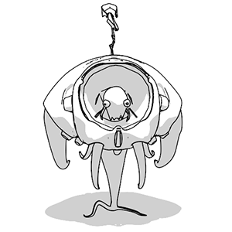
Notes:
Thank you for listening!

