Slide 1
Online Importance Sampling for Stochastic Gradient Optimization
Corentin Salaun, Xingchang Huang, Iliyan Georgiev, Niloy Mitra, Gurprit Singh

Slide 2
Optimization

Slide 3
Optimization task definition
We want a model for image classification
How can me make it ?

Slide 4
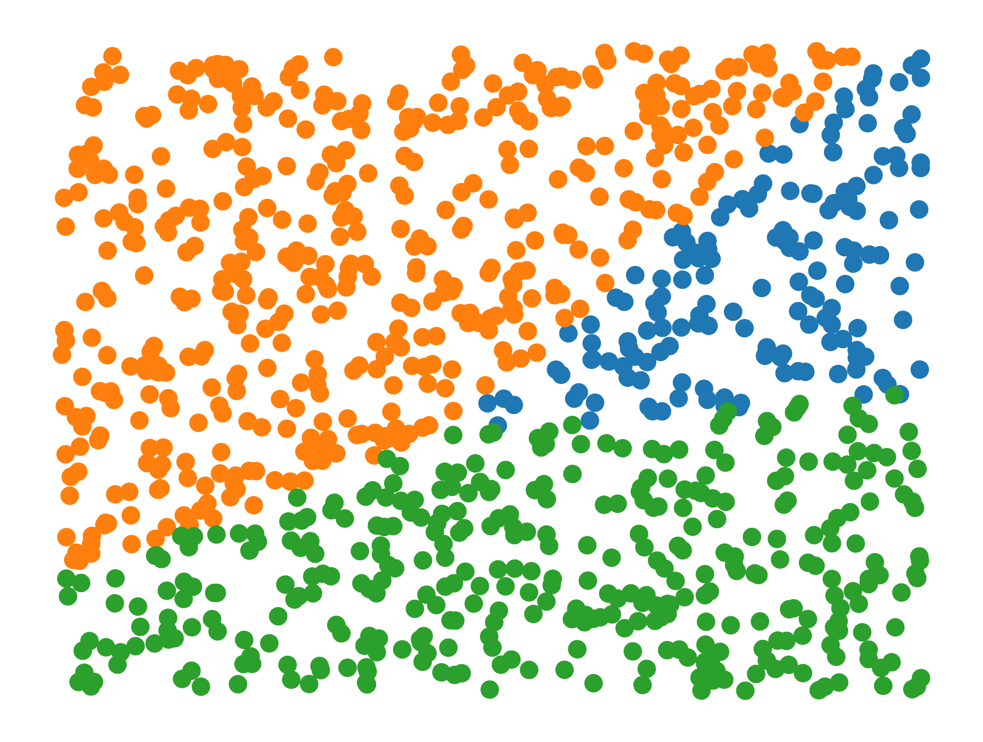
Optimization task definition
There is 3 elements to define:
Define the optimization model m_{θ}(x) = y
Define optimization dataset (set of all training {x,y})
Define the optimization metric (Loss function)
Eg L2 norm, Cross Entropy
Can include regularization term
X
Y
θ

Slide 5
Gradient descent
This problem cannot be directly solve but instead we rely on iterative loss reduction
At each iteration compute the gradient of the loss with respect to model parameters and update them with inverse gradient direction
X
Ŷ
-Y
θ_{t}

Slide 6
Gradient descent
The most critical part in gradient computation is the integral term
The integral is a sum over the dataset in most cases
It mean computing the derivative with respect to all data
X
Ŷ
-Y
θ_{t}

Slide 7
Gradient descent
The most critical part in gradient computation is the integral term
The integral is a sum over the dataset in most cases
It mean computing the derivative with respect to all data
It is impossible to compute the integral analytically
Instead of exact computation it is possible to estimate it
Estimation imply error but also cheaper computation
In an iterative process the estimation error can be compensated over multiple iterations
X
Ŷ
-Y
θ_{t}

Slide 8
Numerical integration

Slide 9
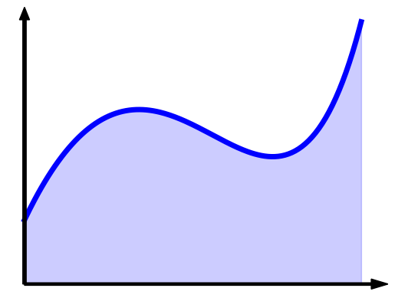
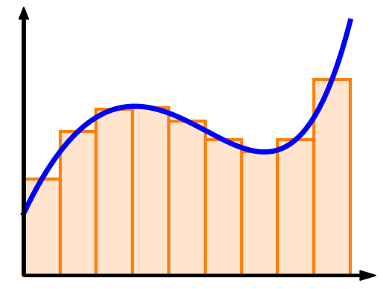
Numerical integration

Slide 10
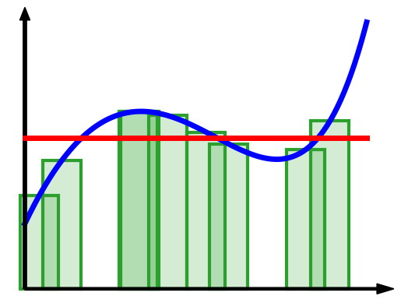
Numerical integration
Regular quadrature: $F≈\sum_{i=1}^{n}{f\left(x_{i}\right)Δx}$
Monte Carlo: ${\left\langle F\right\rangle }_{n}=\sum_{i=1}^{n}{\frac{f\left(x_{i}\right)}{n p\left(x_{i}\right)}}$
$$Δx=\frac{\left|X\right|}{n}$$
$${\left(n p\left(x_{i}\right)\right)}^{−1}$$

Slide 11
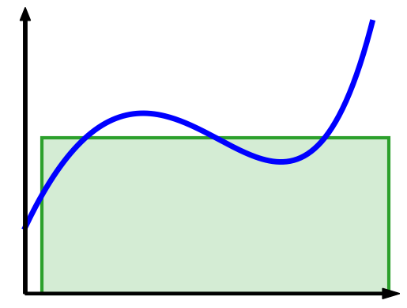
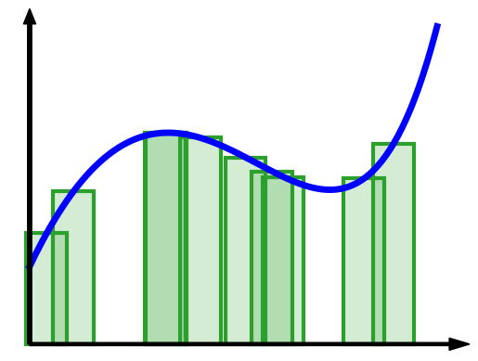
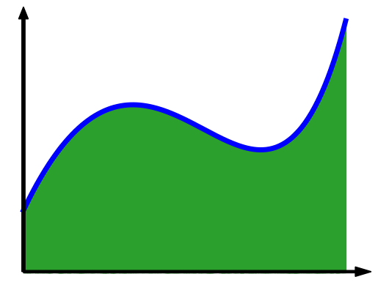
Monte Carlo integration
1 sample
10 samples
1000 samples

Slide 12
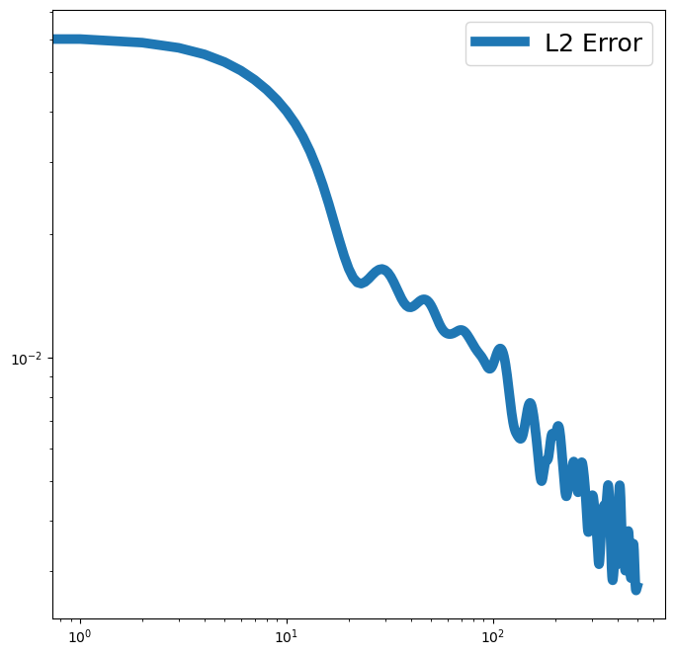
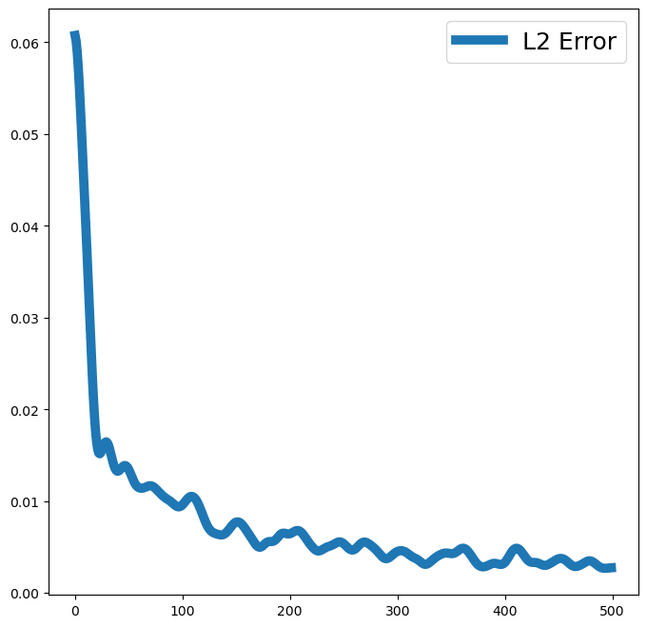
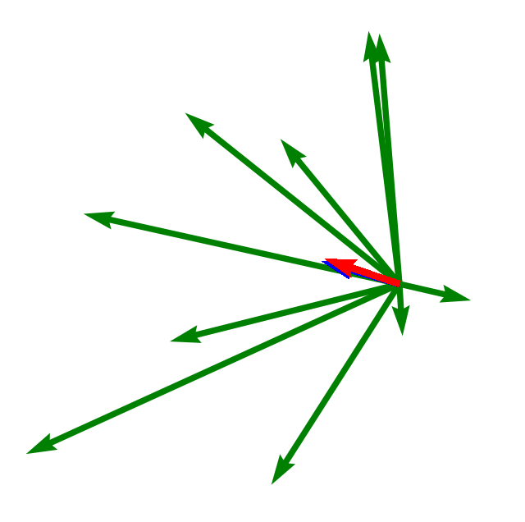
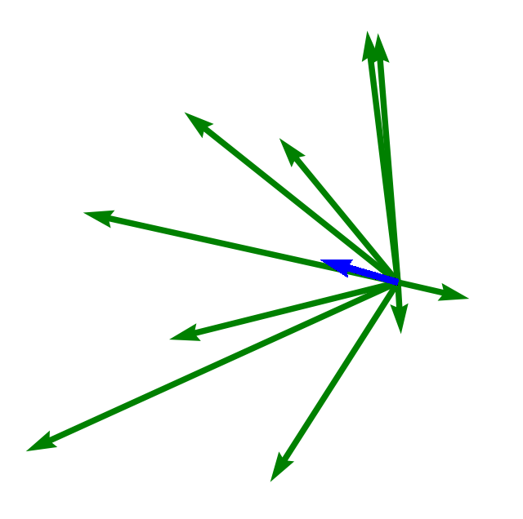
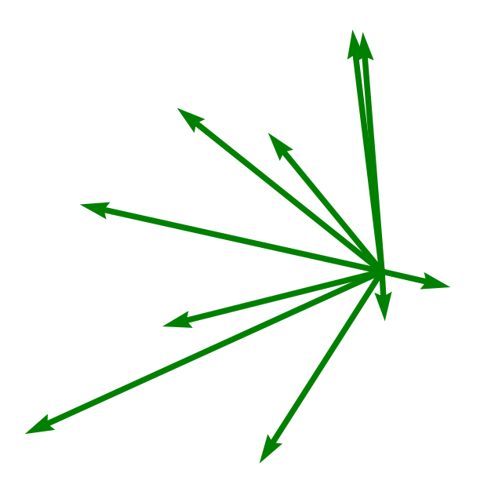
Monte Carlo Gradient estimator
Gradient varies with the data selected for backpropagation
By averaging many single data gradient we can approximate the true gradient
To reduce by a factor 2 the error, we need to multiply by 4 the batch size
Log error
X
Ŷ
-Y
θ_{t}
Log batch size

Slide 13
Stochastic gradient descent
Monte Carlo gradient estimation can be used in an SGD
Compared to Gradient Descent, SGD produce erratic convergence
Expected error is zero mean the convergence goes in the overall good direction
Noise level determine the convergence properties
This show why reducing gradient estimation error is crucial for optimization
X
Ŷ
-Y
θ_{t}

Slide 14
Importance sampling

Slide 15
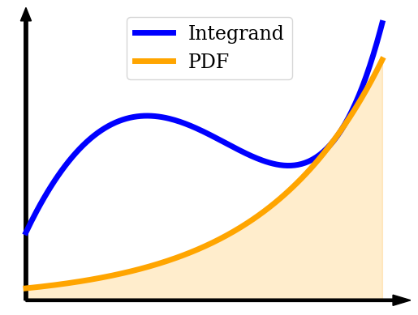
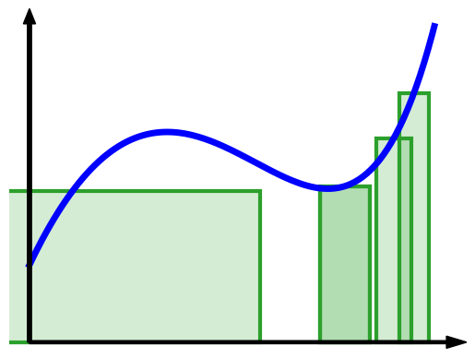
Importance sampling
$$\left(p\left(x_{i}\right)\right)$$
$${\left(n p\left(x_{i}\right)\right)}^{−1}$$

Slide 16
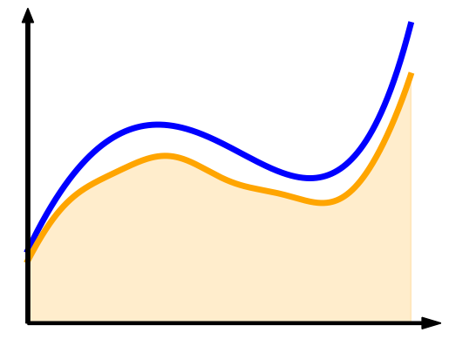
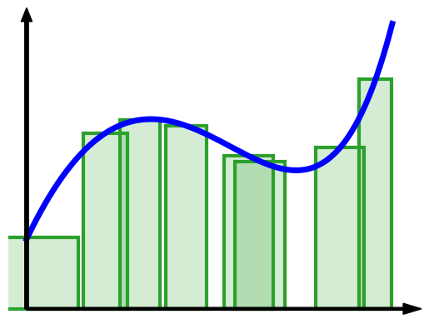
Importance sampling
$$\left(p\left(x_{i}\right)\right)$$
$${\left(n p\left(x_{i}\right)\right)}^{−1}$$

Slide 17
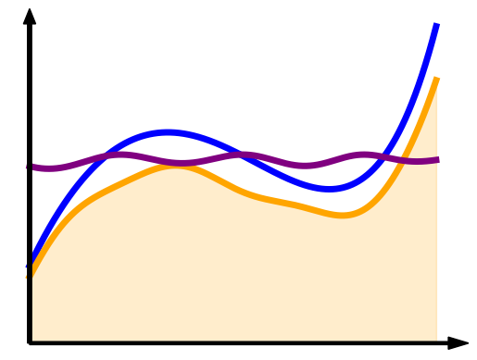
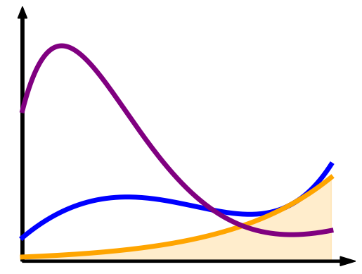
Importance sampling
Importance sampling is used to reduce estimation error in MC estimator
Error reduction appear when the PDF $p$ and the function $f$ are similar
It can be explain as $f/p$ is easier to integrate than $f$ alone
In other case it can increase estimation error
$${\left\langle F\right\rangle }_{n}=\sum_{i=1}^{n}{\frac{f\left(x_{i}\right)}{n p\left(x_{i}\right)}}$$

Slide 18
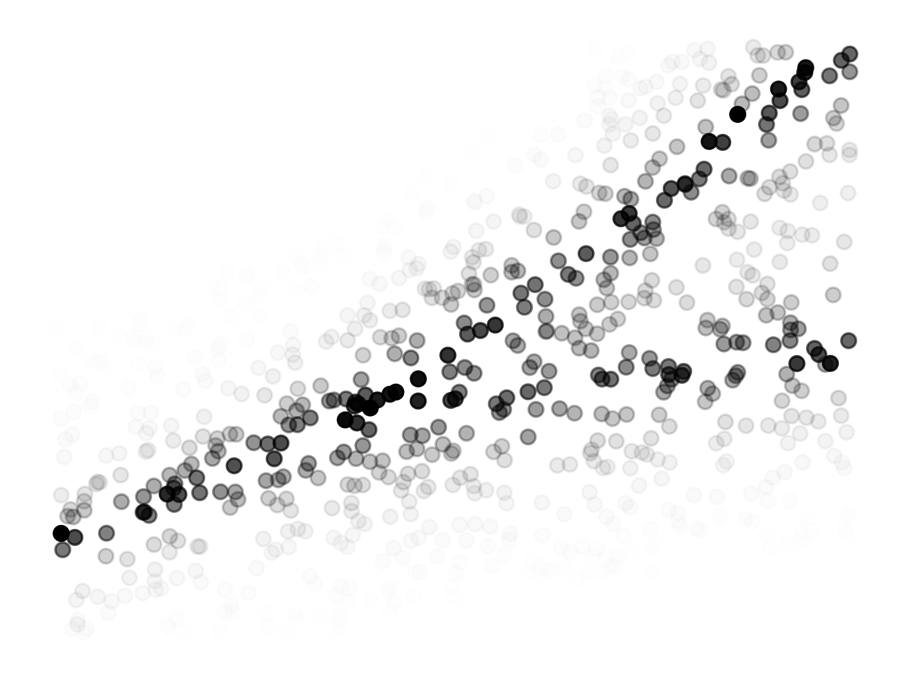
Importance sampling for optimization
To apply importance sampling for optimization we need to find data with higher importance
In a classification task high loss data cluster along the boundary decision
If this data are well classified, the rest of the dataset will be well classified by side effect
There exist no sampling strategy giving optimal properties at all optimization step

Slide 19
Importance mini-batch sampling
Data
importance
Mini-batch

Slide 20
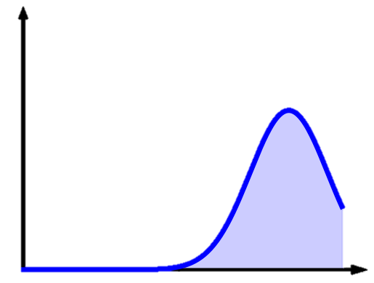
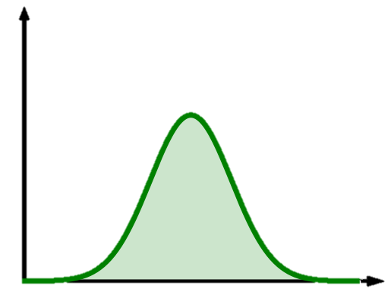
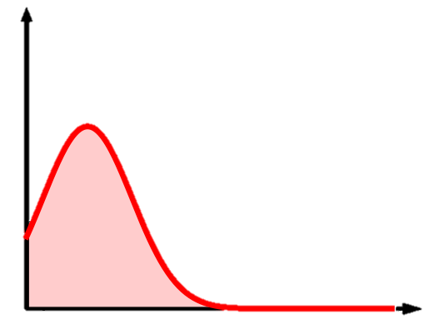
Importance sampling for optimization
θ

Slide 21
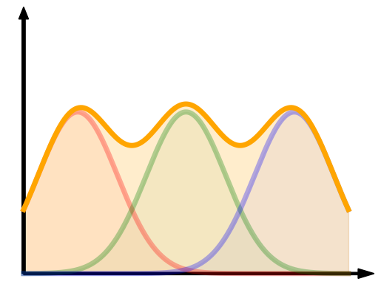
Importance sampling for optimization
The best trade-off is the gradient norm as it offer a mixture of all parameter derivatives
θ

Slide 22
Our method

Slide 23
Our method
In this work we propose 3 main contributions
An adaptive importance metric approximating the gradient norm at low cost
An Online importance sampling algorithm for machine learning optimization
An adaptive data pruning based on our importance metric

Slide 24
Gradient based IS
Computing the gradient norm individually for all parameters is expensive
θ

Slide 25
Gradient based IS
Computing the gradient norm individually for all parameters is expensive
All parameters are not independent and similarity between layers exist
In particular the backpropagation create correlation between the gradient of different layer
Instead of using the full gradient norm, we propose to approximate it at the output layer
We use the gradient of the loss with respect to the network output approximate the full network gradient
We have demonstrate that our importance bound the gradient norm
$$p\left(x\right)= \left\|\frac{dL(\hat{y_{i}},y_{i})}{d\hat{y_{i}}}\right\|$$
θ

Slide 26
Gradient based IS
$$\frac{dL(m\left(x\right),y)}{d\hat{y_{2}}}$$
$$\hat{y_{1}}$$
$$p\left(x\right)= \left\|\frac{dL(\hat{\hat{y}},y)}{d\hat{y}}\right\|=\sqrt{{\left(\frac{dL(m\left(x\right),y)}{d\hat{y_{1}}}\right)}^{2}+{\left(\frac{dL(m\left(x\right),y)}{d\hat{y_{2}}}\right)}^{2}}$$
$$L(m\left(x\right),y)$$
$$\hat{y_{2}}$$
$$\frac{dL(m\left(x\right),y)}{d\hat{y_{2}}}$$
θ
Special case of Cross-Entropy loss can be computed analytically
$$p\left(x\right)=\sqrt{\sum_{j}{{\left(\frac{dL(m\left(x\right),y)}{d\hat{y_{j}}}\right)}^{2}}}=\sqrt{\sum_{j}{{\left(Softmax(\hat{y_{j}}) −y_{j}\right)}^{2}}}$$

Slide 27
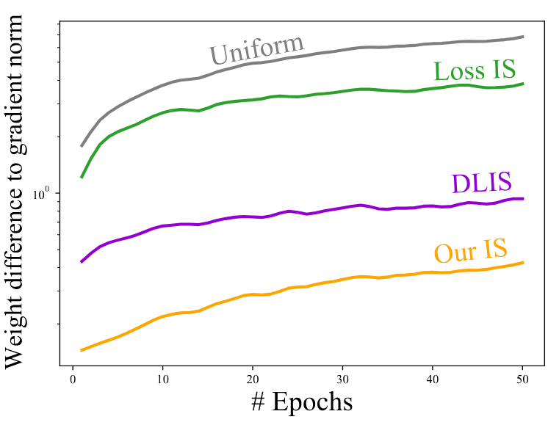
Gradient based IS
Compare to previous attempts
Better quality than simple method
Similar quality at cheaper cost than advanced methods (DLIS [Katharopoulos & Fleuret 2018])
Comparison of the importance weights evolution (MNIST classification)
Our method is the closest to full gradient norm at every epoch
Require a per data computation where most computation is done batch wise
Can benefit from close form evaluation (eg Cross Entropy)
Close form importance allows for fast memory update compare to previous work

Slide 28
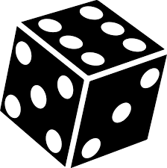
Online algorithm
Data
importance
Mini-batch
X
Ŷ
-Y
p(X)
θ_{t}

Slide 29
Online algorithm
Data
importance
Mini-batch
X
Ŷ
-Y
p(X)
θ_{t}

Slide 30
Online algorithm
Data
importance
Mini-batch
X
Ŷ
-Y
p(X)
θ_{t}

Slide 31
Online algorithm
Data
importance
Mini-batch
X
Ŷ
-Y
p(X)
θ_{t}

Slide 32
Online algorithm
Data
importance
Mini-batch
X
Ŷ
-Y
p(X)
θ_{t}

Slide 33
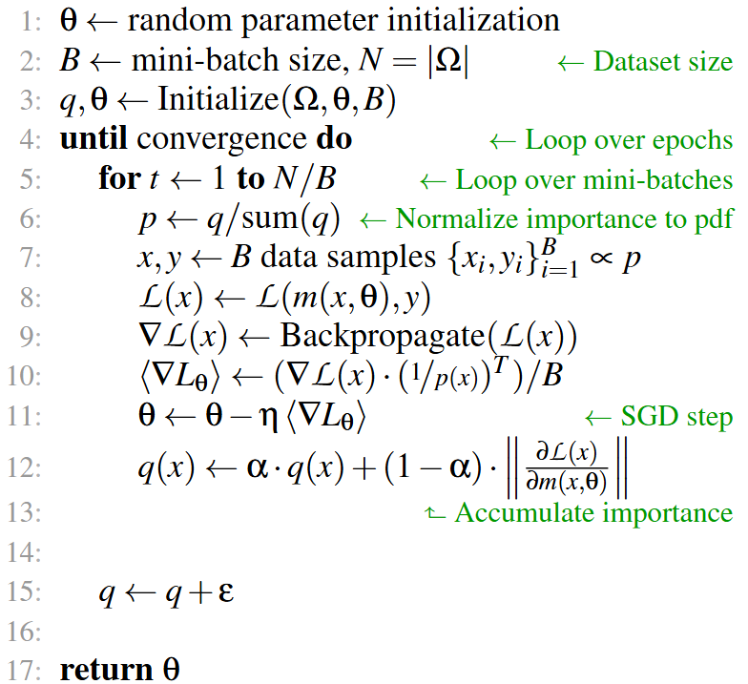
Online algorithm
Optimization algorithm
Compute on the fly the importance
Select multiple data with replacement (Important to avoid bias on small dataset)
Memory update from data seen (limit extra computation)
Add small epsilon at the end of each epoch to avoid forgotten data
Momentum to avoid firefly update
Memory storage for importance metric
Use memory instead of resampling few data from a larger batch
The importance metric evolve over optimization
Important data at the beginning are not necessary the same as in late optimization (or at least not the same magnitude)

Slide 34
Data pruning
Average
importance
Data
importance
Pruning threshold

Slide 35
Data pruning
Data pruning allows to reduce the dataset size by removing data not contributing to learning
Multiple heuristic can be used for pruning (remove a fix portion of the dataset or all data below a threshold)
Pruning can be done as a precomputation or during training
Reducing the dataset size help accelerating training time due to cheaper memory access
Data pruning is useful to maximize gradient magnitude
Removing gradient with small gradient magnitude have an impact on the estimation
It increase the average magnitude in addition of reducing noise
If Pruning is done too aggressively it can create bias and overfit
It is possible to reuse remove data after some time to verify their importance remain low

Slide 36
Results

Slide 37
Results
Comparison of the importance weights evolution (MNIST classification)
Ours method is the closest to optimal distribution
θ

Slide 38
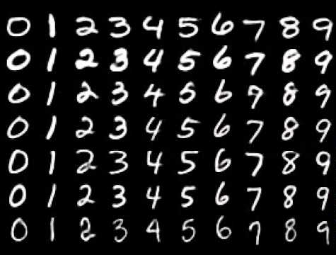
Results
MNIST classification
Hand written digits 0-9 (10 classes) classified using a fully connected network and a Cross entropy loss using weight decay
θ

Slide 39
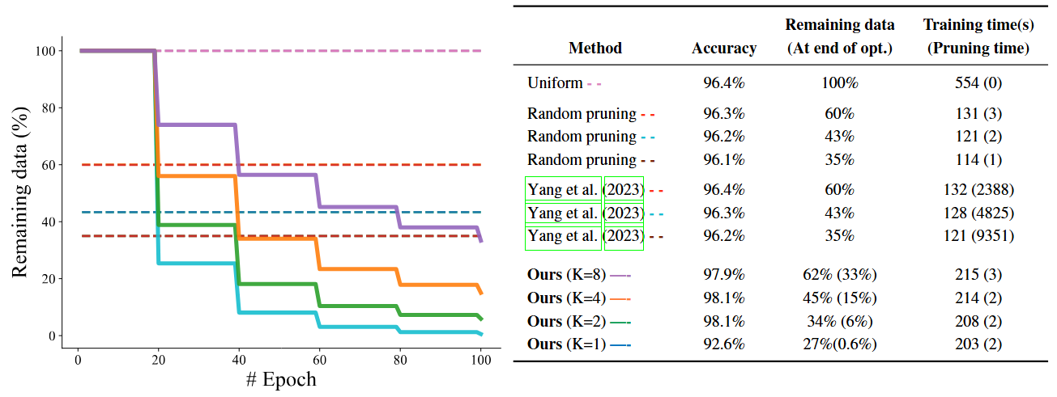
Results

Slide 40
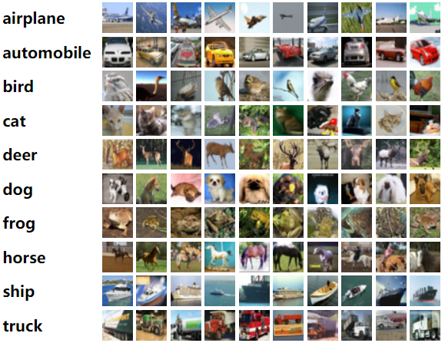
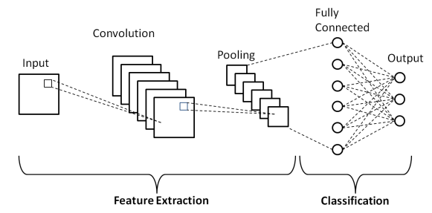
Results
CIFAR-10 is a classical image classification dataset with 10 class
We used a Convolutional network architecture and Simple Cross entropy loss using weight decay

Slide 41
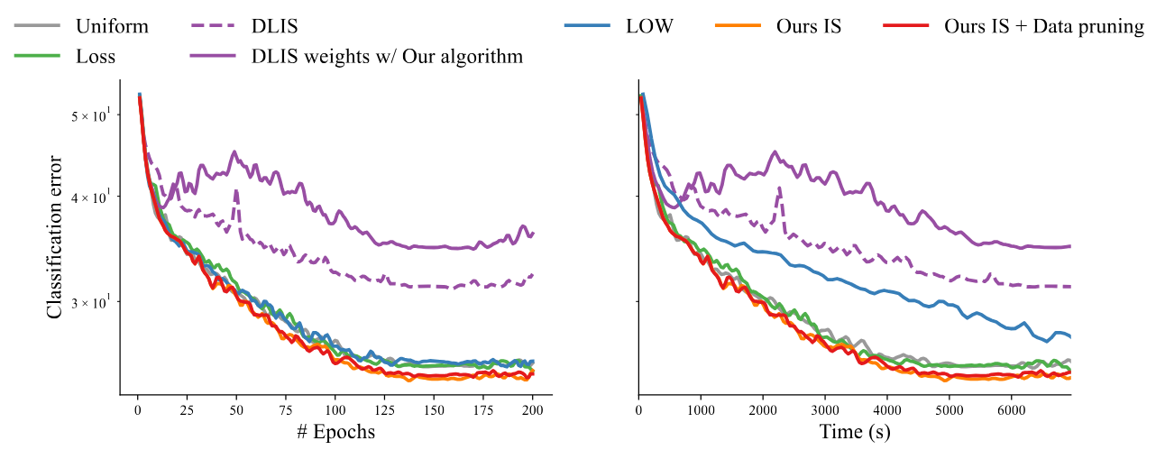
Results

Slide 42
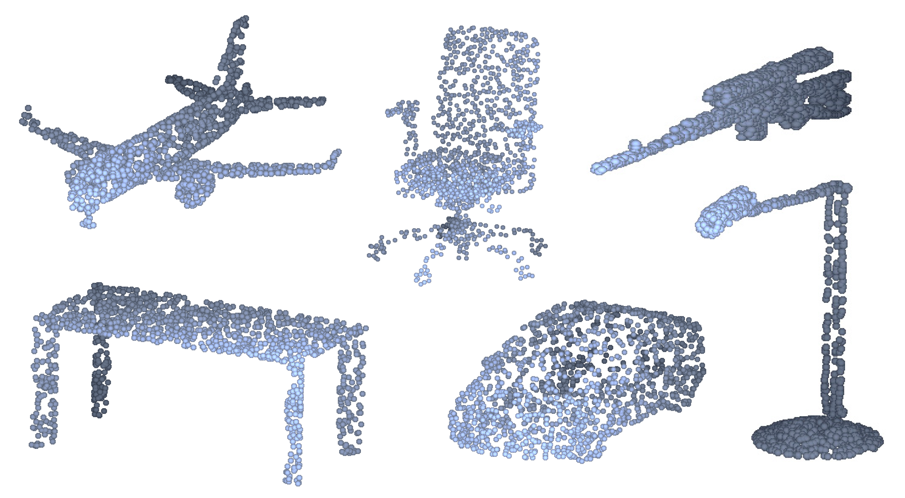
Results
We compared on point cloud classification using a ModelNet40 architecture
Points are sampled using Poisson disc sampling of 20 points
Optimization is done using Cross Entropy loss with weight decay
Notes:
Poisson disc sampling ensure minimum distance between all sampled points

Slide 43
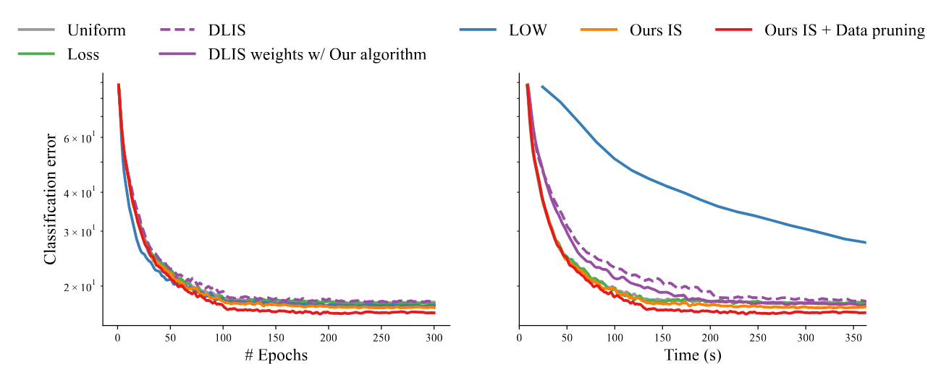
Results
Point cloud classification

Slide 44
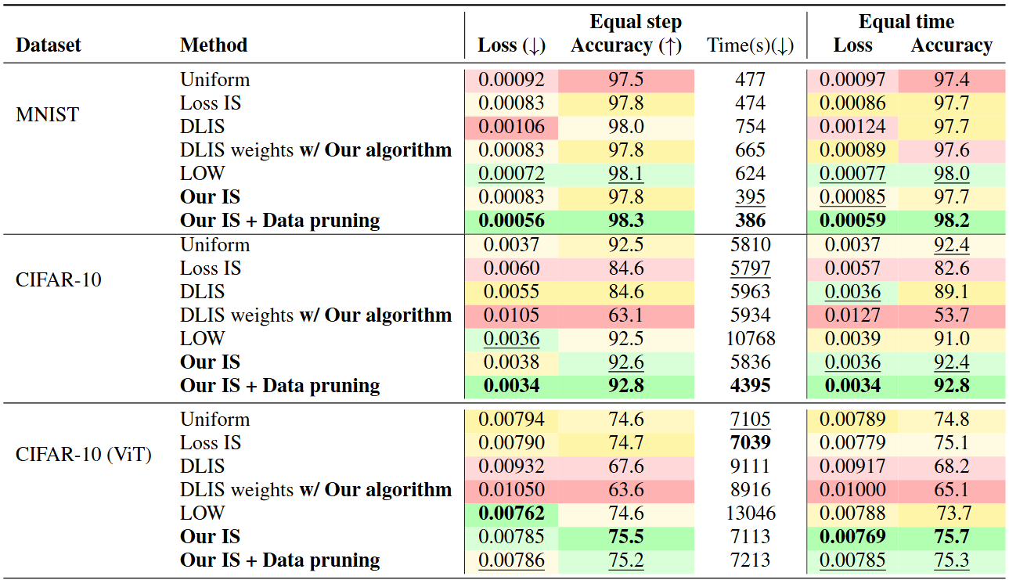
Results

Slide 45
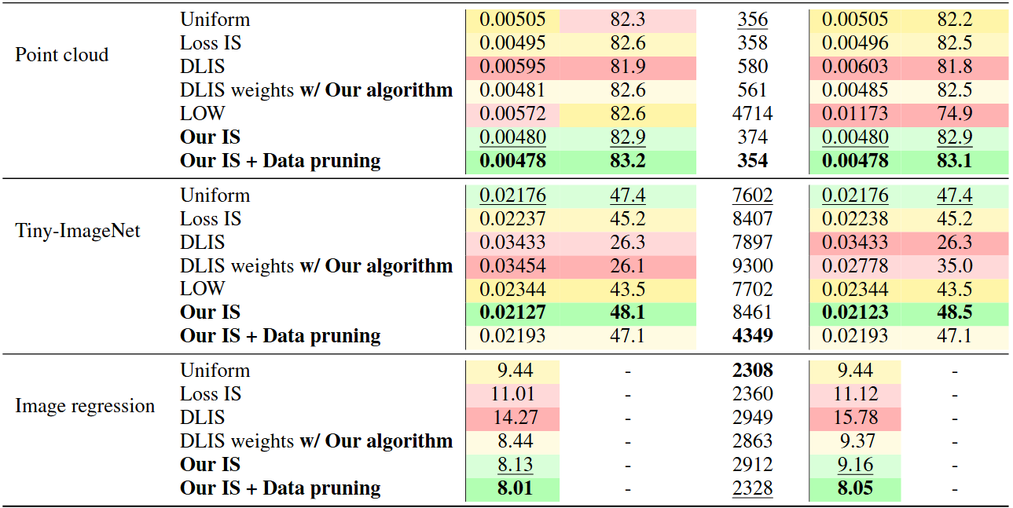
Results

Slide 46
Results
Image regression task use a tiny MLP to encode an image
Input is the pixel coordinates (with Sinusoid encoding) and output the pixel color
Optimization is performed using and $L_{2}$ loss

Slide 47
Future work

Slide 48
Future work
Is it possible to do better than Importance sampling ?
Is it possible to use more that a single sampling distribution ?
Come to our presentation this afternoon
Apply our importance sampling method to deep learning task and larger dataset
Extend our method to unsupervised learning

Slide 49
Conclusion
We presented an online algorithm for adaptive importance sampling
Reduce overhead using memory of all data importance
Adapt importance with evolution of the model parameters
We derived an importance metric based on network output
It offer better trade-off between quality and computation time
Also benefit from close form evaluation
Our method can be combined with data pruning to further speed-up convergence
We demonstrate it’s capacity on classification tasks and beyond

