Slide 1
Multiple Importance Sampling for Stochastic Gradient Estimation
Corentin Salaun, Xingchang Huang, Iliyan Georgiev, Niloy Mitra, Gurprit Singh

Slide 2
Optimization

Slide 3
Optimization task definition
We want a model for image classification
How can me make it ?

Slide 4
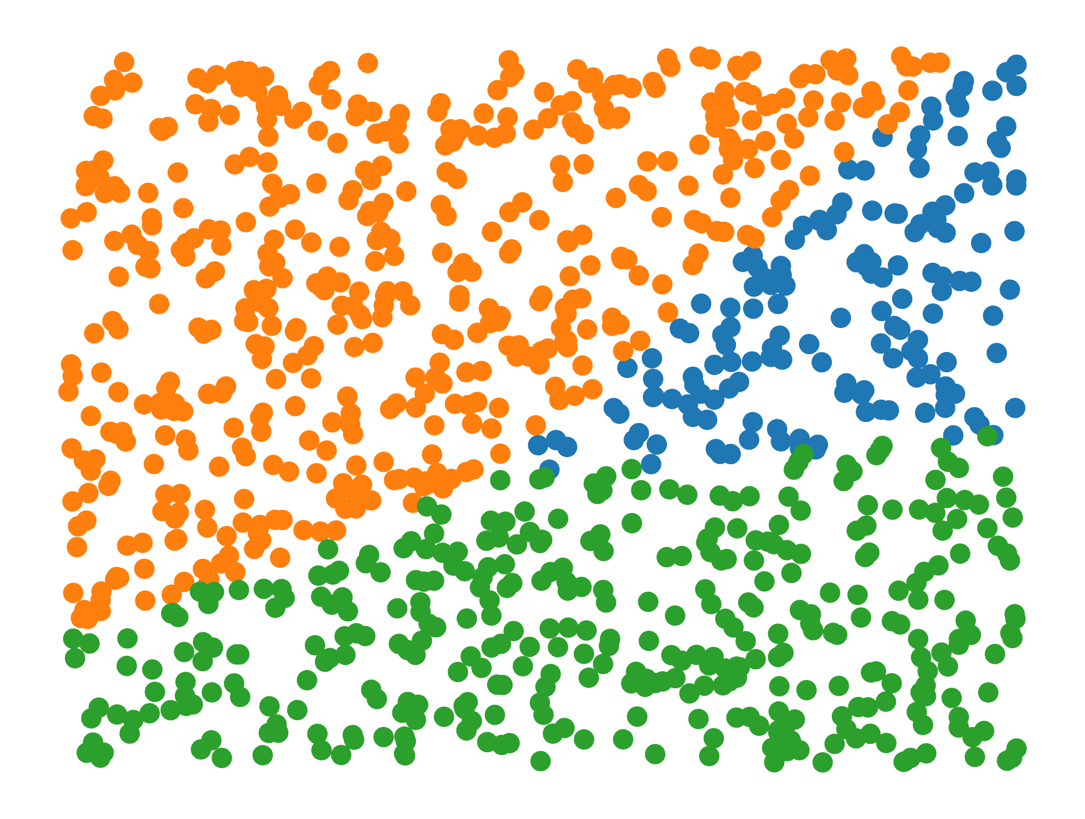
Optimization task definition
There is 3 elements to define:
Define the optimization model m_{θ}(x) = y
Define optimization dataset (set of all training {x,y})
Define the optimization metric (Loss function)
Eg L2 norm, Cross Entropy
Can include regularization term
X
Y
θ

Slide 5
Gradient descent
This problem cannot be directly solve but instead we rely on iterative loss reduction
At each iteration compute the gradient of the loss with respect to model parameters and update them with inverse gradient direction
X
Ŷ
-Y
θ_{t}

Slide 6
Gradient descent
The most critical part in gradient computation is the integral term
The integral is a sum over the dataset in most cases
It mean computing the derivative with respect to all data
X
Ŷ
-Y
θ_{t}

Slide 7
Gradient descent
The most critical part in gradient computation is the integral term
The integral is a sum over the dataset in most cases
It mean computing the derivative with respect to all data
It is impossible to compute the integral analytically
Instead of exact computation it is possible to estimate it
Estimation imply error but also cheaper computation
In an iterative process the estimation error can be compensated over multiple iterations
X
Ŷ
-Y
θ_{t}

Slide 8
Numerical integration

Slide 9
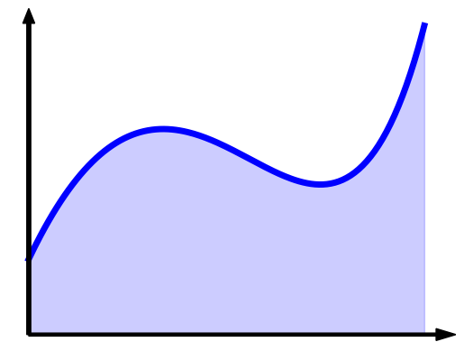
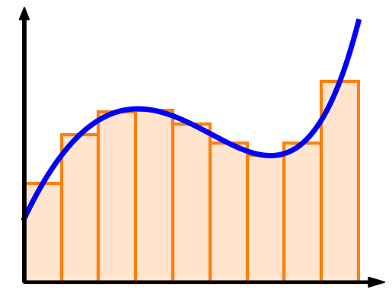
Numerical integration

Slide 10
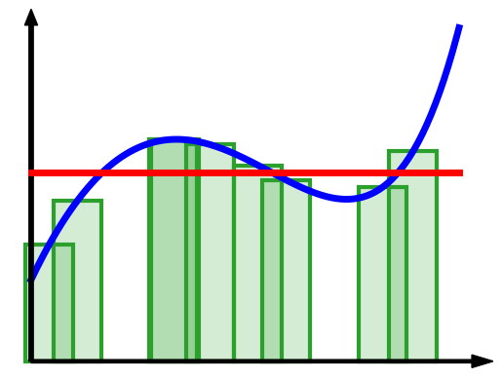
Numerical integration
Regular quadrature: $F≈\sum_{i=1}^{n}{f\left(x_{i}\right)Δx}$
Monte Carlo: ${\left\langle F\right\rangle }_{n}=\sum_{i=1}^{n}{\frac{f\left(x_{i}\right)}{n p\left(x_{i}\right)}}$
$$Δx=\frac{\left|X\right|}{n}$$
$${\left(n p\left(x_{i}\right)\right)}^{−1}$$

Slide 11
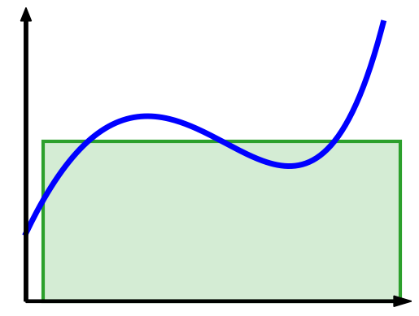
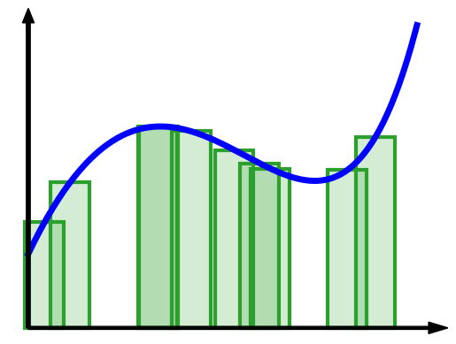
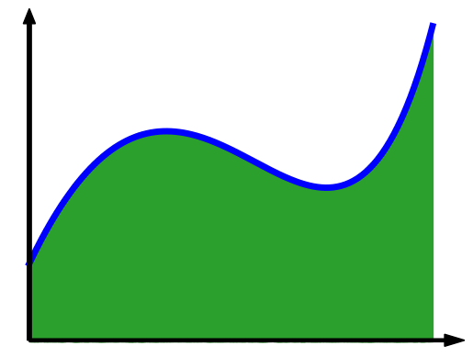
Monte Carlo integration
1 sample
10 samples
1000 samples

Slide 12
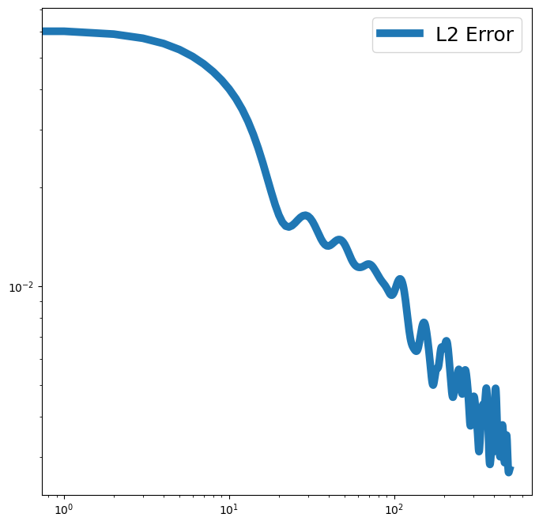
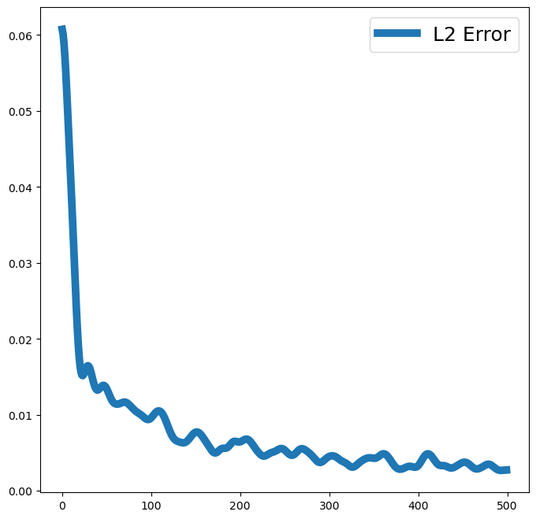
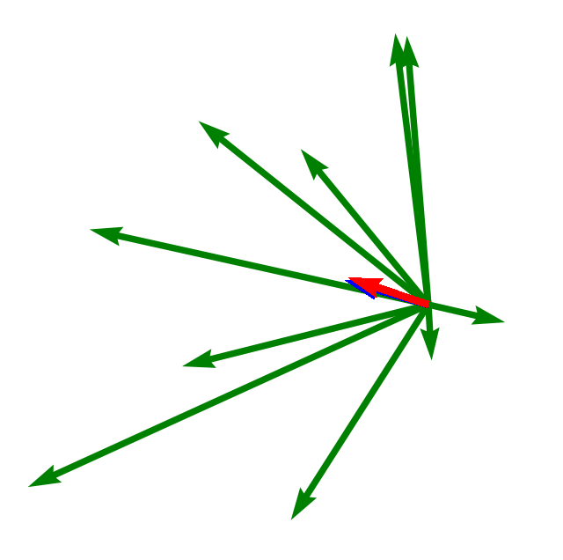
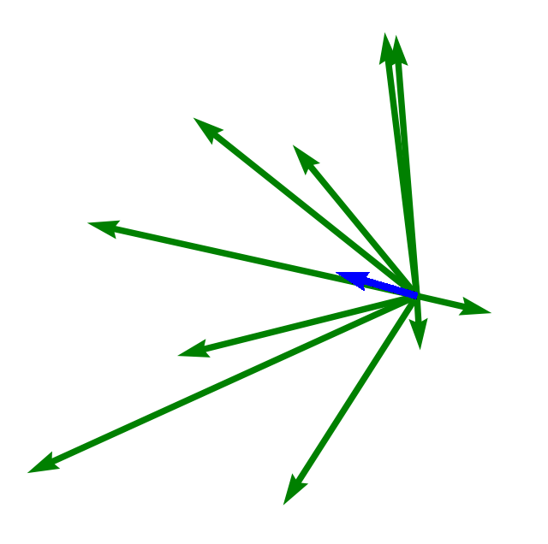
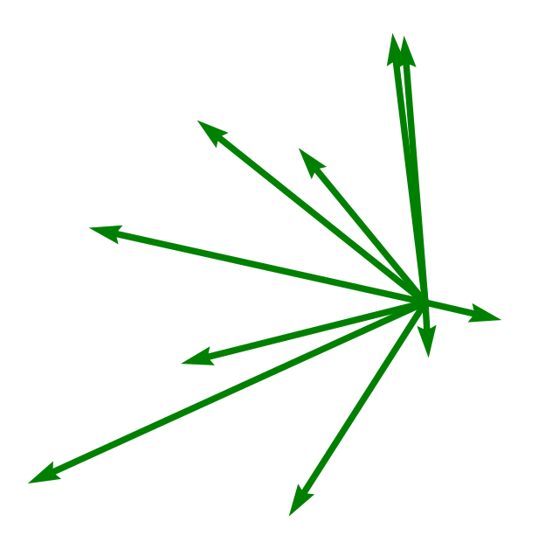
Monte Carlo Gradient estimator
Gradient varies with the data selected for backpropagation
By averaging many single data gradient we can approximate the true gradient
To reduce by a factor 2 the error, we need to multiply by 4 the batch size
Log error
X
Ŷ
-Y
θ_{t}
Log batch size

Slide 13
Stochastic gradient descent
Monte Carlo gradient estimation can be used in an SGD
Compared to Gradient Descent, SGD produce erratic convergence
Expected error is zero mean the convergence goes in the overall good direction
Noise level determine the convergence properties
This show why reducing gradient estimation error is crucial for optimization
X
Ŷ
-Y
θ_{t}

Slide 14
Importance sampling

Slide 15
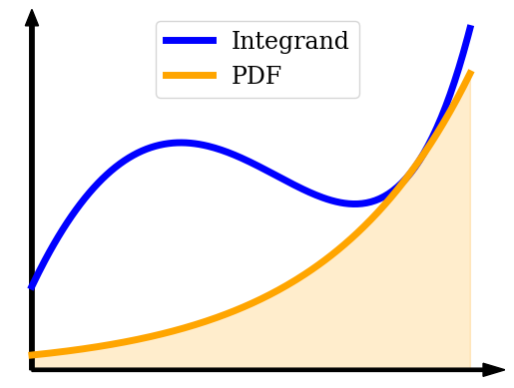
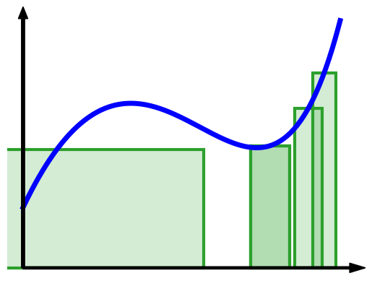
Importance sampling
$$\left(p\left(x_{i}\right)\right)$$
$${\left(n p\left(x_{i}\right)\right)}^{−1}$$

Slide 16
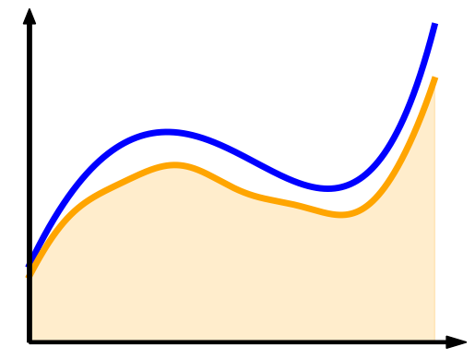
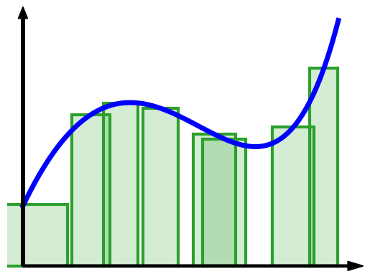
Importance sampling
$$\left(p\left(x_{i}\right)\right)$$
$${\left(n p\left(x_{i}\right)\right)}^{−1}$$

Slide 17
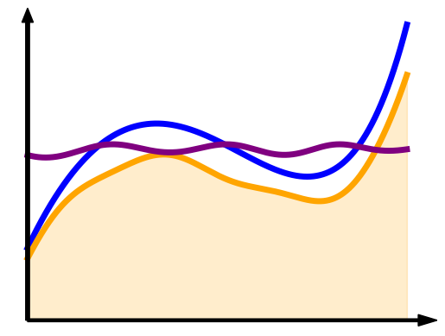
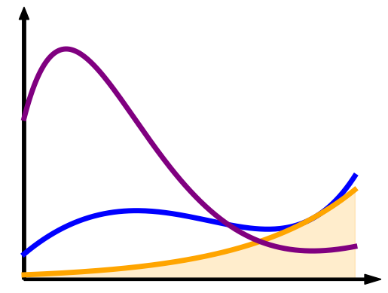
Importance sampling
Importance sampling is used to reduce estimation error in MC estimator
Error reduction appear when the PDF $p$ and the function $f$ are similar
It can be explain as $f/p$ is easier to integrate than $f$ alone
In other case it can increase estimation error
$${\left\langle F\right\rangle }_{n}=\sum_{i=1}^{n}{\frac{f\left(x_{i}\right)}{n p\left(x_{i}\right)}}$$

Slide 18
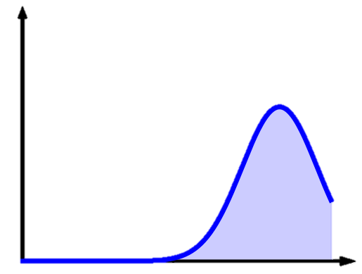
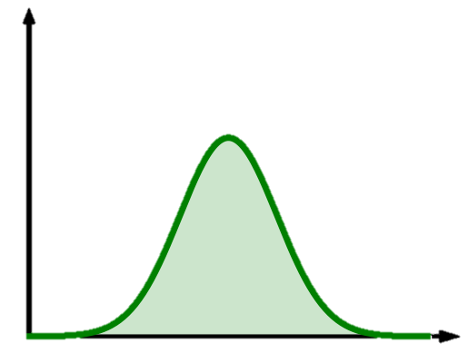
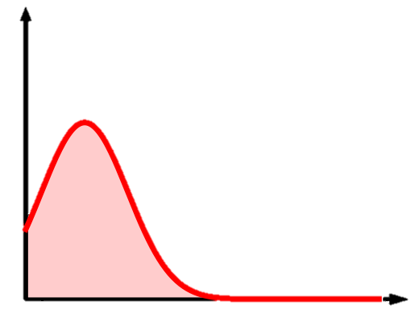
Importance sampling for optimization
θ

Slide 19
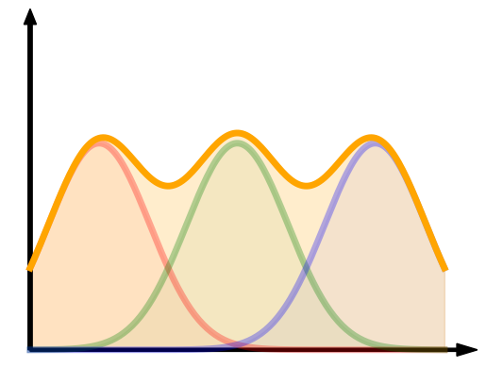
Importance sampling for optimization
The best trade-off is the gradient norm as it offer a mixture of all parameter derivatives
θ

Slide 20
Multiple Importance sampling

Slide 21
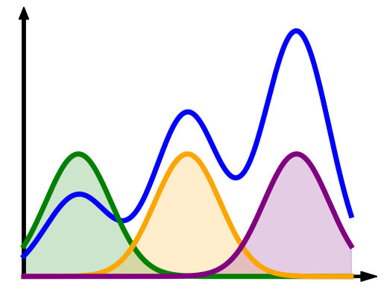
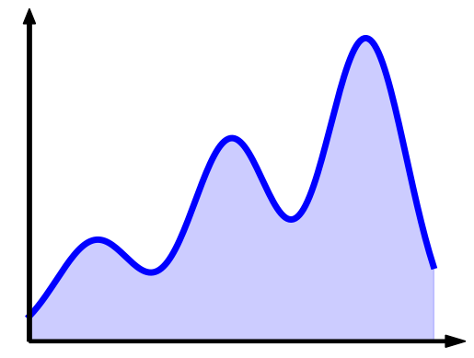
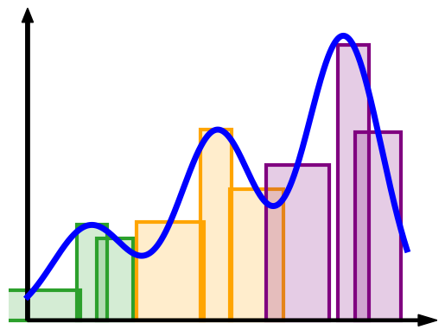
Multiple Importance sampling

Slide 22
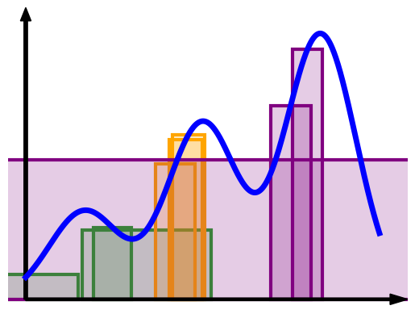
Multiple Importance sampling

Slide 23
Multiple Importance sampling
Importance sampling estimator
Multiple Importance sampling estimator
$${\left\langle F\right\rangle }_{IS}=\sum_{i=1}^{n}{\frac{f\left(x_{i}\right)}{n p\left(x_{i}\right)}}$$
$${\left\langle F\right\rangle }_{MIS}=\sum_{j=1}^{J}{\sum_{i=1}^{n_{j}}{w_{j}\left(x_{ij}\right)\frac{f\left(x_{ij}\right)}{n_{j}p_{j}\left(x_{ij}\right)}}}$$

Slide 24
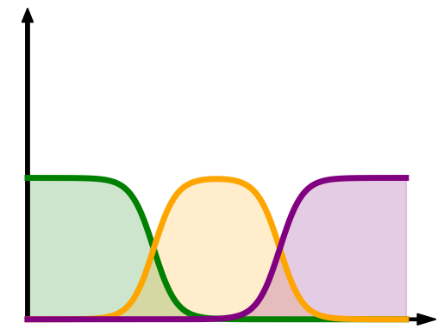
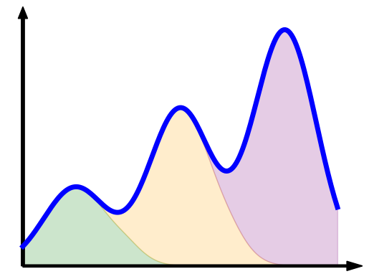
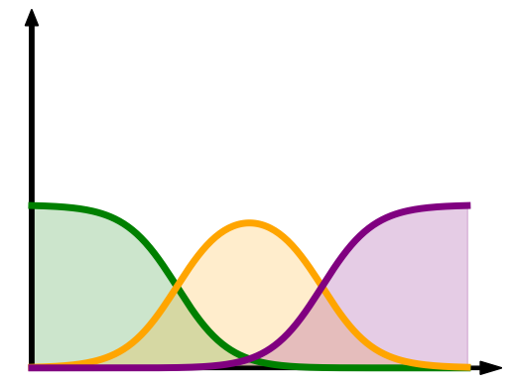
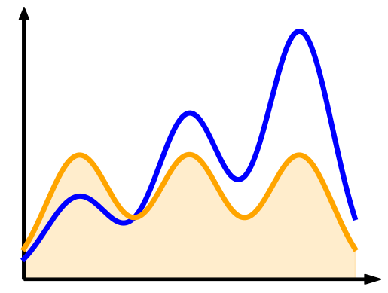
Multiple Importance sampling
MIS weights

Slide 25
Multiple Importance sampling
Veach and Guibas [1995]

Slide 26
Multiple Importance sampling
Veach and Guibas [1995]
MIS weights

Slide 27
Mini-batch sampling
Data
importance
Mini-batch
X
Ŷ
-Y
θ_{t}

Slide 28
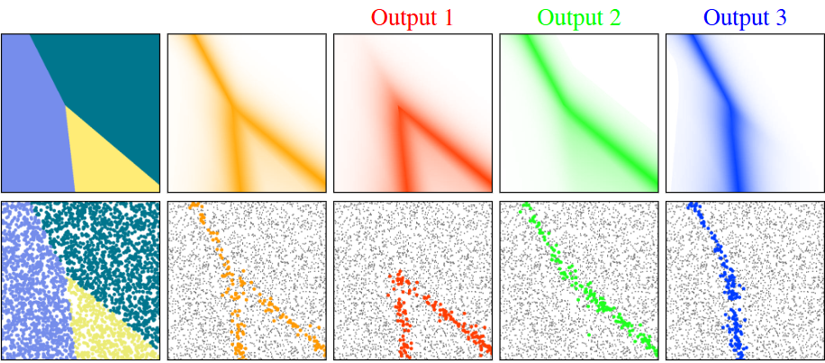
Parameters update
The parameter gradient estimator is then:
$${\left\langle ∇_{θ_{a}}L_{θ}(x_{ij})\right\rangle }_{MIS}= \frac{1}{N}\sum{\frac{dL_{θ}(x_{ij})}{dθ_{a}}\frac{w(x_{ij})}{p_{j}(x_{ij})}}$$
This account for both non-uniform data selection and Multiple Sampling density
In practice MIS for optimization can look like this :
θ

Slide 29
Optimal MIS

Slide 30
Optimal MIS
Heuristic from Veach and Guibas [1995] is equivalent to Importance sampling with a mixture of density
Does not require explicit mixture of density
Same MIS weights for all parameters
As every parameters have different derivatives, it cannot be optimal
We need to adapt MIS weights for each parameter
Find weights optimized for the specificity of each parameters
Error is unknown but it is possible to minimize variance for each parameters
$${\left\langle F\right\rangle }_{MIS}=\sum_{j=1}^{J}{\sum_{i=1}^{n_{j}}{w_{j}\left(x_{ij}\right)\frac{f\left(x_{ij}\right)}{n_{j}p_{j}\left(x_{ij}\right)}}}$$

Slide 31
Optimal MIS
Minimization
$$w_{i}\left(x\right)=\frac{α_{i}p_{i}(x)}{f(x)}+\frac{n_{i}p_{i}(x)}{\sum{n_{k}p_{k}(x)}} \left(1 −\frac{\sum{α_{k}p_{k}(x)}}{f(x)}\right)$$
Veach & Guibas 1995
Balance heuristic
Kondapaneni et al. 2019

Slide 32
Optimal MIS
$$w_{i}\left(x\right)=\frac{α_{i}p_{i}(x)}{f(x)}+\frac{n_{i}p_{i}(x)}{\sum{n_{k}p_{k}(x)}} \left(1 −\frac{\sum{α_{k}p_{k}(x)}}{f(x)}\right)$$
$$a_{ij}= \int{\frac{p_{i}p_{j}}{\sum{n_{k}p_{k}}}}$$
$$b_{i}=\int{\frac{p_{i}f}{\sum{n_{k}p_{k}}}}$$
Balance heuristic
$$\left(\begin{matrix}a_{11} & ⋯ & a_{1N} \\ ⋮ & ⋱ & ⋮ \\ a_{N1} & ⋯ & a_{NN}\end{matrix}\right)$$
$$\left(\begin{matrix}α_{1} \\ ⋮ \\ α_{N}\end{matrix}\right)$$
$$=\left(\begin{matrix}b_{1} \\ ⋮ \\ b_{N}\end{matrix}\right)$$
$N=$ # sampling techniques
$$A$$
$$b$$

Slide 33
Optimal MIS
Optimal MIS minimize variance (estimation error):
The weight depend directly on the function (Differentiate the weight per parameter)
If at least 1 sampling distribution approximate the function then we obtain a low error estimate
Given a set of PDF it give the lower possible error
It also have some limitations:
Require a linear system inversion
The size of the matrix/vector depend on the number of PDF
The more the best error reduction but also the most costly
All distribution need to be used at each optimization step
Matrix inversion can be unstable with few data
$$a_{ij}= \int{\frac{p_{i}p_{j}}{\sum{n_{k}p_{k}}}}$$
$$b_{i}=\int{\frac{p_{i}f}{\sum{n_{k}p_{k}}}}$$
$$\left(\begin{matrix}a_{11} & ⋯ & a_{1N} \\ ⋮ & ⋱ & ⋮ \\ a_{N1} & ⋯ & a_{NN}\end{matrix}\right)$$
$$\left(\begin{matrix}α_{1} \\ ⋮ \\ α_{N}\end{matrix}\right)$$
$$=\left(\begin{matrix}b_{1} \\ ⋮ \\ b_{N}\end{matrix}\right)$$

Slide 34
Momentum estimation
Linear system solution can be unstable at low number of data per distribution
To improve this we propose to estimate the matrix and vector using momentum estimator
This reduce the number of data needed at each step
Final gradient is then equal to a momentum gradient estimator
$$\left(\begin{matrix}a_{11} & ⋯ & a_{1N} \\ ⋮ & ⋱ & ⋮ \\ a_{N1} & ⋯ & a_{NN}\end{matrix}\right)$$
$$\left(\begin{matrix}α_{1} \\ ⋮ \\ α_{N}\end{matrix}\right)$$
$$=\left(\begin{matrix}b_{1} \\ ⋮ \\ b_{N}\end{matrix}\right)$$
$$A_{t}=βA+\left(1−β\right)A_{t−1}$$
$$b_{t}= βb+(1−β)b_{t−1}$$

Slide 35
Results

Slide 36
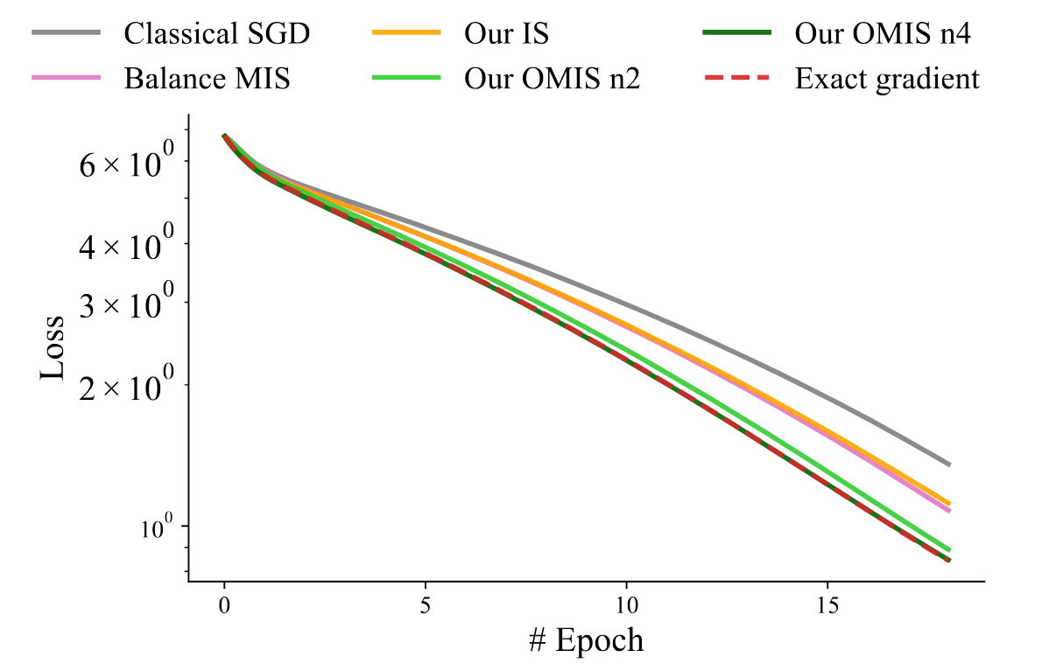
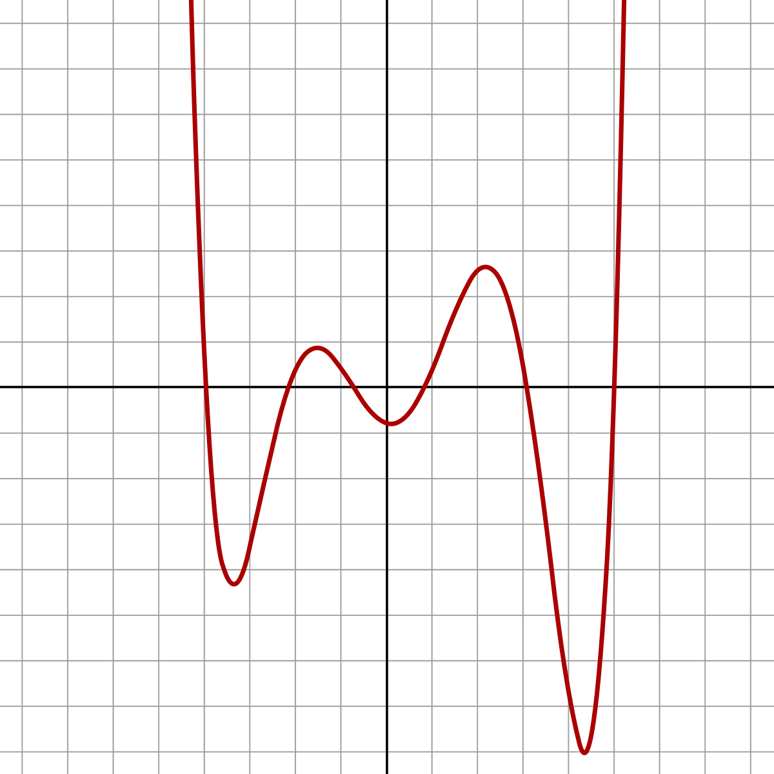
Results
Polynomial regression task

Slide 37
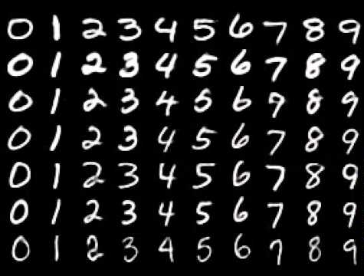
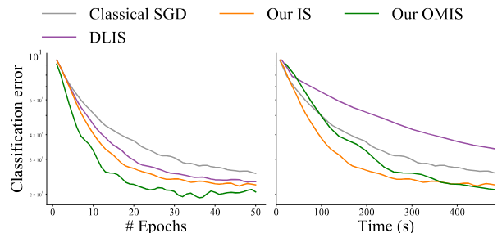
Results
MNIST classification

Slide 38
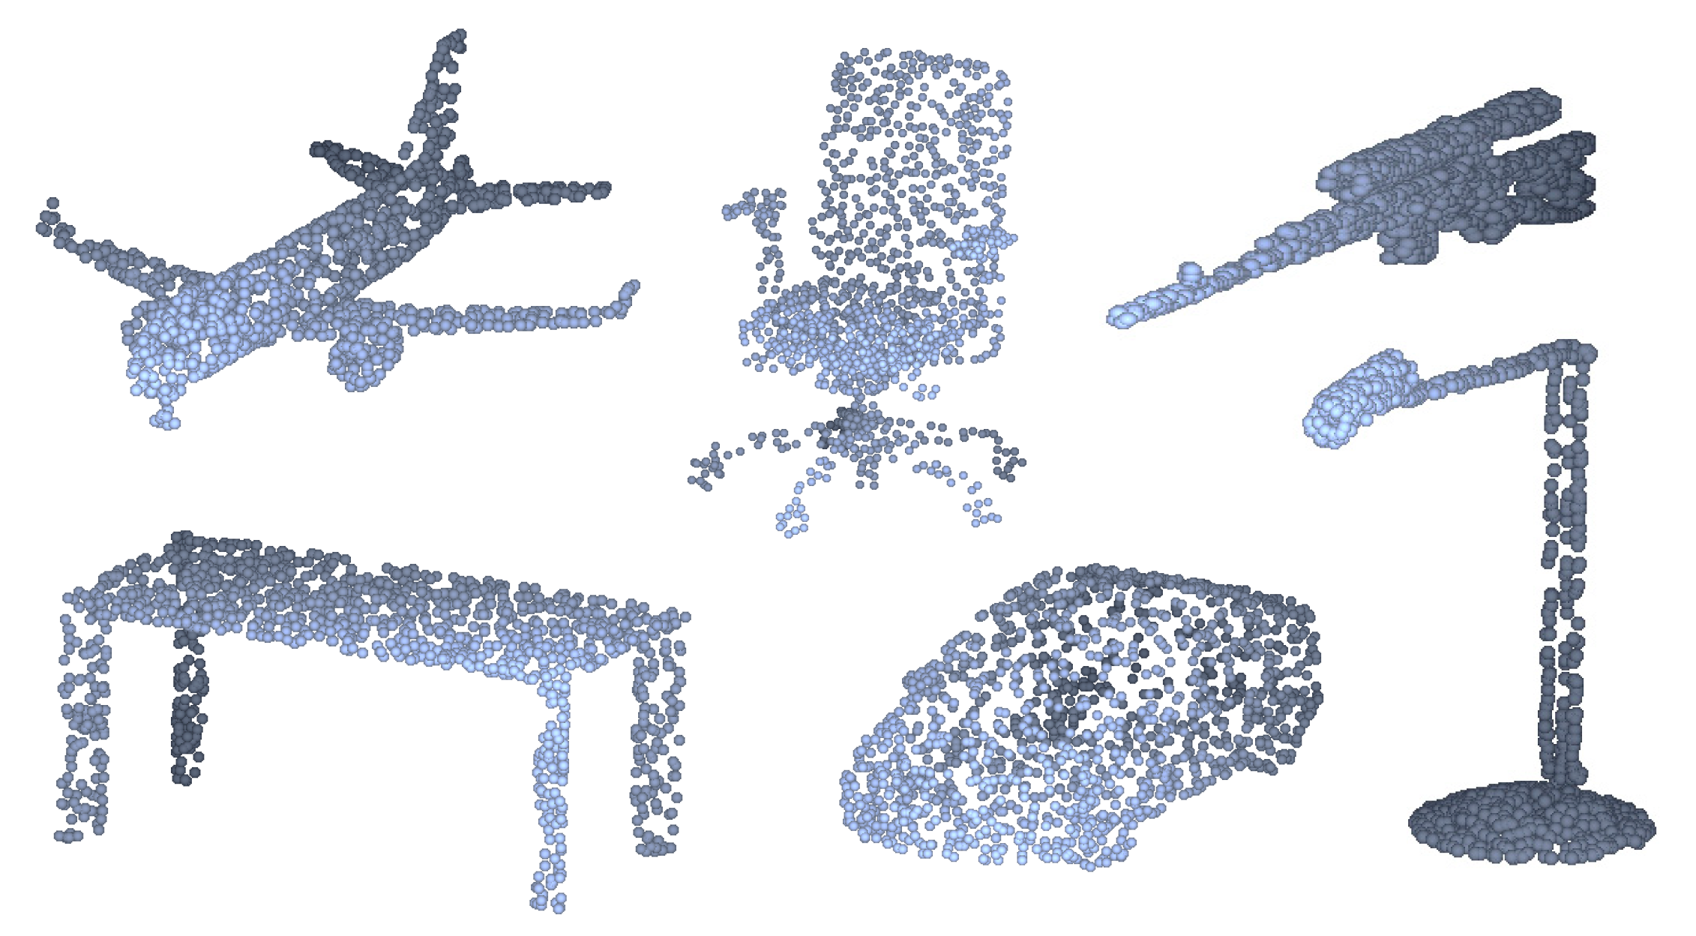
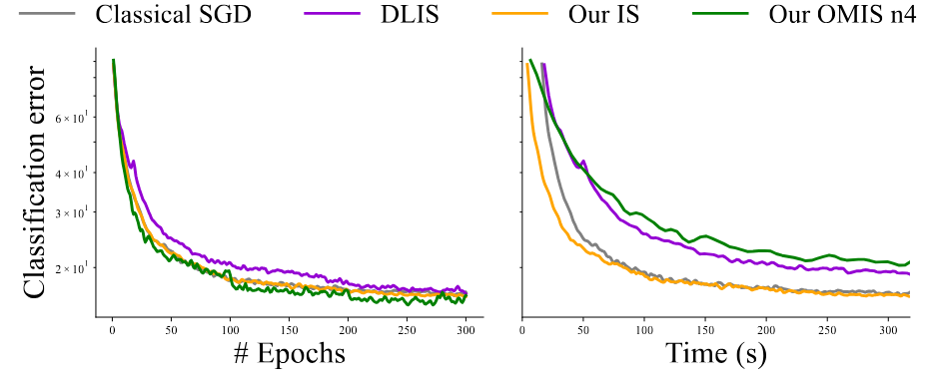
Results
Pointcloud classification

Slide 39
Results

Slide 40
Future work

Slide 41
Future work
Current version is limited:
Implementation remain slow due to iteration over parameters
Require a linear system solution per parameter
Tested on small network and “simple” tasks
Open questions remain
How many distribution are required ?
How to chose them ? (PCA, last layer, other)
Can we derive cheaper heuristic than Optimal MIS to benefit from similar improvement
How the method could scale to larger network, deep learning ?
Can we apply such method on extremely large dataset task ?

Slide 42
Conclusion
We have demonstrated :
The possibility of gradient estimation using MIS to achieve low gradient noise
That estimating each parameters gradient differently can lead to noise reduction
We proposed an adaptive algorithm to obtain MIS weights with adaptive sampling distributions
Ours results demonstrate superior quality with faster convergence that the best Importance sampling
Multiple importance sampling is a powerful error reduction tool
It show promising result for gradient estimation due to it’s multivariate nature
Existing MIS tools are not adapted to gradient based opination task as it was developed for other application (Physically based rendering)
Future work could derive adapted heuristic with properties suited for machine learning
We believe this work could lead following work with improved convergence at low cost

Slide 43
Conclusion
Thanks for your attention

