Slide 1
Importance Caching for
Complex Illumination
Iliyan Georgiev
Saarland University
Intel VCI Saarbrücken
Jaroslav Křivánek
Charles University
Prague
Stefan Popov
Saarland University
Intel VCI Saarbrücken
Philipp Slusallek
Saarland University
Intel VCI, DFKI Saarbrücken

Slide 2
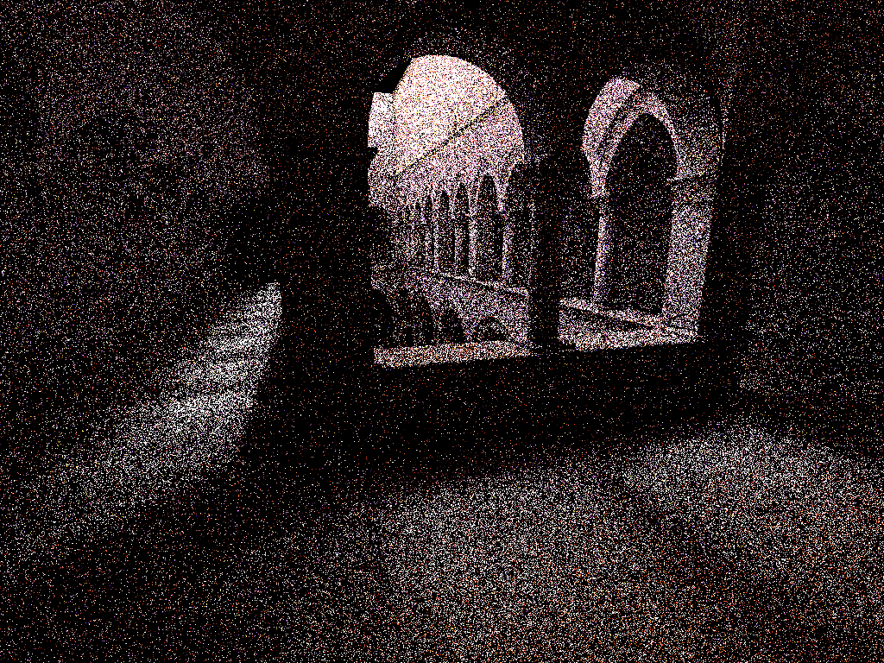
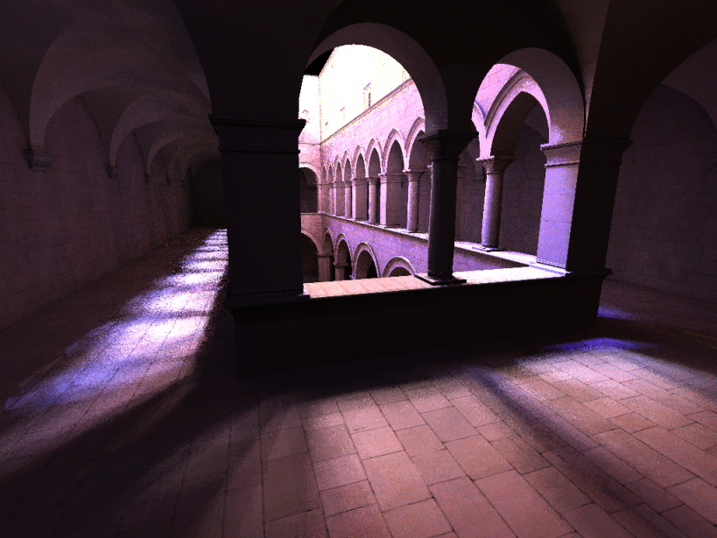
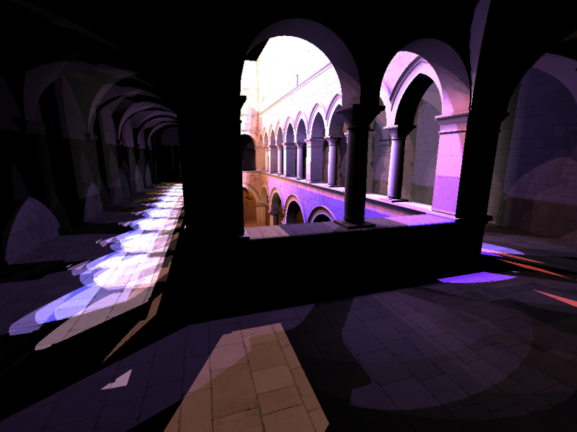
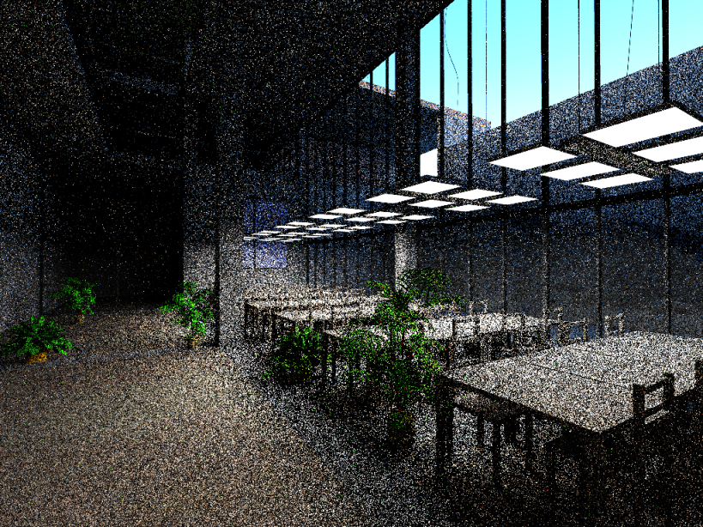
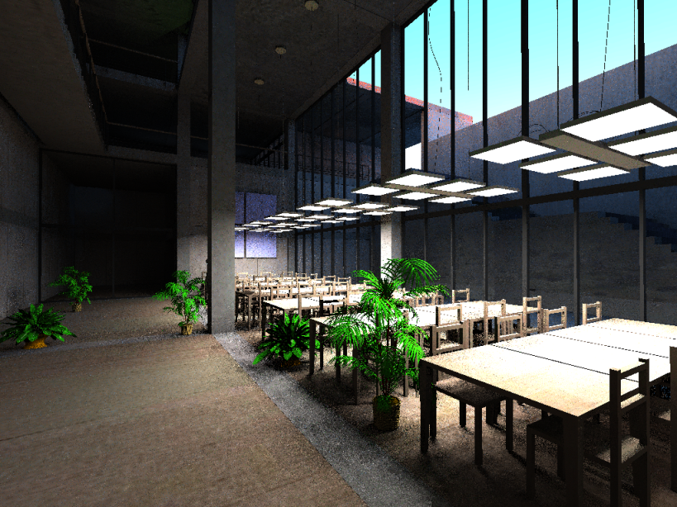
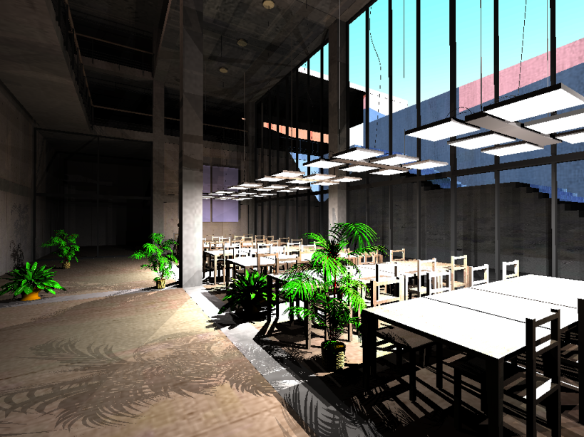
…2 seconds
Path tracing
Importance caching
Instant radiosity
Path tracing
Importance caching
Instant radiosity

Slide 3
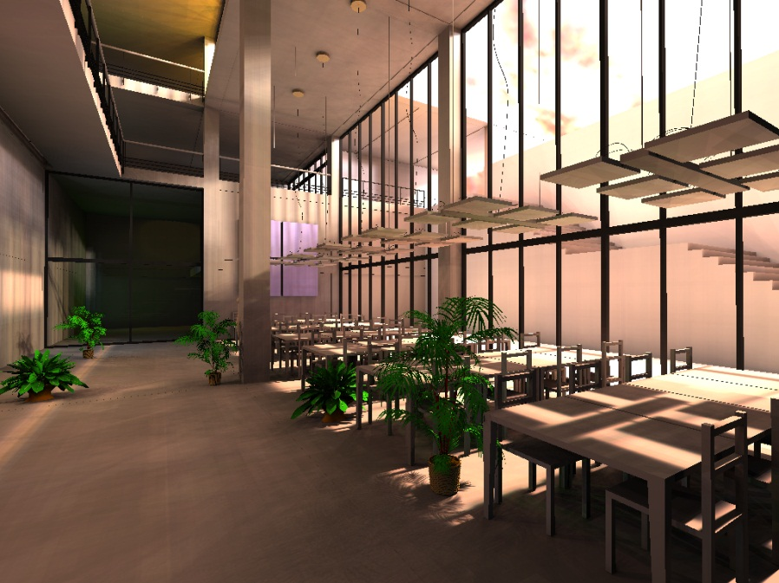
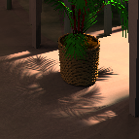


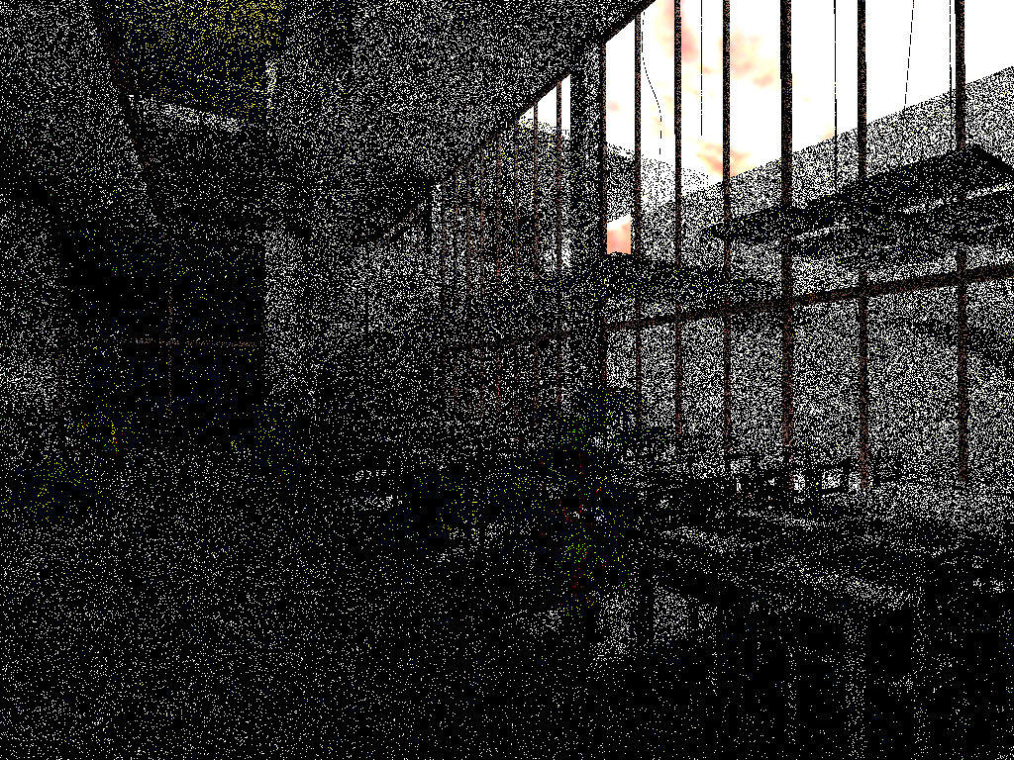
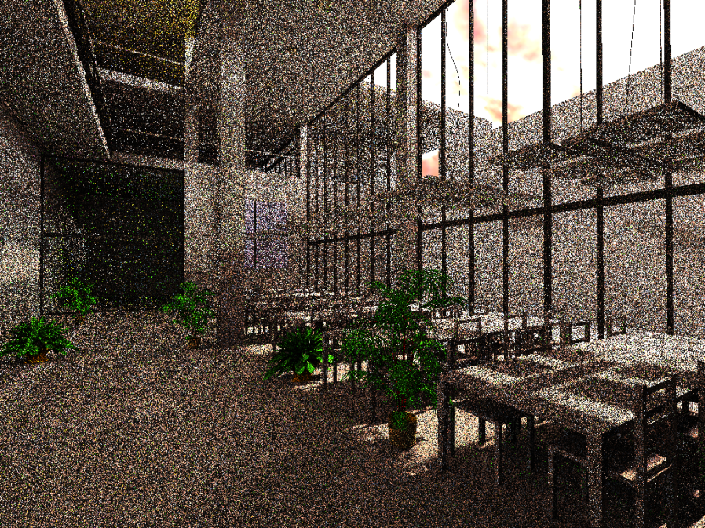
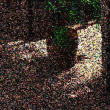
VPL importance sampling
Reference
Perfect PDF
Perfect PDF w/o visibility
Visibility as PDF

Slide 4
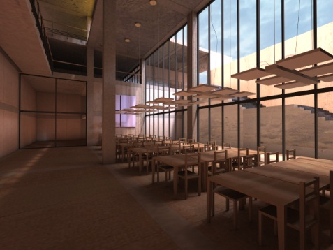
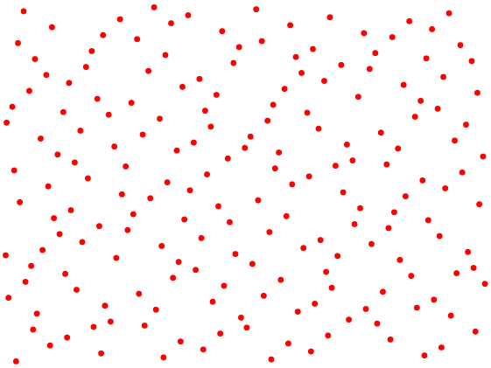
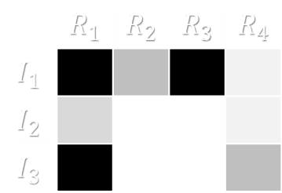

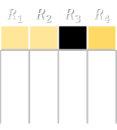


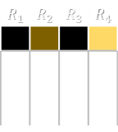

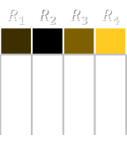








Algorithm outline
$$R_{1}$$
$$R_{2}$$
$$R_{4}$$
$$R_{6}$$
2-3K importance records
$$R_{5}$$
 | $$R_{1}$$ | $$R_{2}$$ | $$R_{3}$$ | $$R_{4}$$
$$I_{1}$$
$$I_{2}$$
$$I_{3}$$
$$I_{3}$$
6-8K virtual point lights
$$R_{1}$$ | $$R_{2}$$ | $$R_{3}$$ | $$R_{4}$$
$$R_{1}$$ | $$R_{2}$$ | $$R_{3}$$ | $$R_{4}$$
. | . | . | .
. | . | . | .
. | . | . | .
2-4 nearest IRs
$$I_{1}$$
$$R_{3}$$
$$I_{2}$$
3 additional distributions
$$R_{1}$$ | $$R_{2}$$ | $$R_{3}$$ | $$R_{4}$$
$$R_{1}$$ | $$R_{2}$$ | $$R_{3}$$ | $$R_{4}$$
. | . | . | .
. | . | . | .
. | . | . | .
$$R_{1}$$ | $$R_{2}$$ | $$R_{3}$$ | $$R_{4}$$
. | . | . | .
. | . | . | .
. | . | . | .
$$R_{1}$$ | $$R_{2}$$ | $$R_{3}$$ | $$R_{4}$$

Slide 5
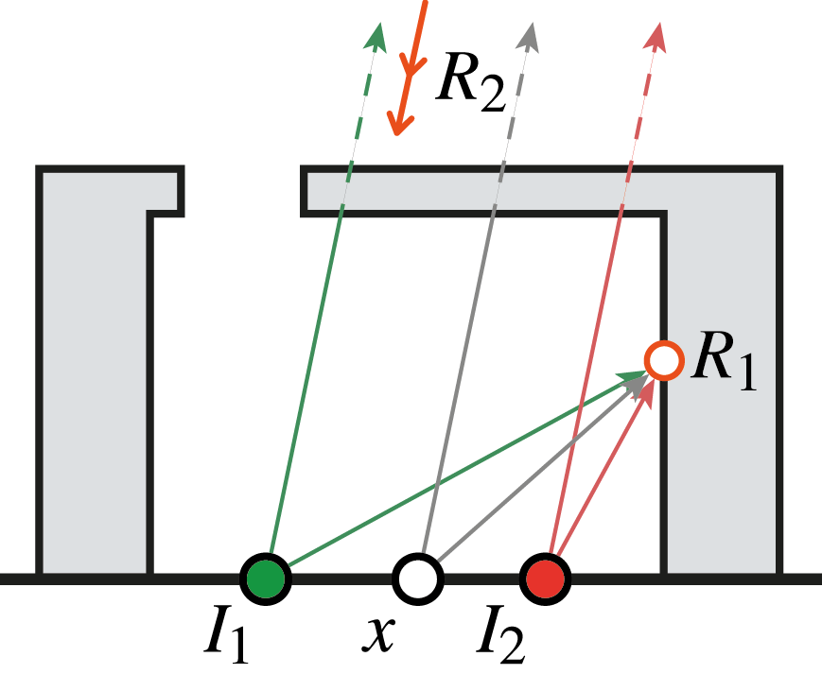
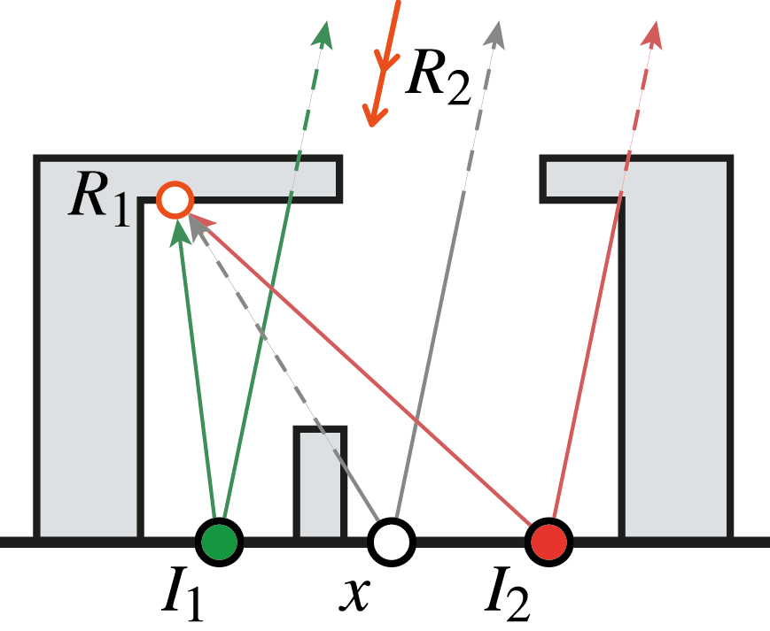
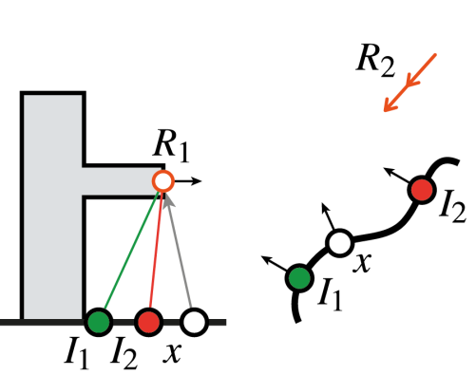
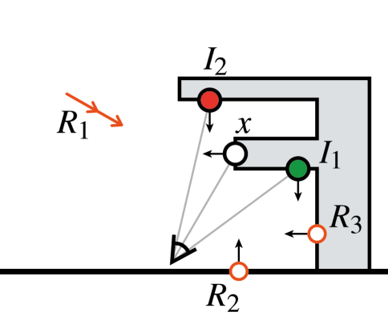
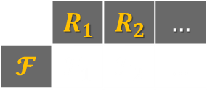



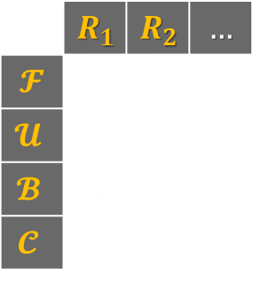

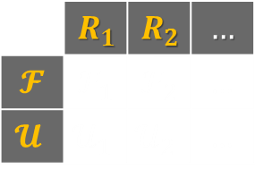
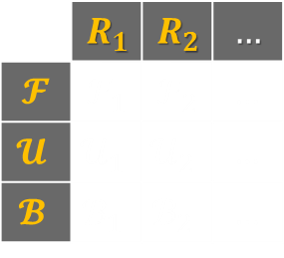
VPL distributions
At each importance record
Full contribution
Unoccluded contribution
$$ℱ_{i}=L_{i}B_{i}G_{i}V_{i}$$
$$𝒰_{i}=L_{i}B_{i}G_{i}$$
 | $$R_{1}$$ | $$R_{2}$$ | $$…$$
$$𝓕$$ | $$ℱ_{1}$$ | $$ℱ_{2}$$ | …
 | $$R_{1}$$ | $$R_{2}$$ | $$…$$
$$𝓕$$ | $$ℱ_{1}$$ | $$ℱ_{2}$$ | …
$$𝓤$$ | $$𝒰_{1}$$ | $$𝒰_{2}$$ | …
$$𝓑$$ | $$ℬ_{1}$$ | $$ℬ_{2}$$ | …
 | $$R_{1}$$ | $$R_{2}$$ | $$…$$
$$𝓕$$ | $$ℱ_{1}$$ | $$ℱ_{2}$$ | …
$$𝓤$$ | $$𝒰_{1}$$ | $$𝒰_{2}$$ | …
 | $$R_{1}$$ | $$R_{2}$$ | $$…$$
$$𝓕$$ | $$ℱ_{1}$$ | $$ℱ_{2}$$ | …
$$𝓤$$ | $$𝒰_{1}$$ | $$𝒰_{2}$$ | …
$$𝓑$$ | $$ℬ_{1}$$ | $$ℬ_{2}$$ | …
$$𝓒$$ | $$𝒞_{1}$$ | $$𝒞_{2}$$ | …
Bounded contribution
Uniform
$$ℬ_{i}=L_{i}B_{i}G_{i}^{max}$$
$$𝒞_{i}=1$$

Slide 6







Distribution combination
$$I_{2}$$
$$x$$
$$I_{1}$$
$$I_{3}$$
balance heuristic
MIS
Bilateral combination
  Horizontal mixture
  Vertical priority-based
$α$-max
heuristic
$$L(x)$$

Slide 7
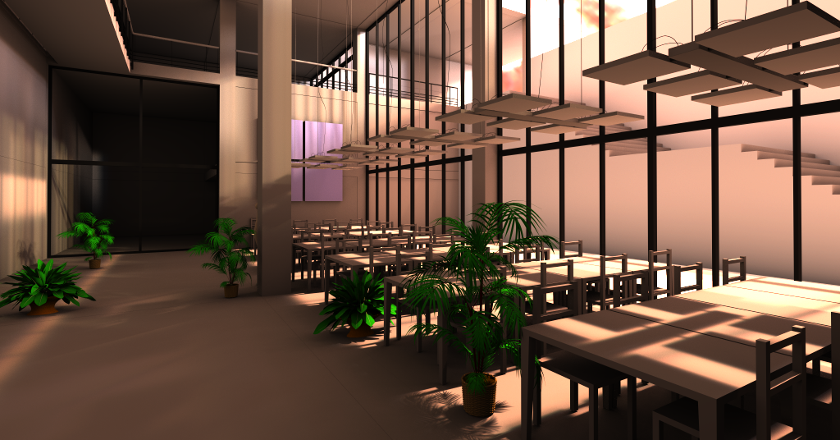
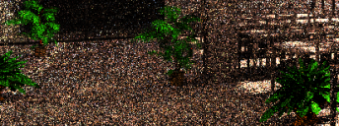
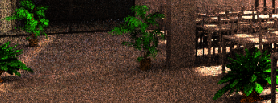






Results
Reference
Uniform ($𝓒$)
No visibility ($𝓤𝓑𝓒$)
No conservative ($𝓕𝓒$)
Combined ($𝓕𝓤𝓑𝓒$)

Slide 8
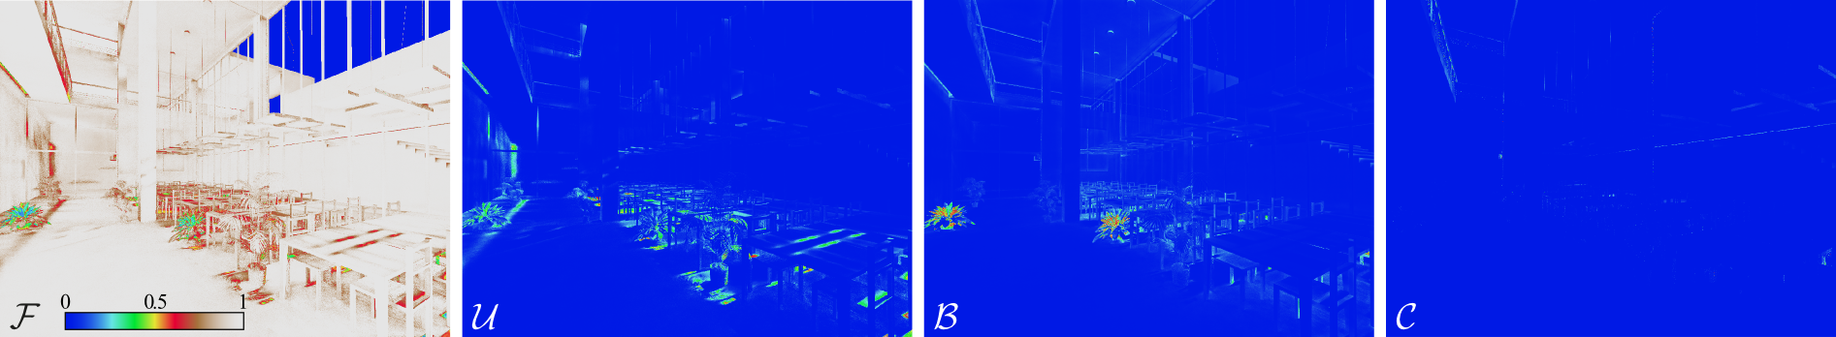

Results
Reference ($𝓕𝓤𝓑𝓒$)
$𝓕𝓤𝓑𝓒$ fractional contributions

Slide 9
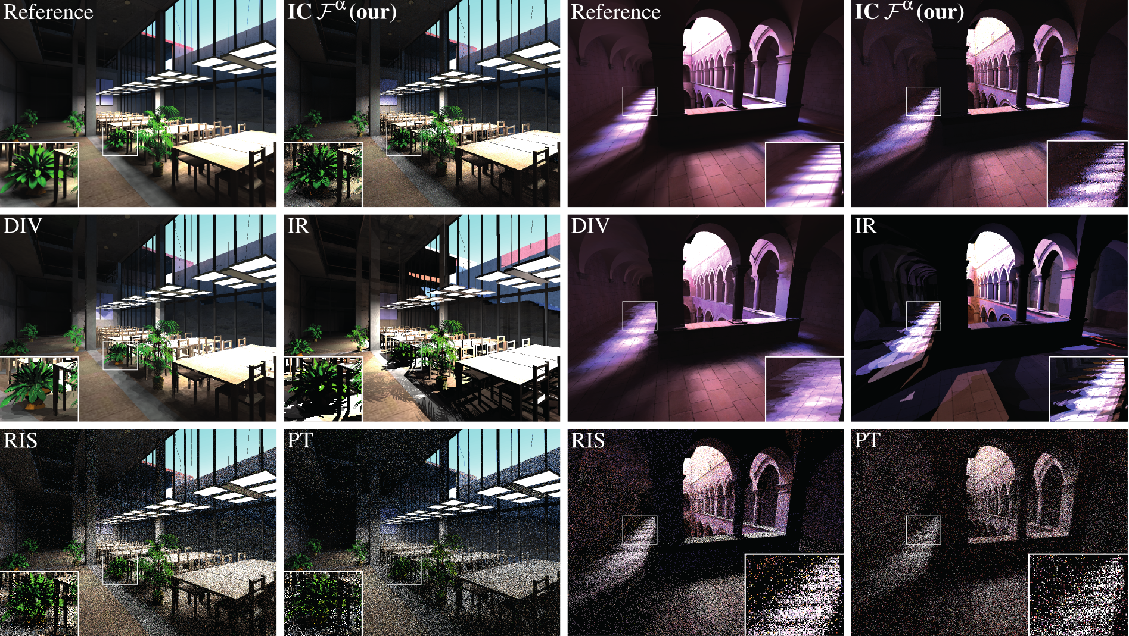
Results
Interactive previews (1024x768, 0.5 FPS)

Slide 10
Results
Interactive previews (1024x768, 0.5 FPS)

Slide 11
Summary
Unbiased coherence exploitation
  Handle discontinuities
Progressive rendering
  Good approximation within few seconds
  Bounded memory convergence
Future
  Adaptive IR distribution
  More VPLs, e.g. Lightcuts

Slide 12
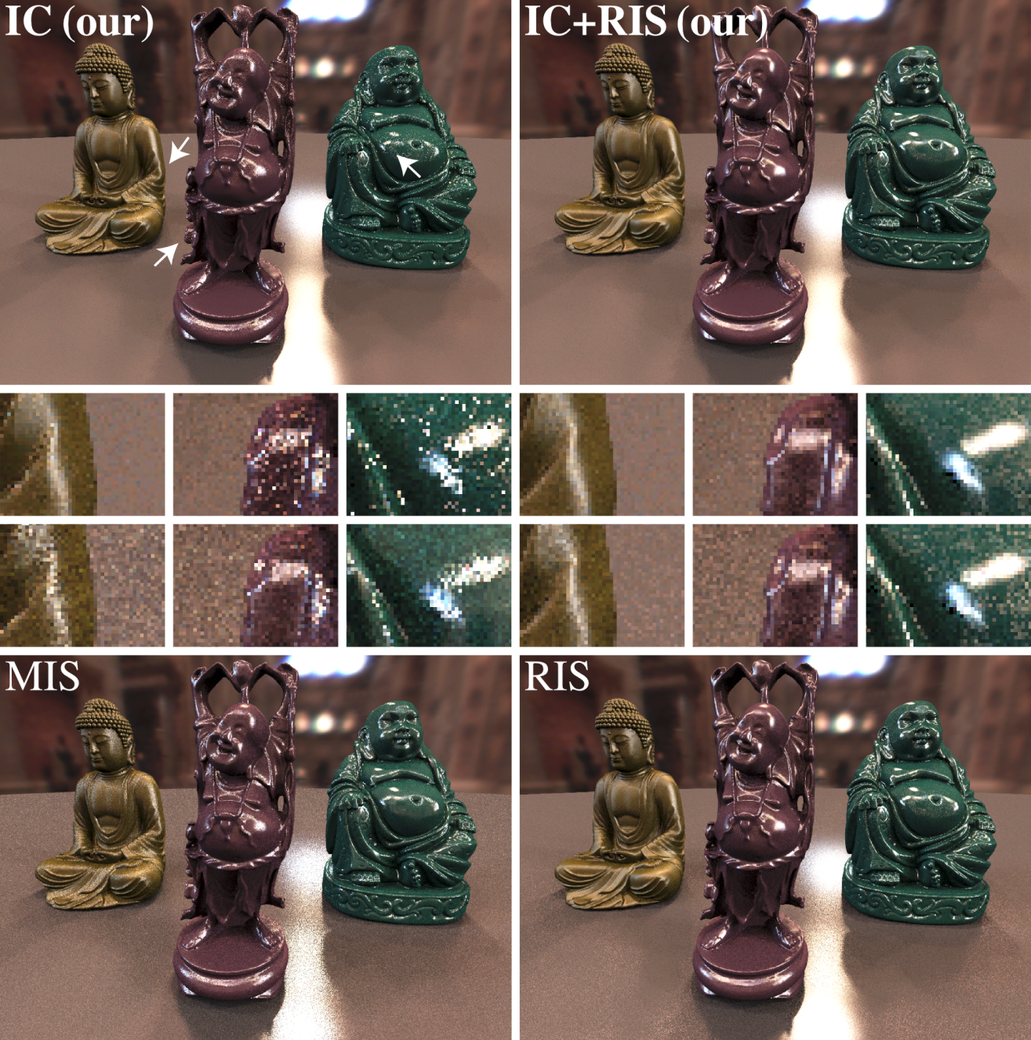
Results
Glossy materials

Slide 13
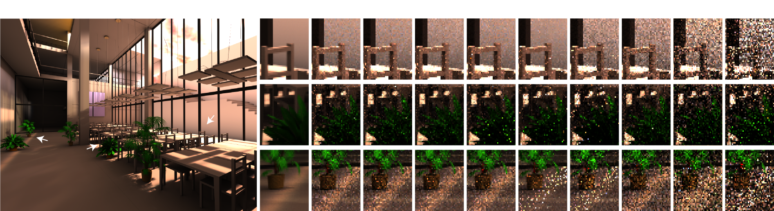
Results

Slide 14
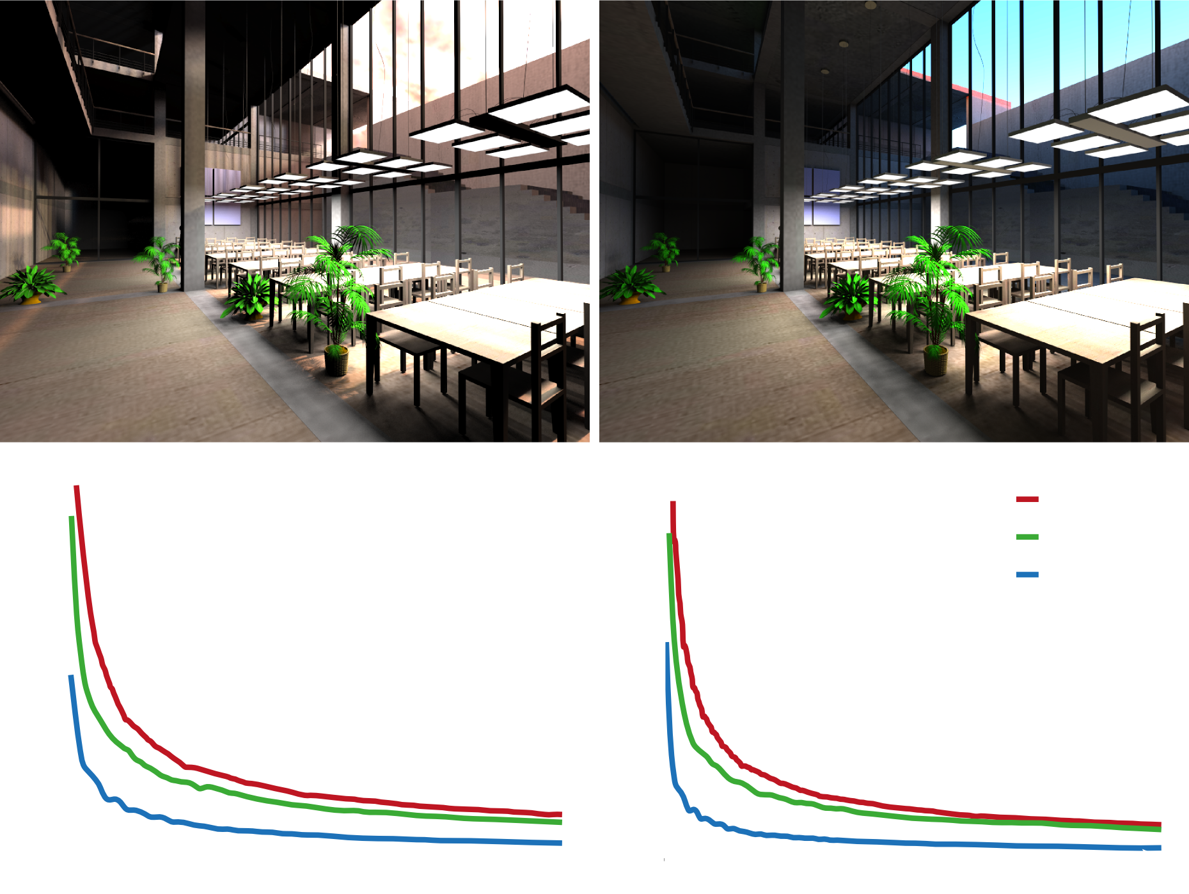
Results
Direct illumination only
Full global illumination

