Slide 1
Simple and Robust
Iterative Importance Sampling of
Virtual Point Lights
Iliyan Georgiev
Philipp Slusallek

Slide 2
Motivation
Instant Radiosity (IR) – two-pass
  Cheap pre-processing
  Expensive rendering
Previous approaches
  Bidirectional Instant Radiosity [Segovia et al. 06]
  Metropolis Instant Radiosity [Segovia et al. 07]
    Difficult to implement
    Multiple sampling strategies
    Many parameters
    Stratification problems
  “One-pixel image” assumption

Slide 3
Our Method
Simple extension of IR
  Generate VPLs from light sources only
Probabilistically accept VPLs
  Proportionally to total contribution
  All VPLs bring the same power to the image
“One-pixel image” assumption
Minimum importance storage
  Filter VPLs on the fly

Slide 4

Probabilistic VPL Acceptance
VPL energy
$L_{i}=\frac{L_{i}}{p_{i}}p_{i}=$ $\frac{L_{i}}{p_{i}}\int_{0}^{1}{χ_{\left[0,p_{i}\right]}\left(t\right)dt}$
One-sample Monte Carlo integration with $ξ$
$\hat{L_{i}}=\left\{\begin{aligned} \frac{L_{i}}{p_{i}}, ξ<p_{i} \\ &0, \text{else}\end{aligned}\right.$
Allows to control VPL density

Slide 5

Importance Sampling
Want $N$ VPLs with equal total image contribution
  $Φ_{v}=\frac{Φ}{N}$
For each VPL candidate $i \text{with} \text{energy} L_{i}$
  Estimate total image contribution $Φ_{i}$
  Russian roulette decision with $p_{i}=min\left(\frac{Φ_{i}}{Φ_{v}}+ε,1\right)$
    Accept with energy $\frac{L_{i}}{p_{i}}$
    Discard
See paper for details

Slide 6

Estimating Image Contribution
Computing $Φ_{i}$
  Cast a number of camera rays
  Connect VPLs to camera points to estimate $Φ_{i}$
  Camera points – analog of importons
Computing $Φ_{v}$
  Iteratively
      Start with $Φ_{v}=0$
      Loop
        Render frame
        Accumulate $Φ_{v}$
  Single pass – path tracing, using VPLs, etc.

Slide 7
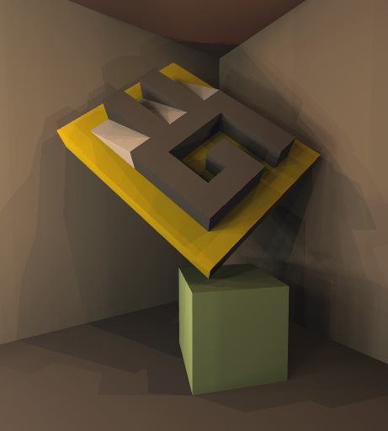
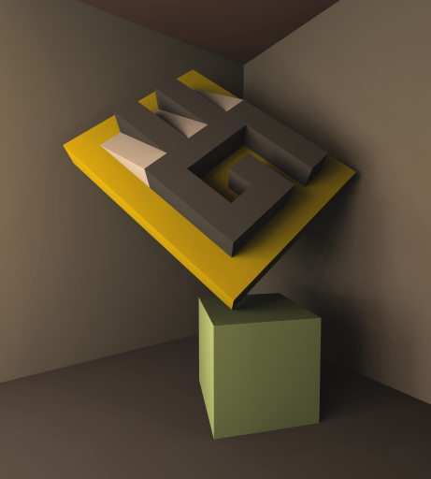
Results
Instant Radiosity
Our Extension (0.07 acceptance)

Slide 8
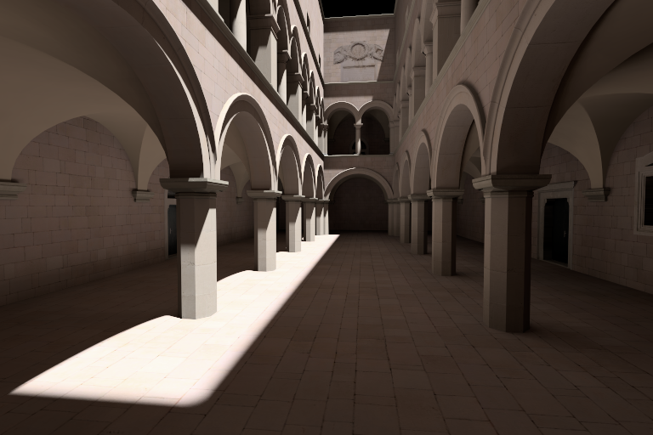
Results
Average acceptance probability: 0.28

Slide 9
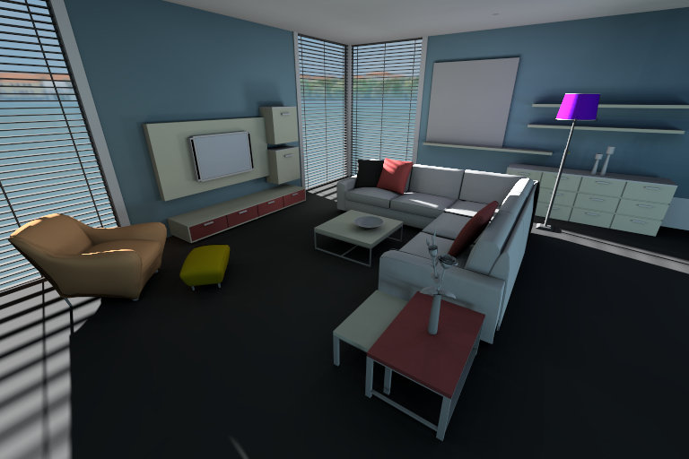
Results
Average acceptance probability: 0.23

Slide 10
Wrap Up
Simple extension of IR
  Generate VPLs from light sources only
Probabilistically accept VPLs on the fly
  No additional storage
  Easy to parallelize
Few parameters
“One-pixel image” assumption

Slide 11
Iliyan Georgiev

