Slide 1
Real-time Ray Tracing for Virtual Reality Applications
Iliyan Georgiev¹, Dmitri Rubinstein¹,
Hilko Hoffmann², Philipp Slusallek^{1,2}
¹ Saarland University, Germany
² DFKI Saarbrücken, Germany
Notes:
Talk about real-time ray tracing
Give you a feeling about its relevant to visualization and virtual reality systems TODAY
Discuss one of the main issues in applying RTRT in industry
What we in SB are working on to address this

Slide 2
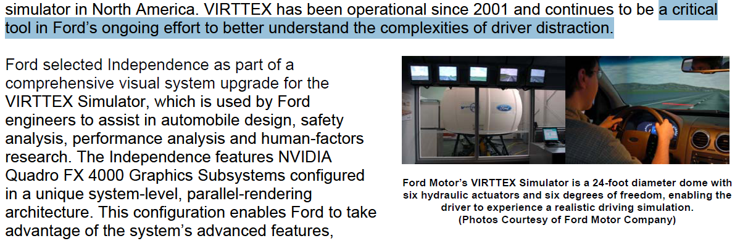
Notes:
(real story)
This year (2008) I attended a talk given by some industry researchers and a lady from Ford was giving an overview about the VR system they used to detect driver distraction. Three days later I rented a Ford Mustang convertible. In the moment I got into the car, I was blinded by the vast amount of chrome instruments on the dashboard, which were reflecting the strong Californian sun. Apparently, Ford hadn’t detected this kind of distraction using their system.

Slide 3
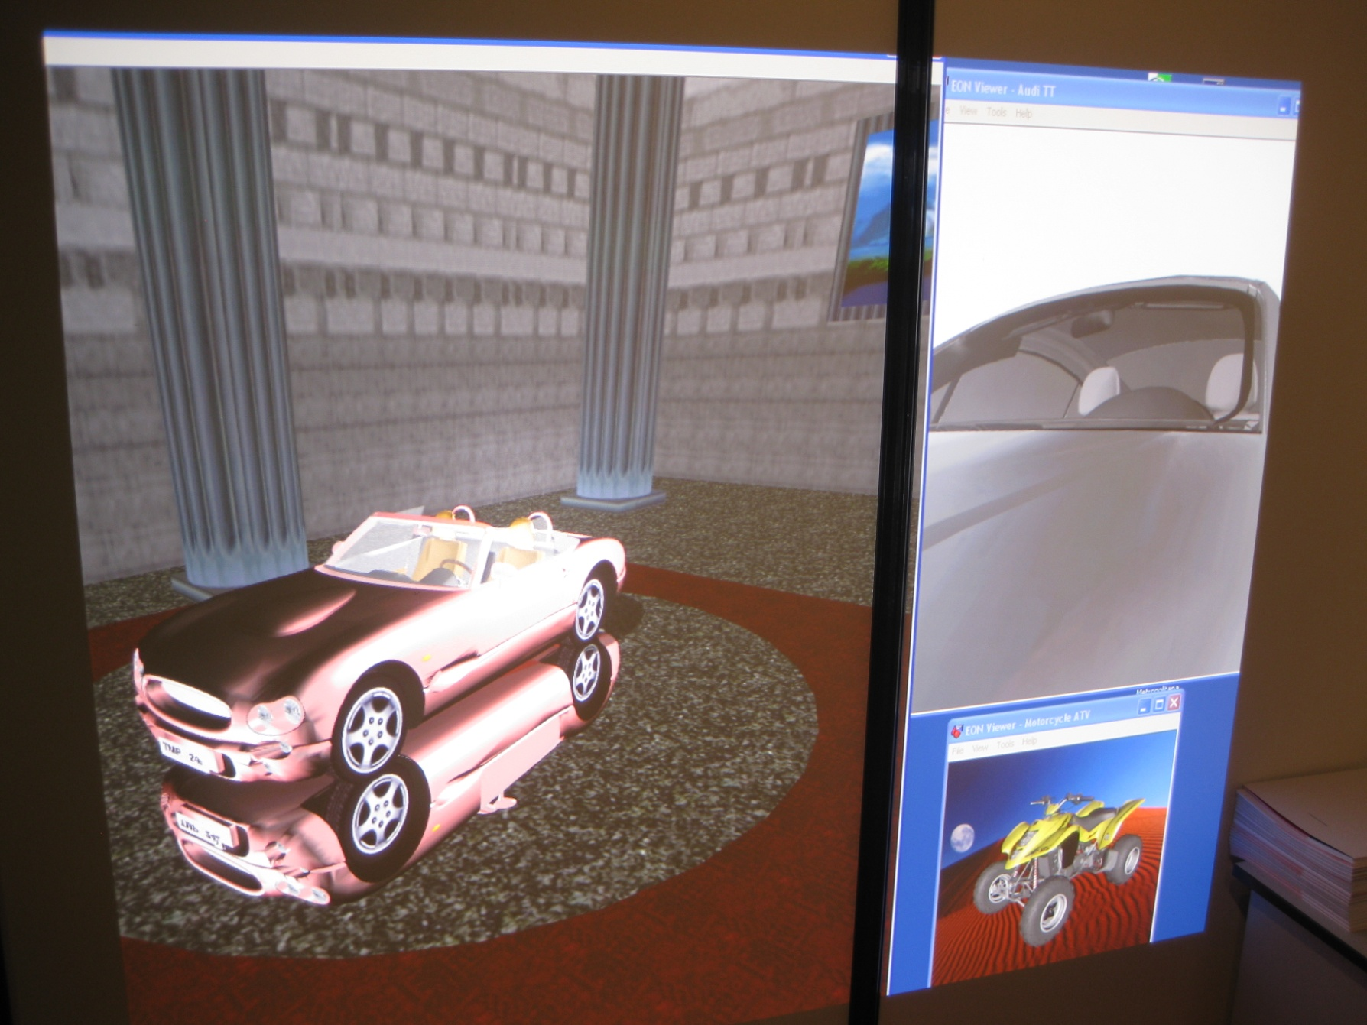
Intuition 2008 Exhibition
Notes:
Shots from the VR systems currently running downstairs.

Slide 4
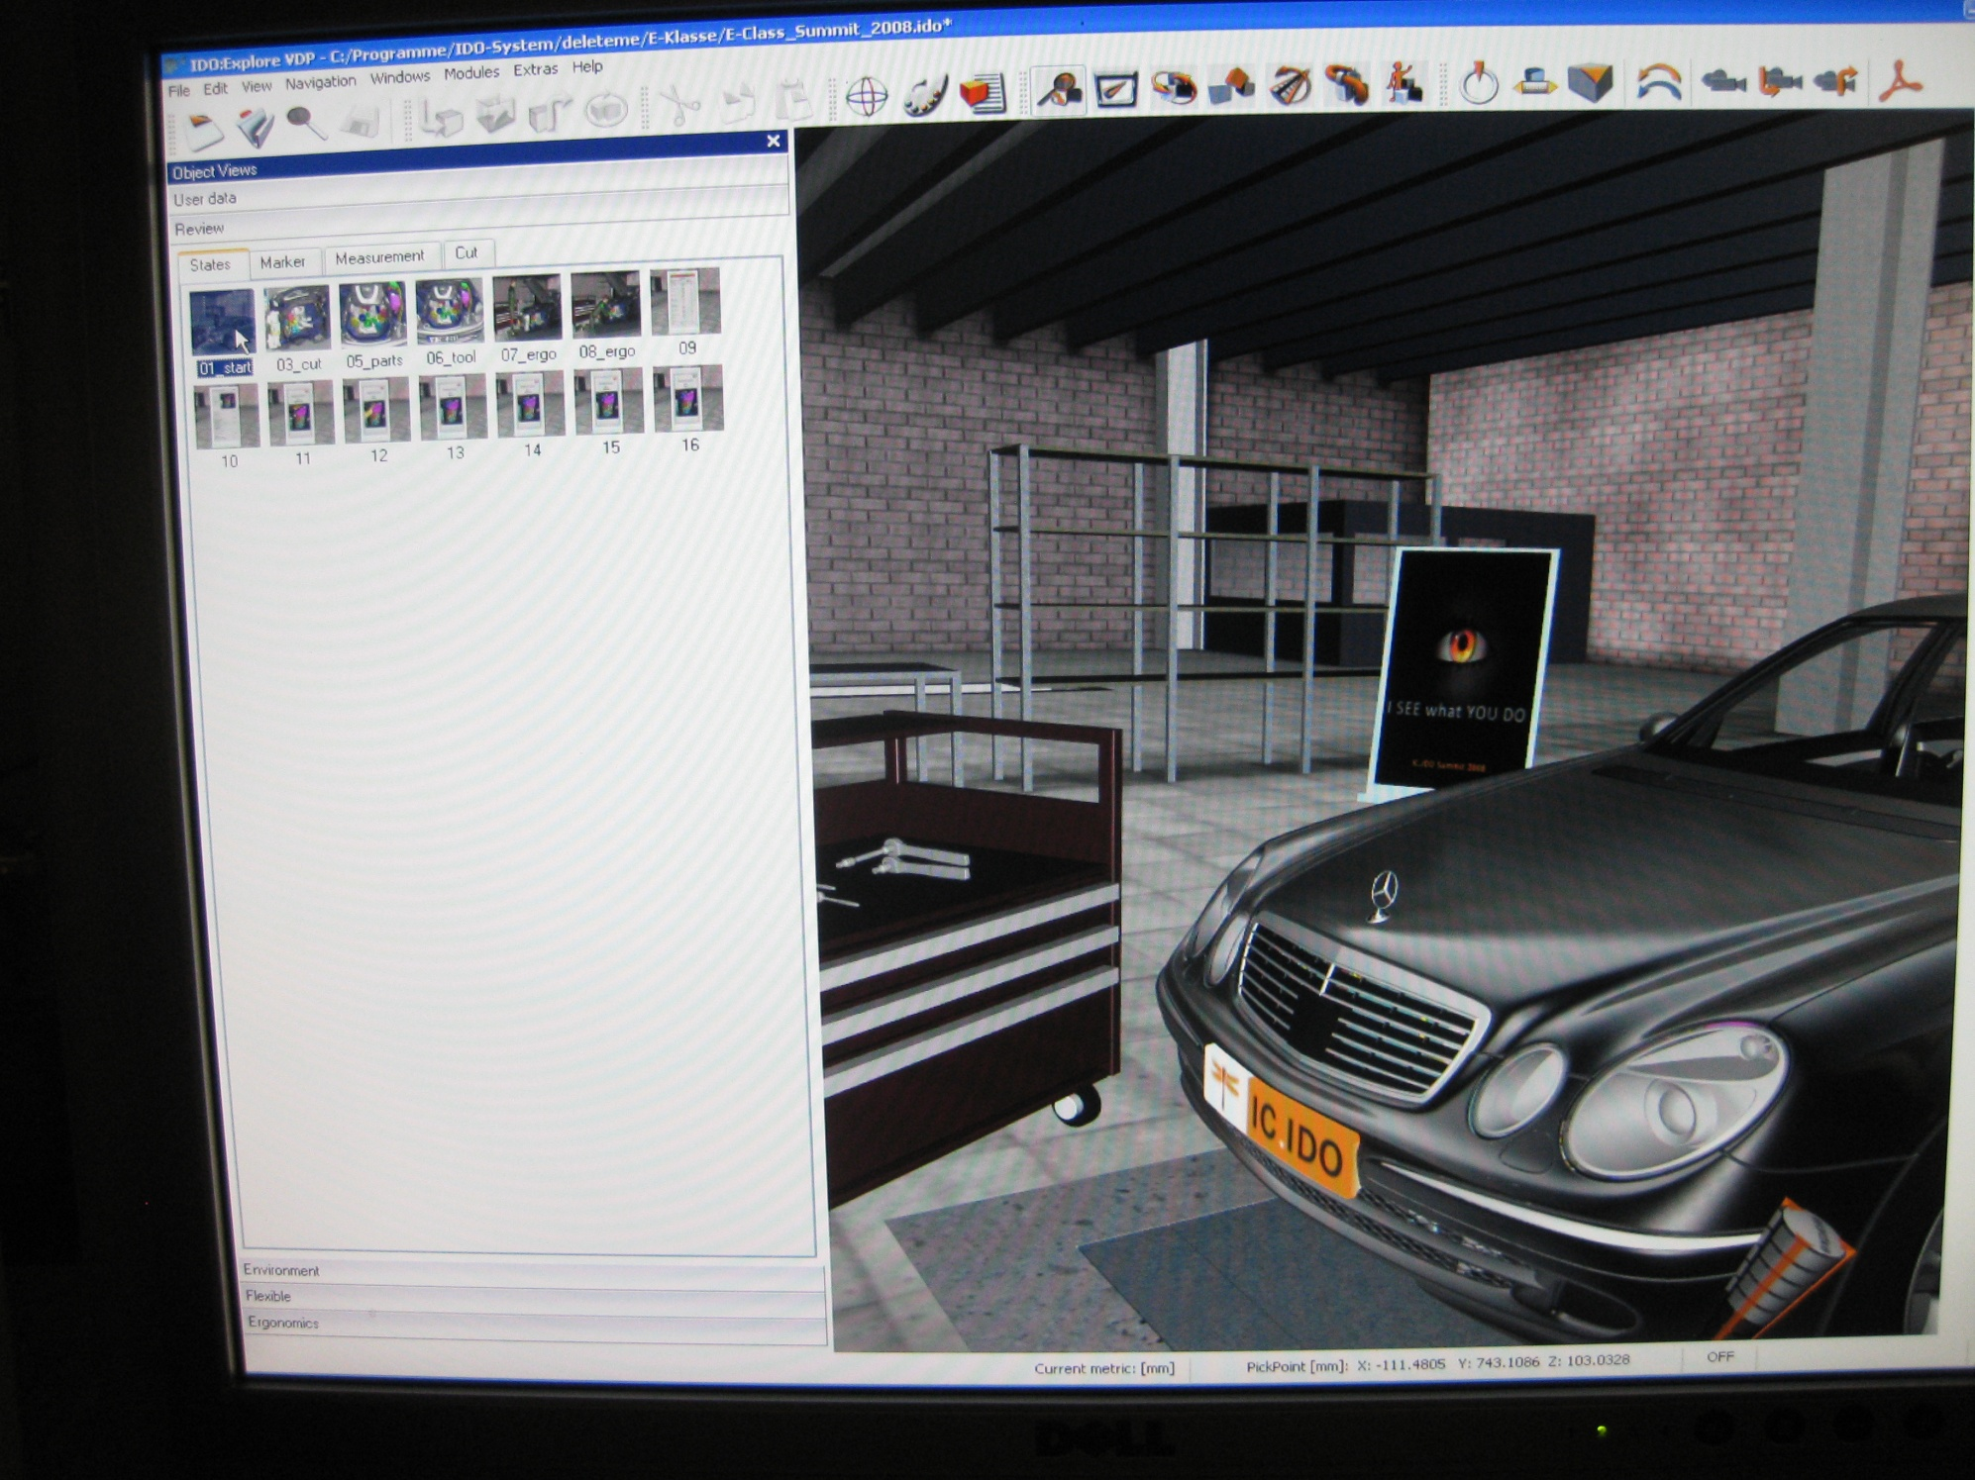

Intuition 2008 Exhibition
Notes:
Shots from the VR systems currently running downstairs.

Slide 5
Why Ray Tracing?
Rasterization becomes…
  Too complicated
  Inefficient
Ray tracing delivers…
  Accurate visual simulation
  Physically correct results
Ray tracing just works
  Simple, well understood algorithm
  No input data tweaking
Ray tracing is useful not only for rendering…
  Collision detection, object picking, etc.
Ray tracing is becoming faster
Ray tracing is becoming mainstream
  Support by hardware manufacturers
Notes:
It is all about Visual Simulation
* Users need to trust the results they see
* Accurate data instead of "nice pictures“
In industry people cannot afford to spend time
* Visual simulation need to work immediately
* Without tweaking
* Without a lot ot of work by the user
* RT is ideal for this.
Rasterization
* A lot of different algorithms
* Scenes need LOTS of tweaking
* Inefficient for accurate lighting simulation
Easy quality evaluation for RT rendered images

Slide 6
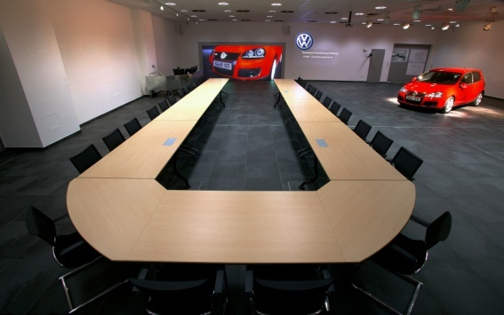
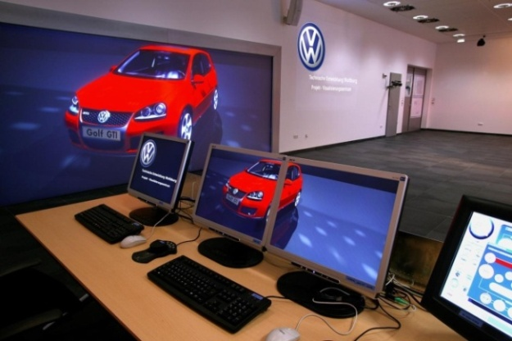
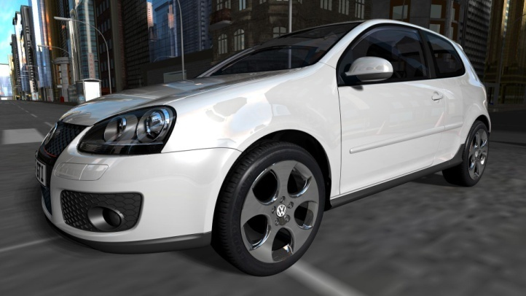
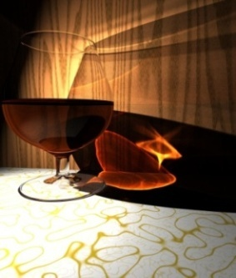
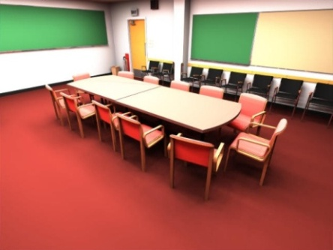
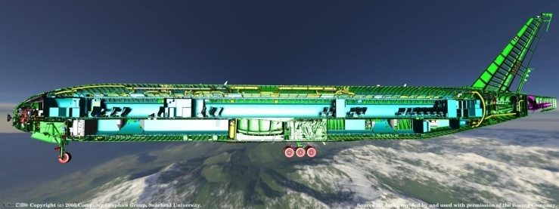
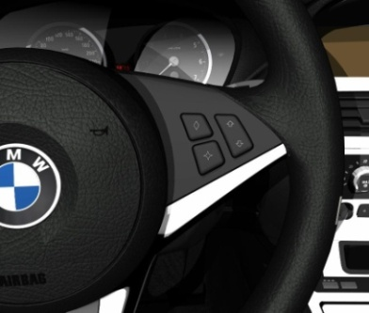
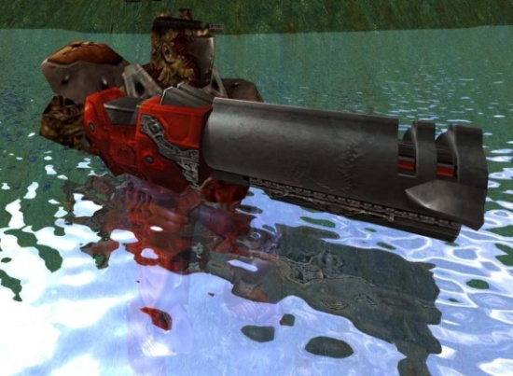
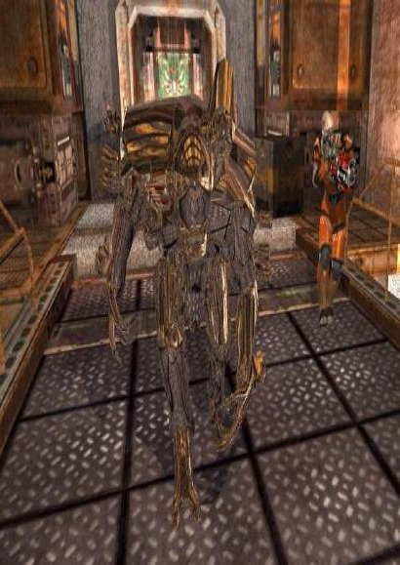
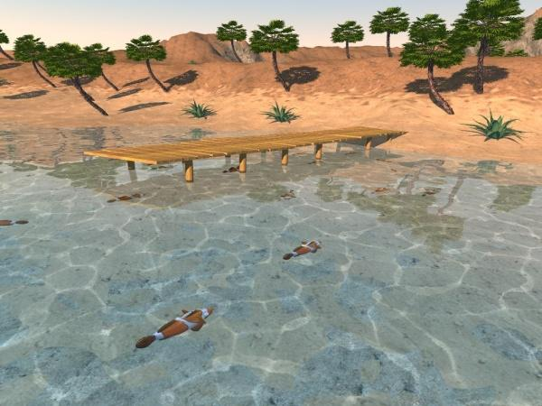
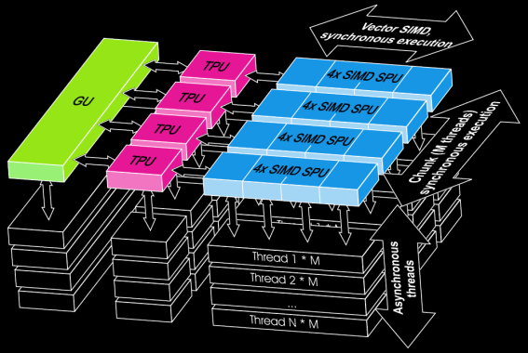
RTRT Achievements

Slide 7
RTRT Achievements
OpenRT in Industry
Notes:
At the top is the Visualization Center at Volkwagen, where decision makers across all ranks (up to the CEO) come to make "design reviews", where they use the virtual model to decide which version of a new design they will produce. This can save them big money.

Slide 8
RTRT Achievements
OpenRT in Industry
Notes:
An ever larger RT-VisCenter has been built at Airbus in Hamburg. Using RT this has been the first time they have been able to view an entire airplane at once -- and even with advanced lighting effects.

Slide 9
RTRT Achievements
OpenRT for Global Illumination

Slide 10
RTRT Achievements
OpenRT for Games

Slide 11
RTRT Achievements
DRPU – Hardware Prototype

Slide 12
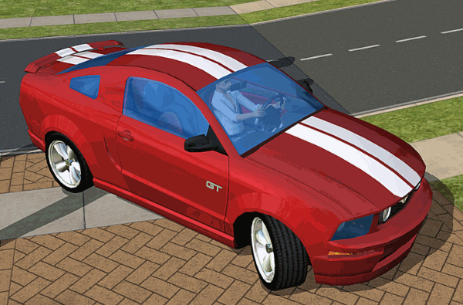
Rasterization Quality

Slide 13
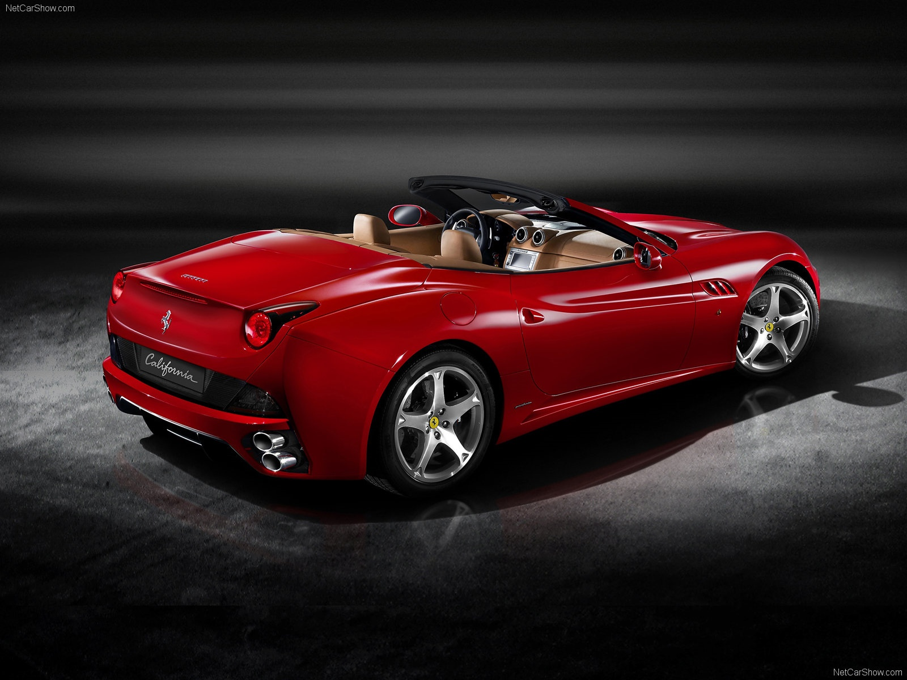
Ray Tracing Quality

Slide 14
Trends
Faster and more capable hardware
  Increasing parallelism
    Multiple cores
    SIMD
  Increasing programmability
    GPUs
    Larrabee
Consequences
  Trend towards software-based graphics
  Need fast and flexible software architectures!
Notes:
Revolution in terms of parallel processing power
Multiple cores
Data-parallel pipelines
Specialized hardware becoming more programmable
Converging to massively parallel general purpose accelerators
Larrabee – take best from both worlds
Parallel processing power
Feature rich instruction set
With all the processing power and programmability it becomes obvious
The trend towards software-based graphics
Need fast & flex software architectures

Slide 15
Flexibility vs. Performance
OpenRT
  Fixed, non-extensible API
    Could not adopt new technology
  Inefficient for highly dynamic scenes
Existing ray tracing systems
  Trade-offs between flexibility and performance
  Hand-coded low-level optimizations
  Object-oriented design
Ideally – both flexibility and performance
Notes:
Bad OpenRT
fixed config of algs and data struct
no new algorithms
no multi-core, SIMD
OOP bad for RTRT
* RT is versatile – no OOP tools
* RTRT requires maximum optimization

Slide 16
RTfact
Generic building blocks
  Composable at design/compile time
  Decouples of algorithms and data structures
  Not only for rendering
Compatible
  Uses existing tools
  Integrates with other software
Portable
Intuitive arbitrary-level abstractions
High performance
  Allows efficient code generation
Notes:
* Ray tracer prototyping library
* Provides the building blocks for creating custom ray tracing-based solutions
* NOT providing a complete rendering system (previous approaches have failed)*
* Employing generic programming paradigms (template programming),
* Flexibility of off-line rendering systems with the performance of modern ray tracing algorithms
* Separating the many different algorithms from each other AND from the concrete representation of the data
* Achieve seamless component integration and composability not previously seen in other RTRT systems.
* Separating the basic ray tracing functionality from the rendering
* Employ ray tracing not only for visualization, but also for many other VR tasks
* Tasks are collision detection and object interaction,
* Today are commonly implemented through with RT-like approaches but usually employ their own algorithms and data structures

Slide 17
RTfact
General Infrastructure
Rendering
Building
SIMD Primitives
Ray tracing
Scene management

Slide 18
RTfact
Example Application
PinholeCamera camera; // initialization omitted
OpenGLFrameBuffer fb; // initialization omitted
BasicScene<Triangle> scene; // initialization omitted
BVH<Triangle> tree;
BVHBuilder builder;
BVHIntersector<PlueckerTriangleIntersector> intersector;
RayTracingRenderer<PixelCenterSampler,
DirectIlluminationIntegrator> renderer;
builder.build(tree, scene.prim.begin(), scene.prim.end());
renderer.render<64>(scene, camera, fb, fb.getClipRegion(),
tree, intersector);

Slide 19
RTfact
Example Application
PinholeCamera camera; // initialization omitted
OpenGLFrameBuffer fb; // initialization omitted
BasicScene<Triangle> scene; // initialization omitted
BVH<Triangle> tree;
BVHBuilder builder;
BVHIntersector<PlueckerTriangleIntersector> intersector;
RayTracingRenderer<PixelCenterSampler,
DirectIlluminationIntegrator> renderer;
builder.build(tree, scene.prim.begin(), scene.prim.end());
renderer.render<64>(scene, camera, fb, fb.getClipRegion(),
tree, intersector);

Slide 20
RTfact
Example Application
PinholeCamera camera; // initialization omitted
OpenGLFrameBuffer fb; // initialization omitted
BasicScene<Triangle> scene; // initialization omitted
BVH<Triangle> tree;
BVHBuilder builder;
BVHIntersector<PlueckerTriangleIntersector> intersector;
RayTracingRenderer<PixelCenterSampler,
DirectIlluminationIntegrator> renderer;
builder.build(tree, scene.prim.begin(), scene.prim.end());
renderer.render<64>(scene, camera, fb, fb.getClipRegion(),
tree, intersector);

Slide 21
RTfact
Example Application
PinholeCamera camera; // initialization omitted
OpenGLFrameBuffer fb; // initialization omitted
BasicScene<Triangle> scene; // initialization omitted
BVH<Triangle> tree;
BVHBuilder builder;
BVHIntersector<PlueckerTriangleIntersector> intersector;
RayTracingRenderer<PixelCenterSampler,
DirectIlluminationIntegrator> renderer;
builder.build(tree, scene.prim.begin(), scene.prim.end());
renderer.render<64>(scene, camera, fb, fb.getClipRegion(),
tree, intersector);

Slide 22
RTfact
Example Application
PinholeCamera camera; // initialization omitted
OpenGLFrameBuffer fb; // initialization omitted
BasicScene<Triangle> scene; // initialization omitted
BVH<Triangle> tree;
BVHBuilder builder;
BVHIntersector<PlueckerTriangleIntersector> intersector;
RayTracingRenderer<PixelCenterSampler,
DirectIlluminationIntegrator> renderer;
builder.build(tree, scene.prim.begin(), scene.prim.end());
renderer.render<64>(scene, camera, fb, fb.getClipRegion(),
tree, intersector);

Slide 23
RTfact
Example Application
PinholeCamera camera; // initialization omitted
OpenGLFrameBuffer fb; // initialization omitted
BasicScene<Triangle> scene; // initialization omitted
BVH<Triangle> tree;
BVHBuilder builder;
BVHIntersector<PlueckerTriangleIntersector> intersector;
RayTracingRenderer<PixelCenterSampler,
DirectIlluminationIntegrator> renderer;
builder.build(tree, scene.prim.begin(), scene.prim.end());
renderer.render<64>(scene, camera, fb, fb.getClipRegion(),
tree, intersector);

Slide 24
RTfact
Example Application
PinholeCamera camera; // initialization omitted
OpenGLFrameBuffer fb; // initialization omitted
BasicScene<Triangle> scene; // initialization omitted
BVH<Triangle> tree;
BVHBuilder builder;
BVHIntersector<PlueckerTriangleIntersector> intersector;
RayTracingRenderer<PixelCenterSampler,
DirectIlluminationIntegrator> renderer;
builder.build(tree, scene.prim.begin(), scene.prim.end());
renderer.render<64>(scene, camera, fb, fb.getClipRegion(),
tree, intersector);

Slide 25
RTfact
Example Application
PinholeCamera camera; // initialization omitted
OpenGLFrameBuffer fb; // initialization omitted
BasicScene<Triangle> scene; // initialization omitted
BVH<Triangle> tree;
BVHBuilder builder;
BVHIntersector<PlueckerTriangleIntersector> intersector;
RayTracingRenderer<PixelCenterSampler,
DirectIlluminationIntegrator> renderer;
builder.build(tree, scene.prim.begin(), scene.prim.end());
renderer.render<64>(scene, camera, fb, fb.getClipRegion(),
tree, intersector);

Slide 26
RTfact
Example Application
PinholeCamera camera; // initialization omitted
OpenGLFrameBuffer fb; // initialization omitted
BasicScene<Point> scene; // initialization omitted
LoDKdTree<Point> tree;
LoDKdTreeBuilder builder;
LoDKdTreeIntersector<PointIntersector> intersector;
RayTracingRenderer<PixelCenterSampler,
LoDIntegrator> renderer;
builder.build(tree, scene.prim.begin(), scene.prim.end());
renderer.render<16>(scene, camera, fb, fb.getClipRegion(),
tree, intersector);

Slide 27
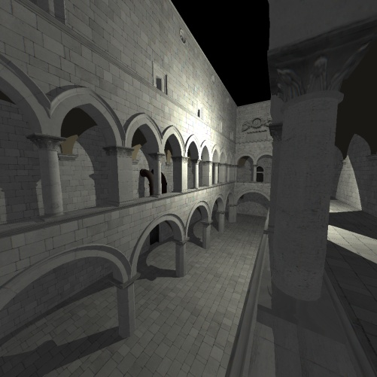
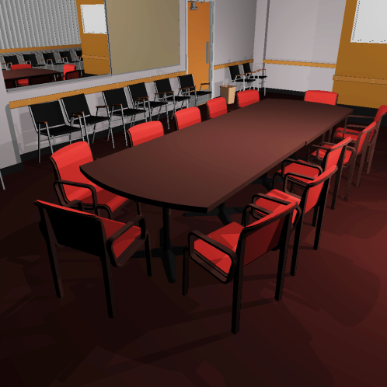
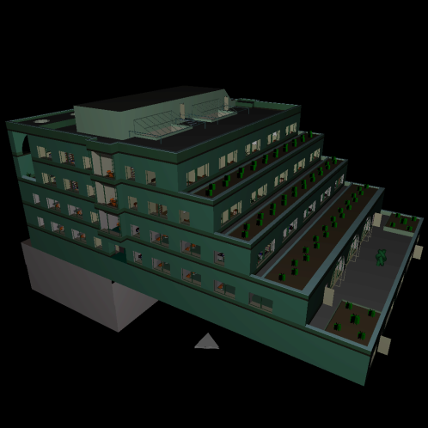
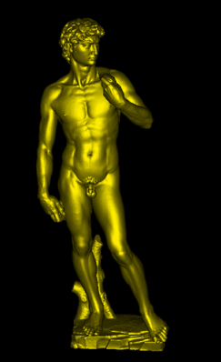
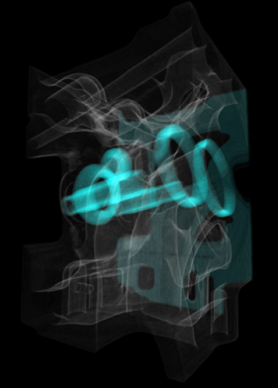
RTfact
Results
Sponza (76k tri)
Conference (280k tri)
Soda Hall (2.5M tri)
Packet kd-tree | Sponza | Conference | Soda Hall
OpenRT | 4.5 | 4.2 | 5.1
Manta | 4.7 | 4.2 | 5.4
RTfact | 6.8 | 6.4 | 6.5
Frustum BVH | Sponza | Conference | Soda Hall
DynBVH | N/A | 9.3 | 11.1
Manta | 4.5 | 4.8 | 5.6
Arauna | 13.2 | 11.3 | N/A
RTfact | 13.1 | 11.6 | 11.4
David
Engine

Slide 28
Scene Management
Existing Libraries
E.g. OpenInventor
  Deeply integrated with rasterization APIs
  Complete graph traversal each frame
Not efficient for ray tracing
  Optimized for rasterization-based rendering
  Need incremental scene updates

Slide 29
RTSG
Overview
VRML 2.0 compliant
  Full X3D support in progress
    CAD, animations, arbitrary shading, etc.
Extensible
Renderer independent
  Ray tracing
    RTfact, OpenRT
  Rasterization
    OGRE (OpenGL, DirectX)
  Incremental updates

Slide 30
RTSG
Usage
Application
RTSG
RTfact
OGRE
OpenRT
OpenGL
DirectX

Slide 31
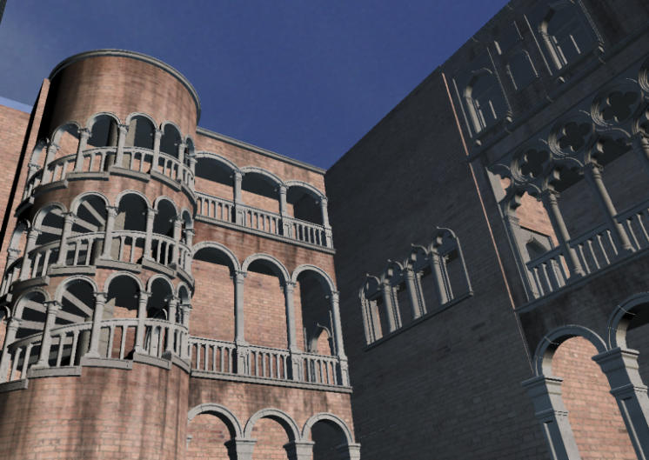
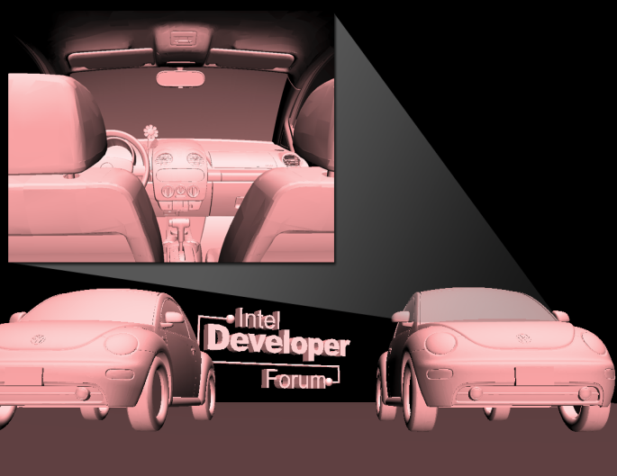
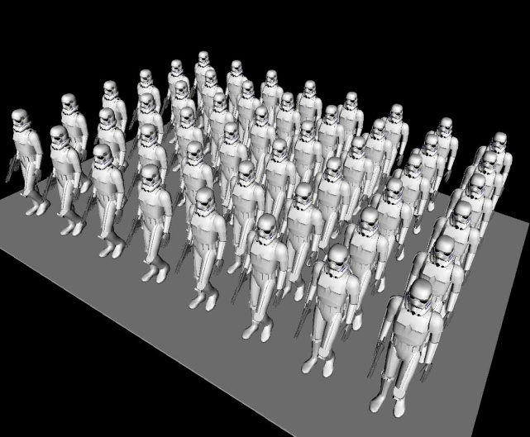
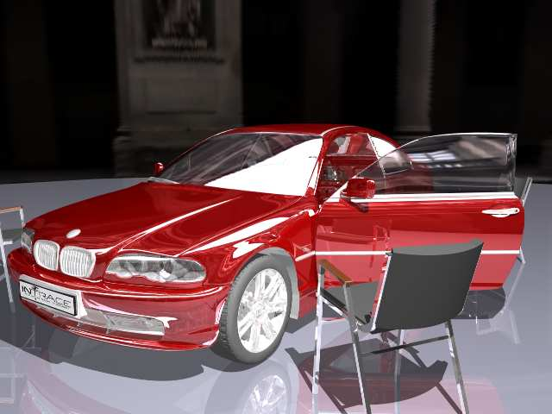
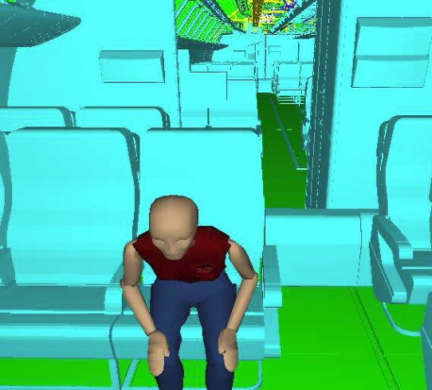
RTSG
Results
Venice (1M tri)
Beetles (2.7M tri)
Troopers (1M tri)
Performance (FPS)
 | Venice | Beetles | Troopers
BS Contact | 151.6 | 14.8 | 11.6
Flux Player | 24.7 | 30.4 | 9.2
InstantReality | (crashes) | 64.2 | 24.7
Octaga Player | 64.2 | 38.2 | 14.0
Xj3D | 123.4 | 26.8 | 27.2
RTSG-OGRE | 631.2 | 113.7 | 51.6
Boeing 777
(350M tri)
Notes:
Finally, argue that we are building a VR/AR system based on RTSG, which will include RT -- but is already the fastes VRML/X3D browser when using rasterization.

Slide 32
Wrap Up
Ray tracing will “always” be relevant
Hardware gets massively parallel and programmable
  Need flexible and fast software architectures
RTfact
  Generic and highly flexible
  Fast
RTSG
  VRML2.0 and X3D compliant
  Robust
Ray tracing based VR system in progress

