Slide 1
Measuring Properties of Molecular Surfaces Using
Ray Casting
Mike Phillips, Iliyan Georgiev, Anna Dehof, Stefan Nickels,
Lukas Marsalek, Hans-Peter Lenhof,
Andreas Hildebrandt, Philipp Slusallek

Slide 2
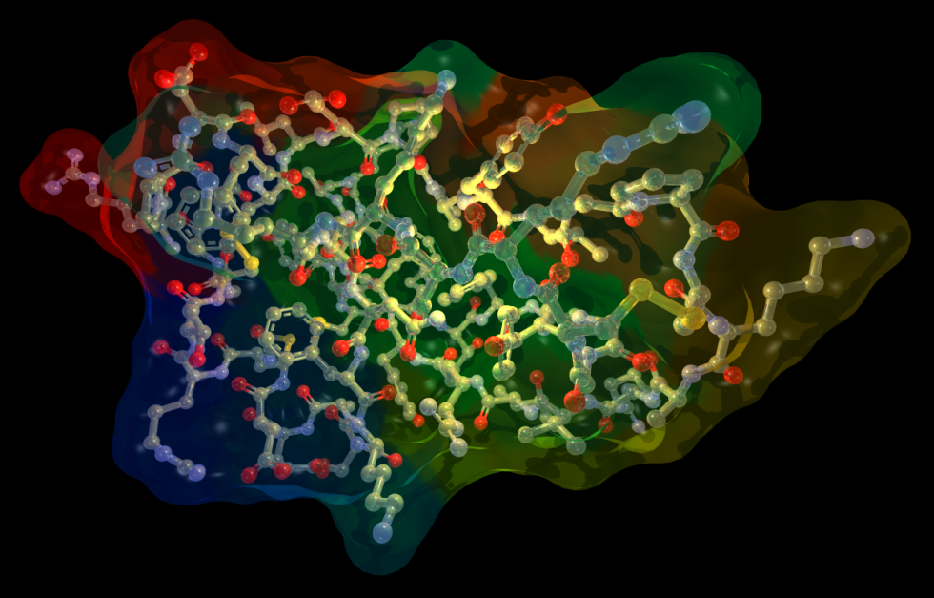
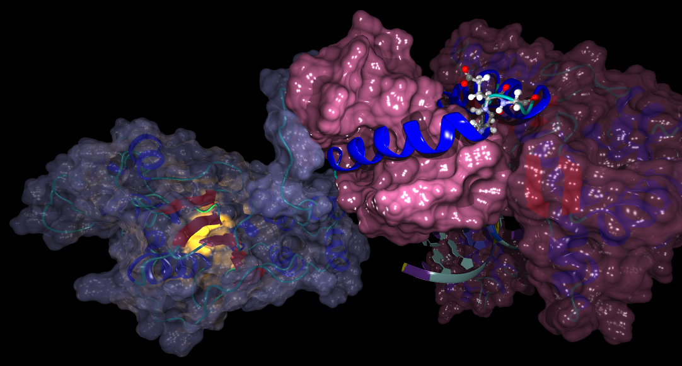
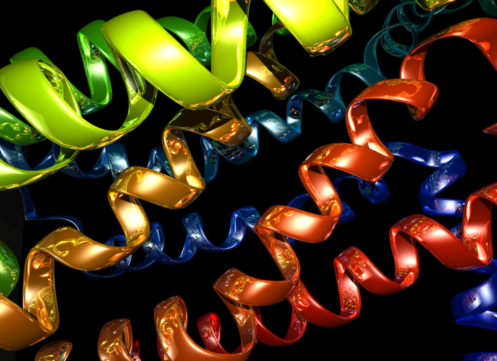
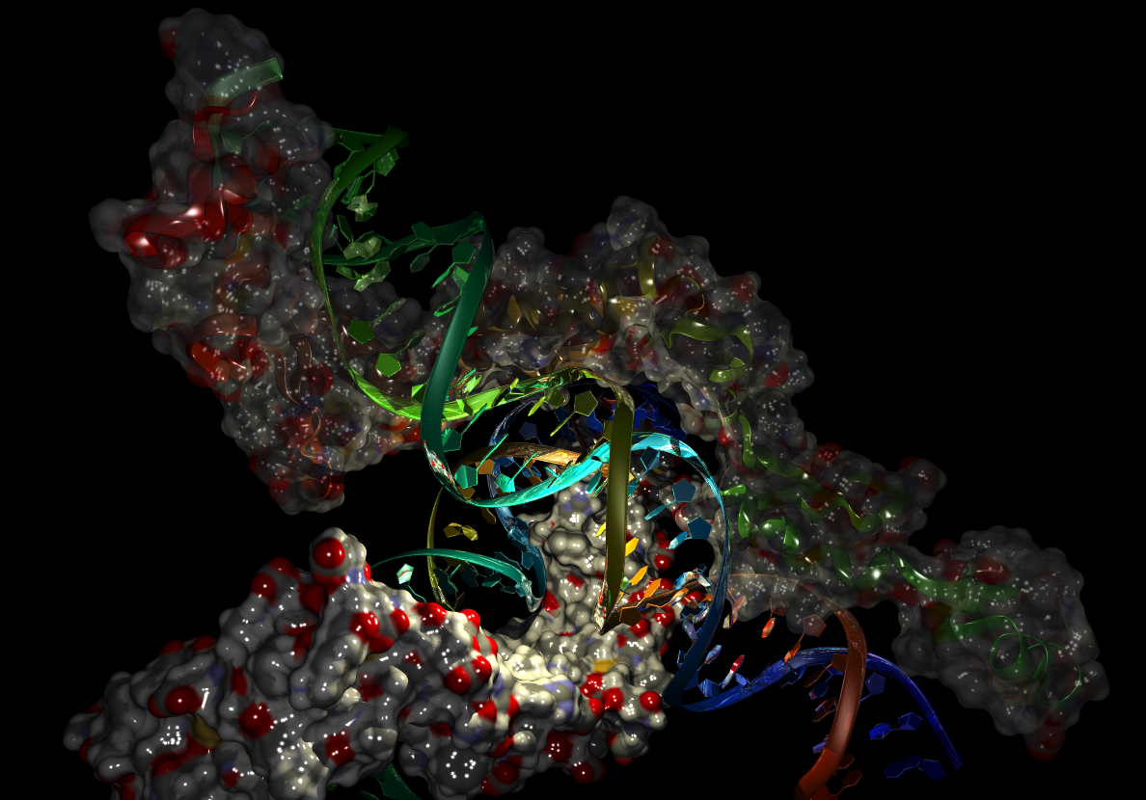
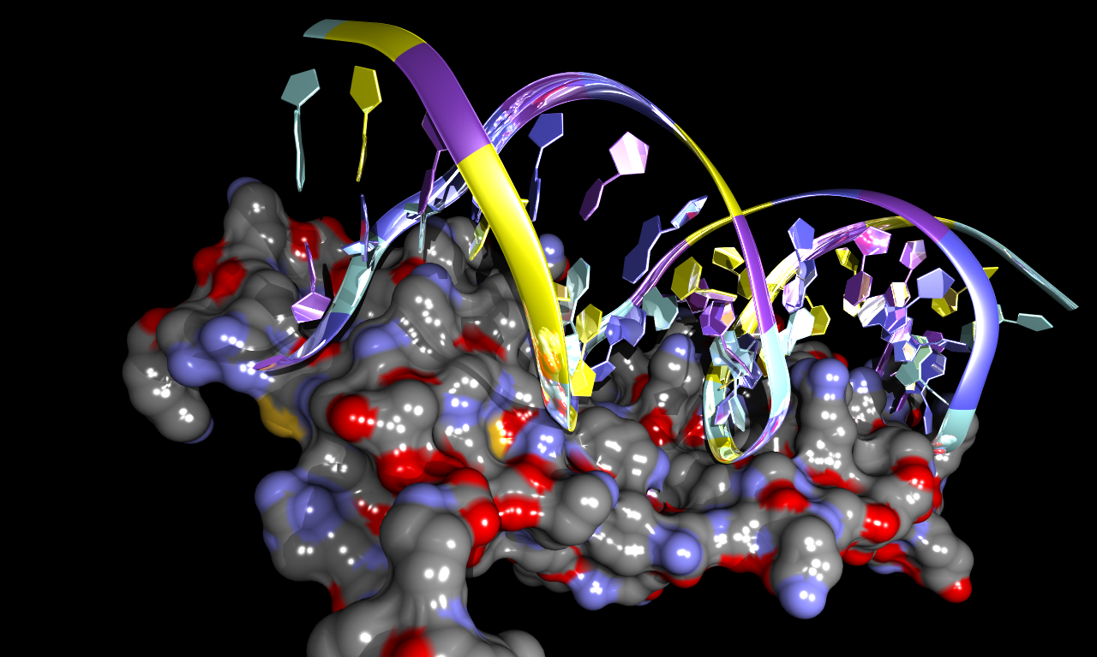
Ray Tracing
…in BALLView

Slide 3
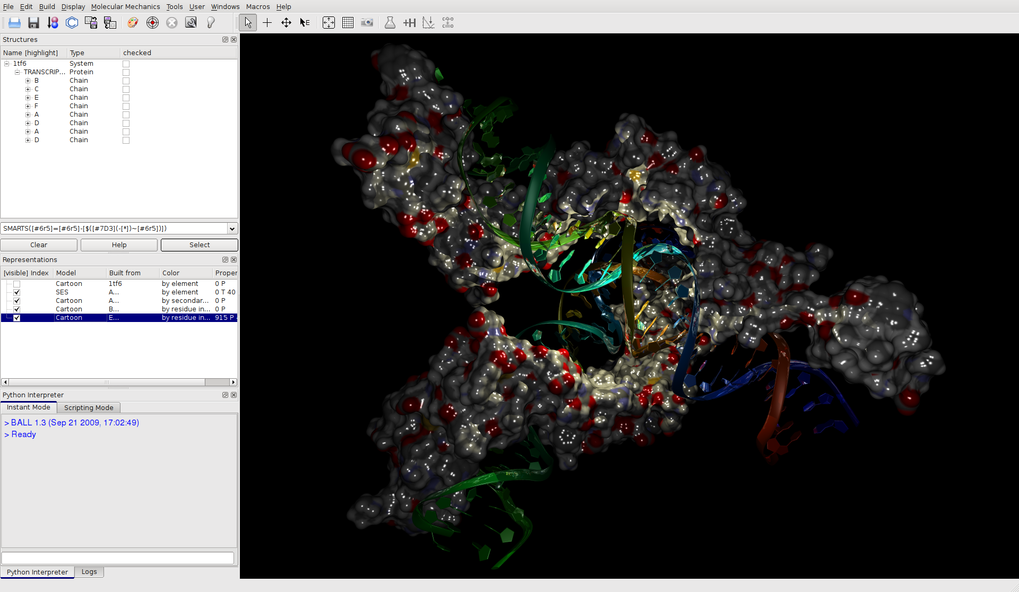

Slide 4
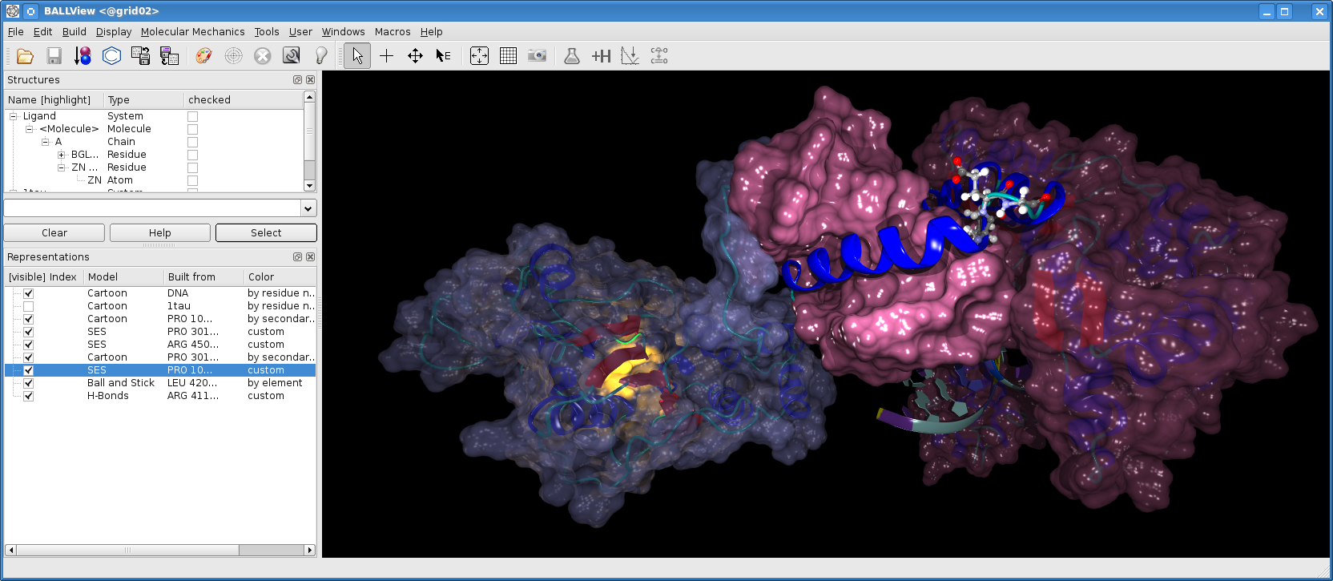

Slide 5
Ray Tracing
Basics

Slide 6
Ray Tracing
Basics
Check for intersection with an object
Find the closest intersection

Slide 7
Why Ray Tracing?
Just works
  Simple, well understood algorithm
  No input data tweaking
Delivers…
  Accurate visual simulation
  Physically correct results
Useful not only for rendering…
  Collision detection, object picking, measuring, etc.
Becoming fast
  Moore’s law
  Algorithms (parallelism)
  Real-time visual effects never possible before

Slide 8




Volume Estimation
Basic Idea
Three-dimensional integral
Split dimensions
Solve analytically
Solve numerically

Slide 9

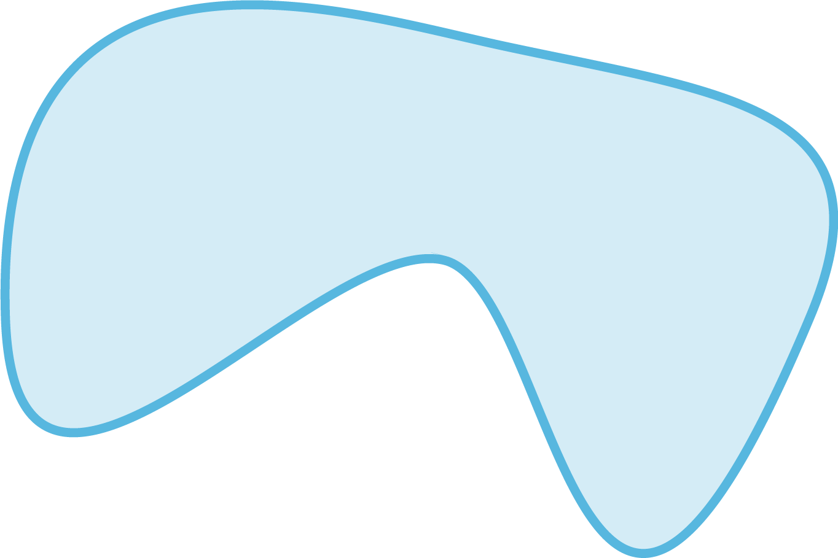





Volume Estimation
1D Integral
Observation
  is piecewise constant
  Analytic solution
Ray in space
Reformulate integral
ð

Slide 10

Volume Estimation
2D Integral
Numerical solution
A

Slide 11
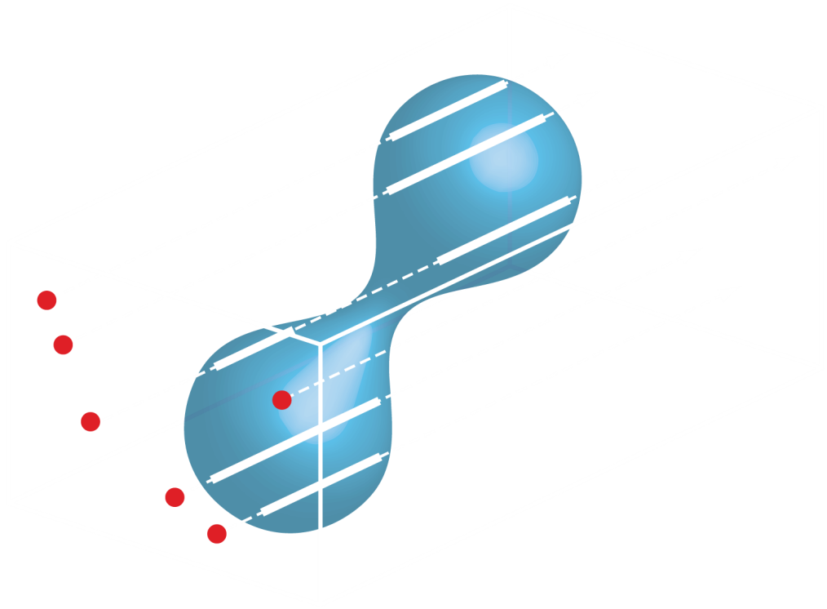
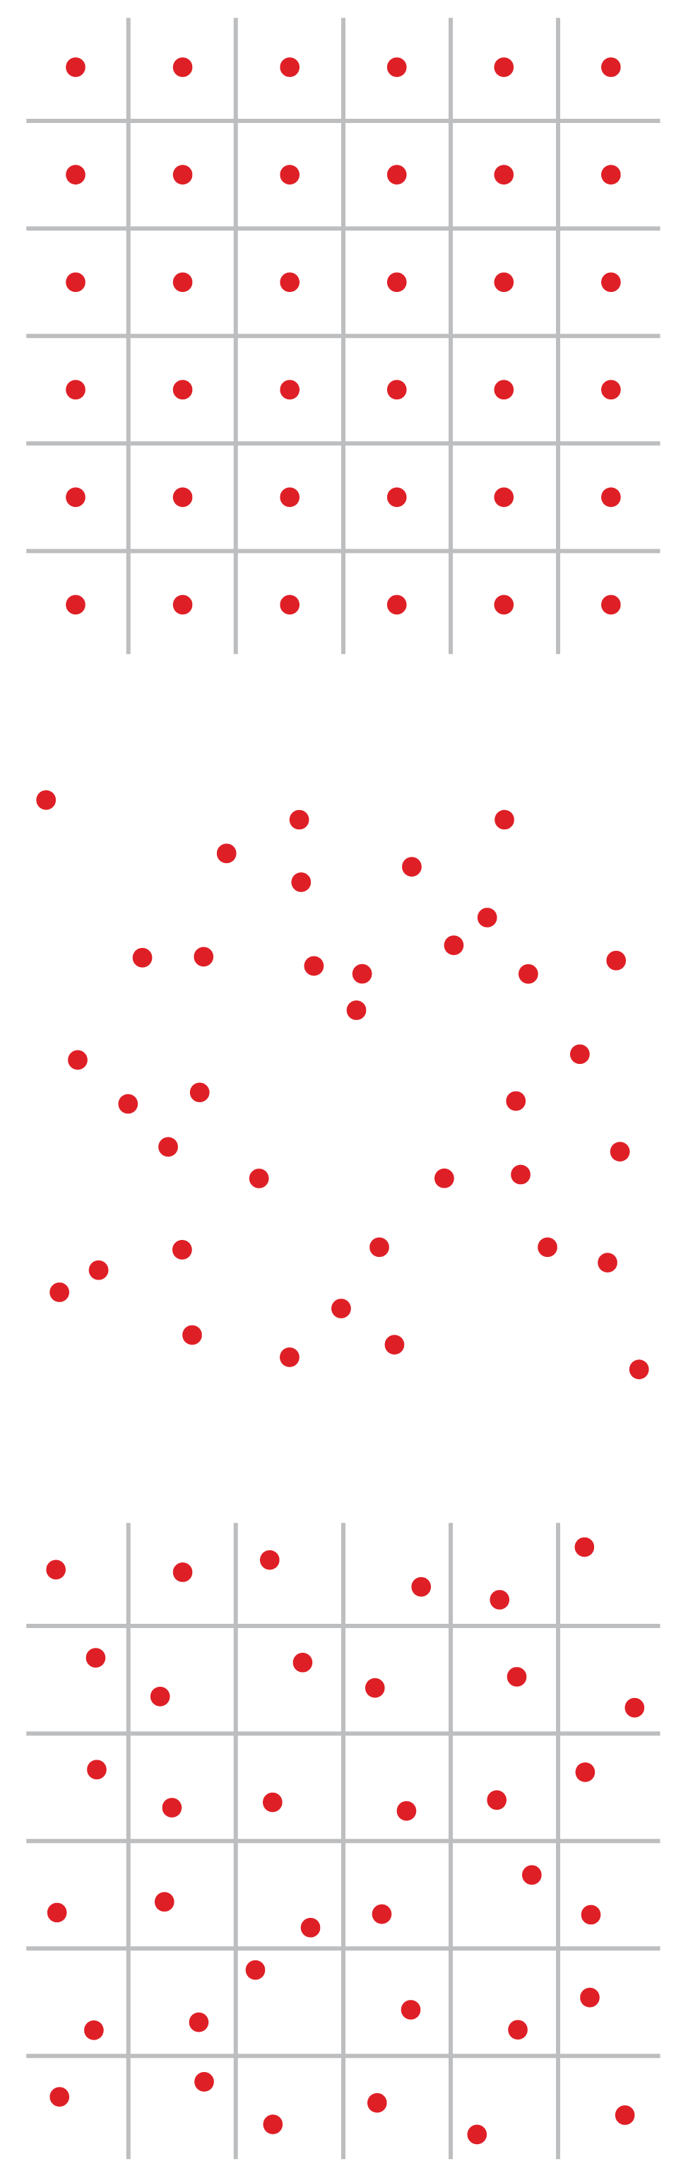
Volume Estimation
Ray Casting

Slide 12
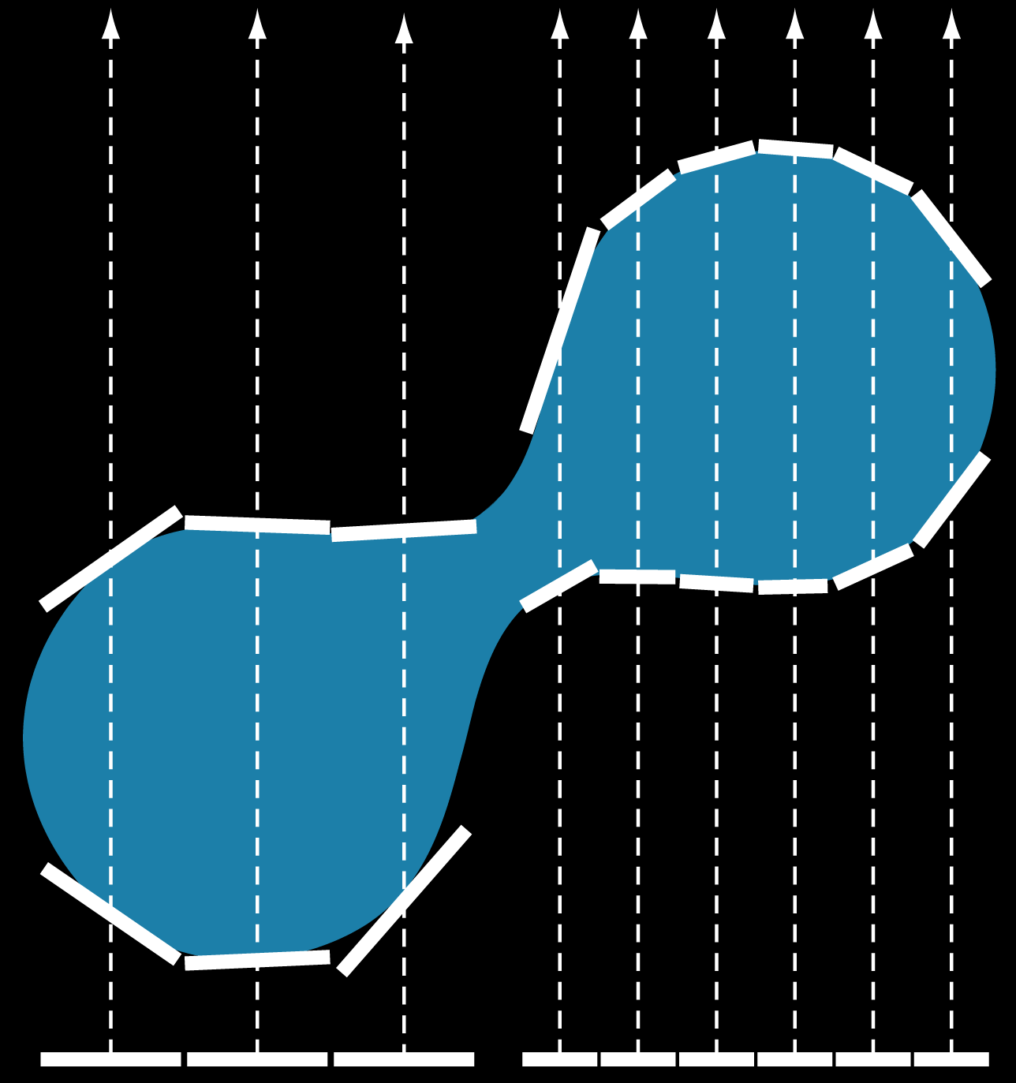


Surface Area Estimation
Numerical solution
  Piece-wise linear
  surface approximation
Need to clamp
when

Slide 13
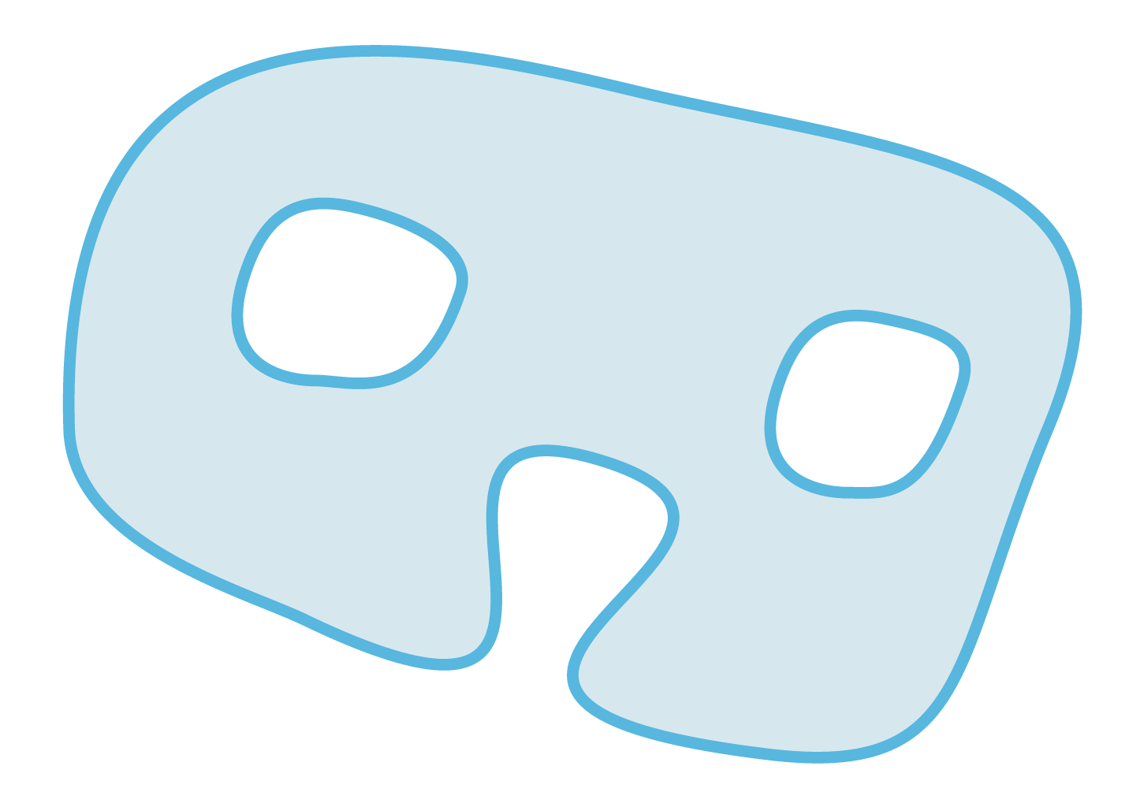
Cavity Detection
Object

Slide 14
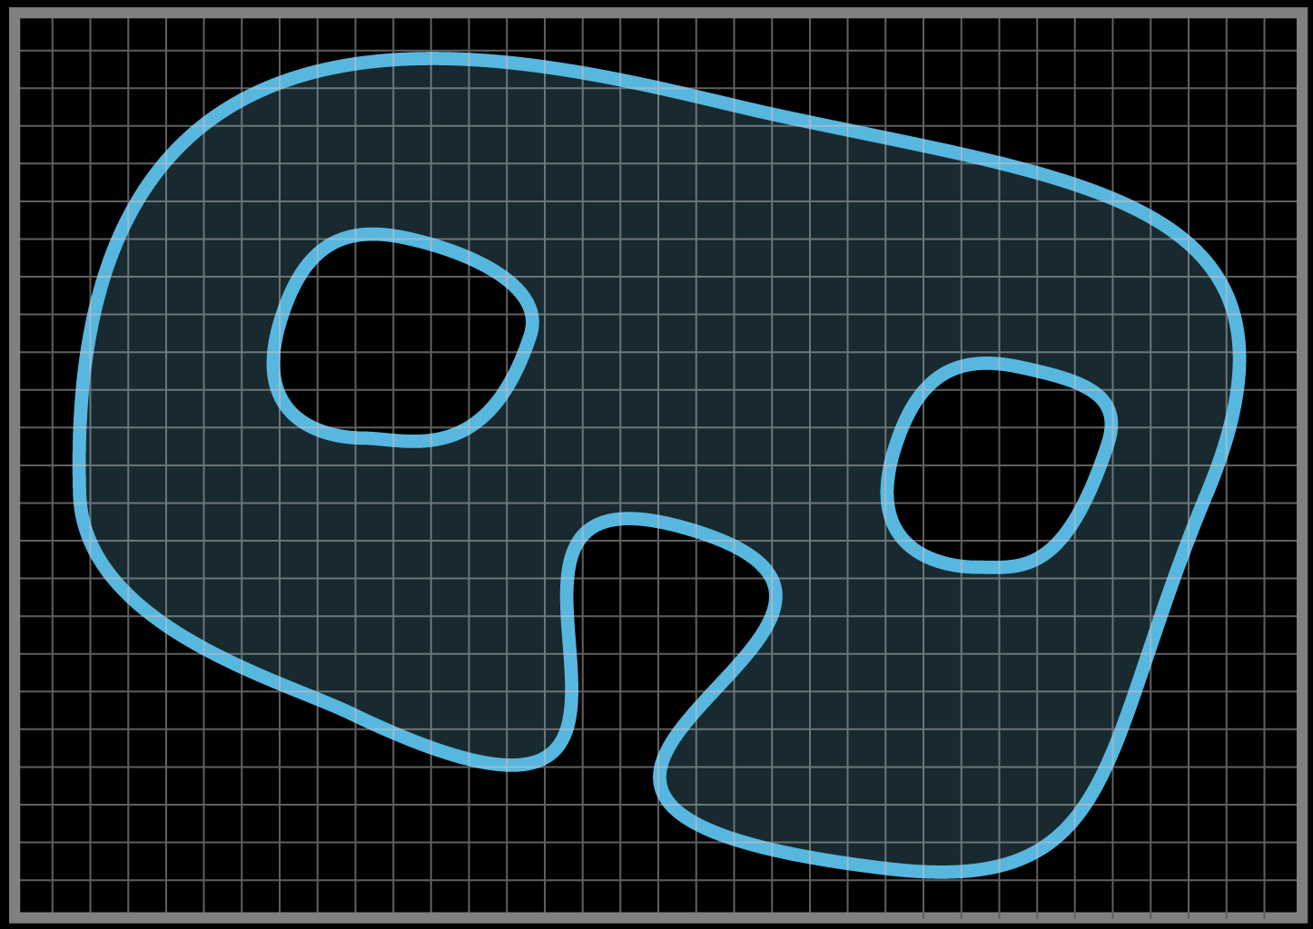
Cavity Detection
Grid Construction

Slide 15
Cavity Detection
Ray Casting

Slide 16
Cavity Detection
Grid Population

Slide 17
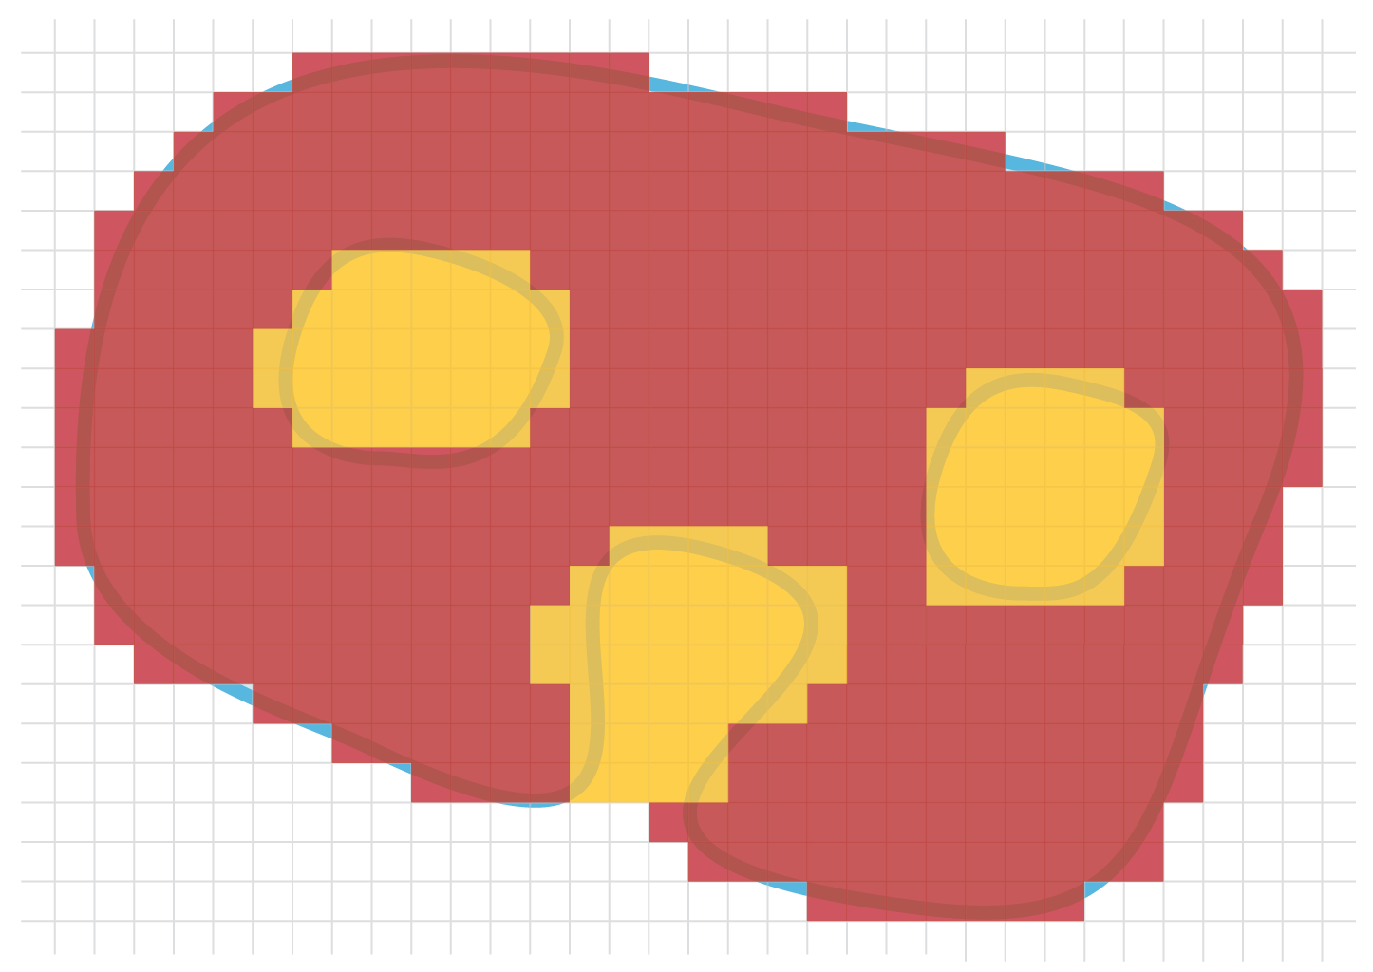
Cavity Detection
Grid Population

Slide 18
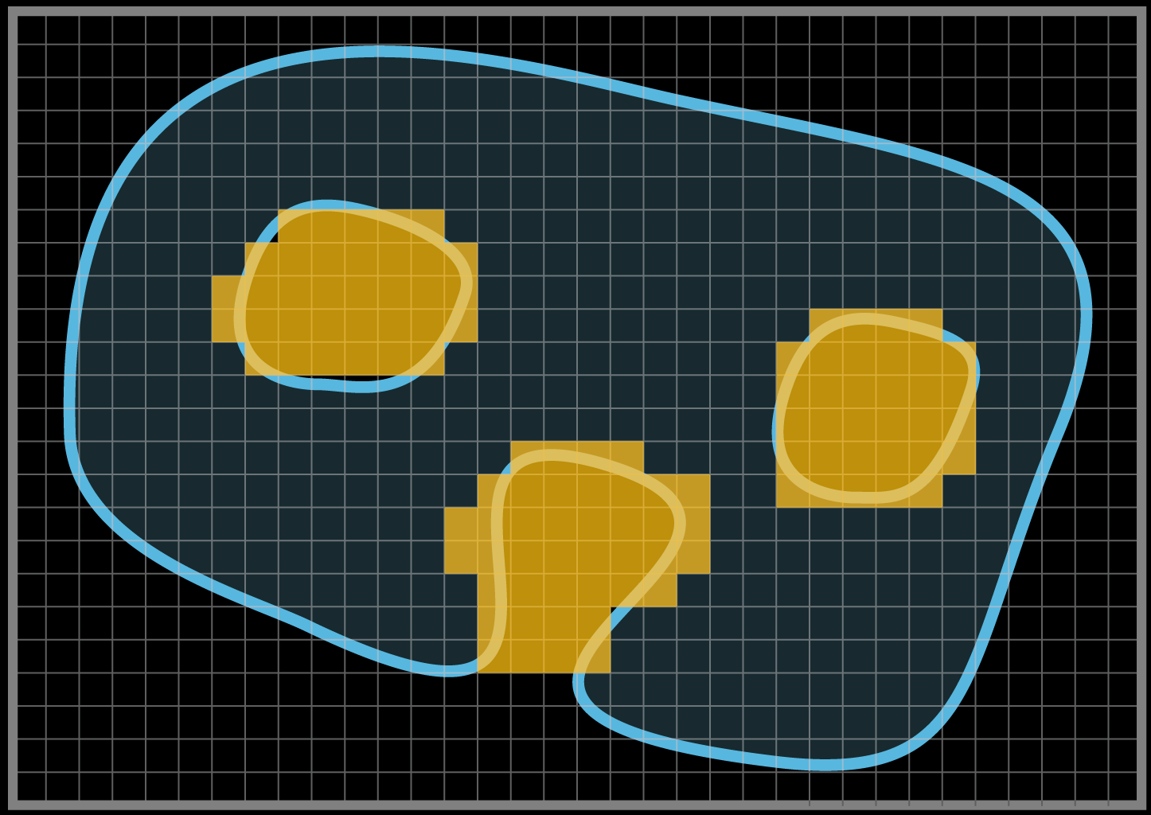
Cavity Detection
Cavity Isolation (Floodfill)

Slide 19
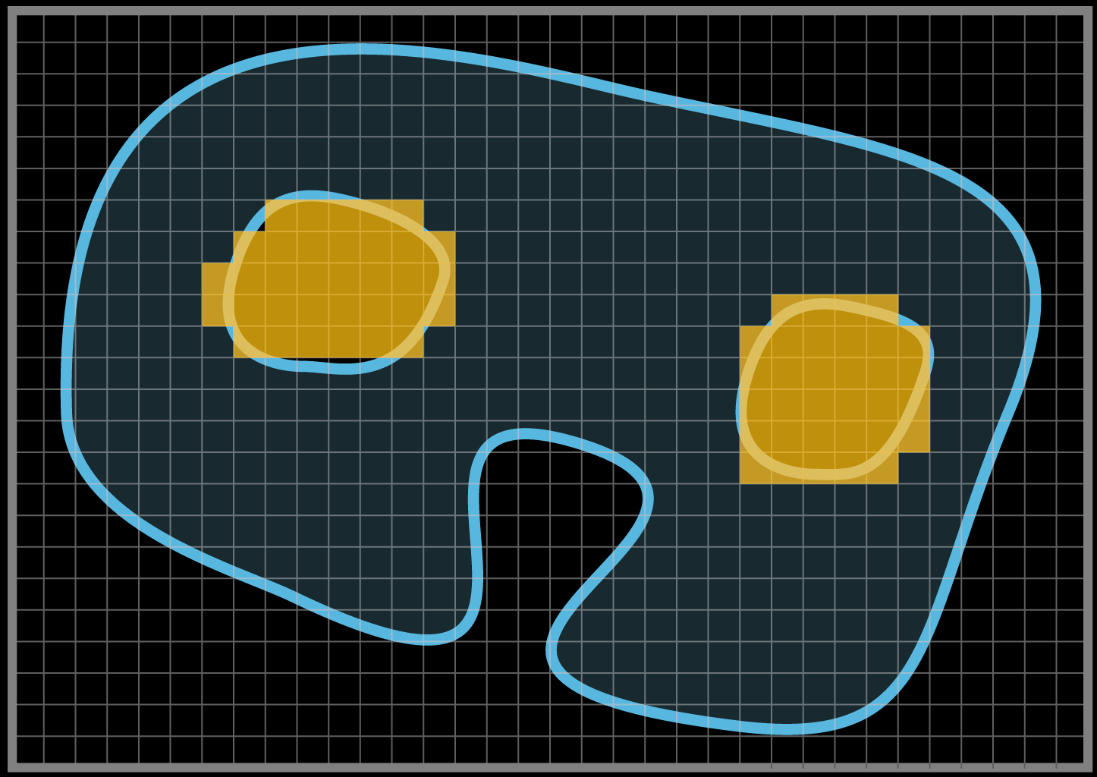
Cavity Detection
Cavity Isolation (Floodfill)

Slide 20
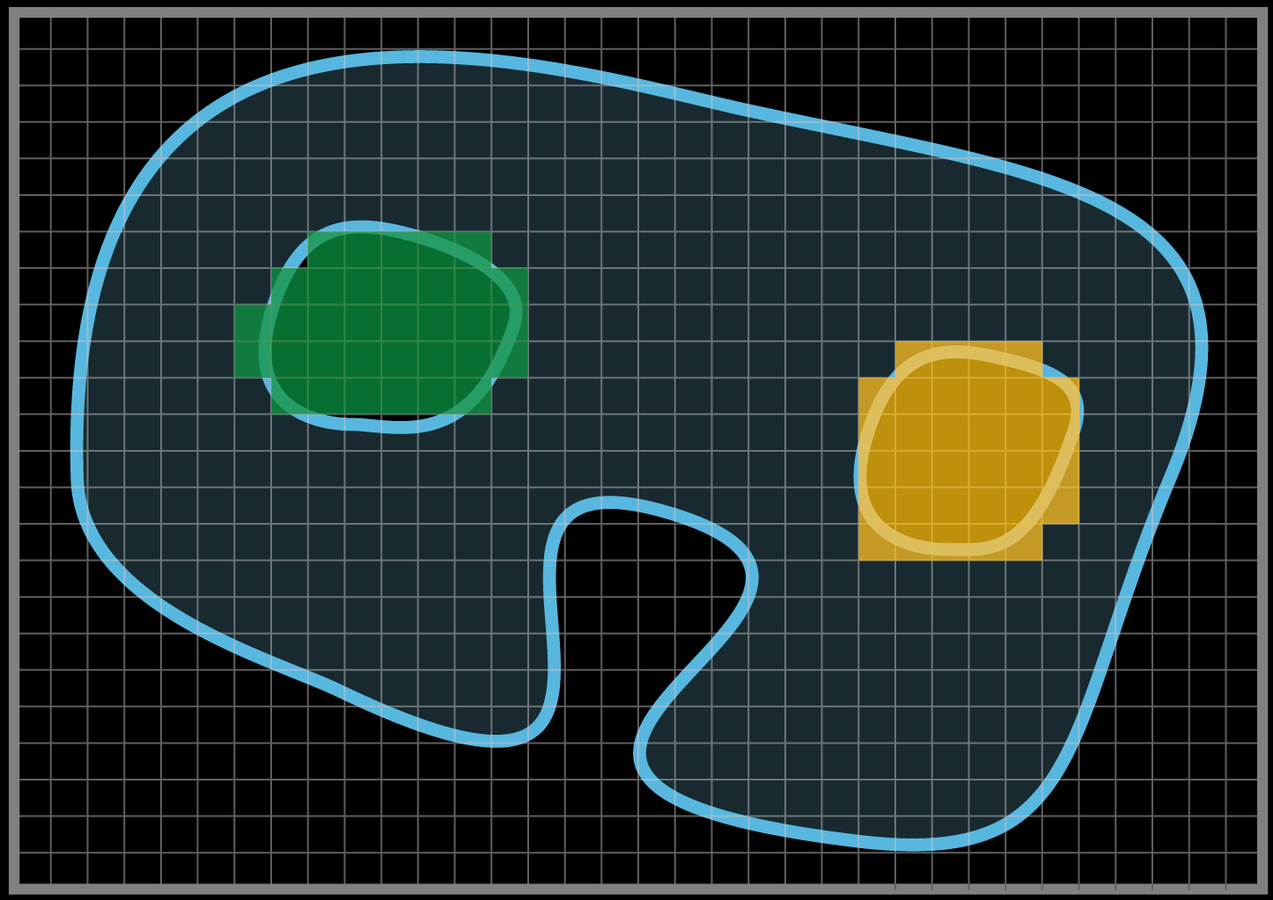
Cavity Detection
Cavity Enumeration (Floodfill)

Slide 21
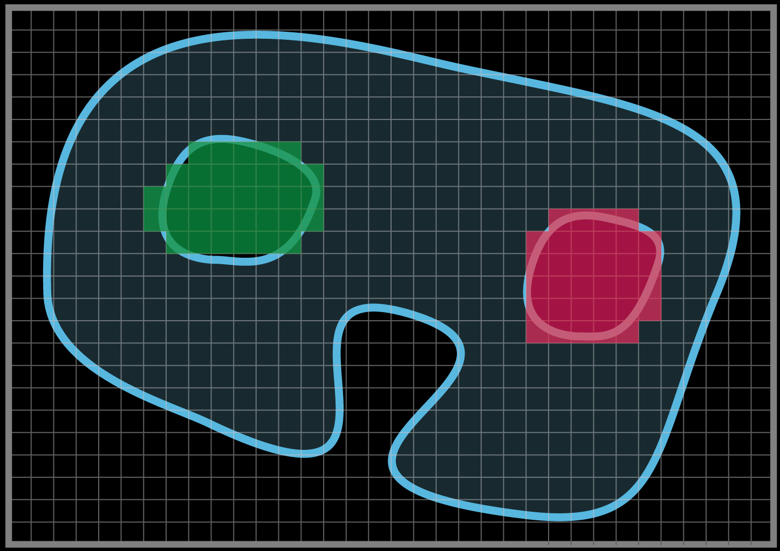
Cavity Detection
Cavity Enumeration (Floodfill)

Slide 22
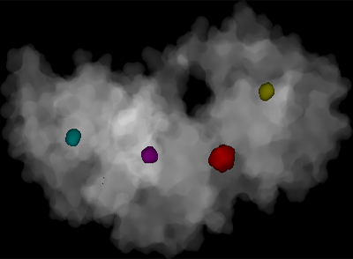
Cavity Detection
Real Example
1g2a molecule

Slide 23
Results
Volume Estimation
Close match to MSMS
Molecule | Volume | MSMS Diff. (%)
1ajs | 114,468 | 0.181
1rh0 | 121,438 | 0.079
1dys | 89,417 | 0.134
1hf0 | 49,202 | 0.376
1hf8 | 37,444 | 0.111
1gar | 52,562 | 0.000

Slide 24
Results
Surface Area (SA) & Cavities
Varying accuracy
  “Bad” triangulations
  Clamping
Molecule | Cavities | MSMS SA Diff. (%)
1g2a | 4 | 14.75
1qjp | 4 | 7.52
256l | 3 | 0.04
2ihl | 1 | 1.16
1ton | 4 | 14.70
1gar | 3 | 1.13

Slide 25
Performance & Extensions
Performance
  Just fast
    Can trace millions of rays/sec
    Presented results – only 40,000 rays!
  Byproduct of visualization
  Triangulation is the bottleneck
Completely generic approach
  Triangulation can be avoided altogether!
Different surface representations
  Analytic SES, skin surfaces, arbitrary implicits, …
Seamless integration in BALLView
  i.e. clipping regions

Slide 26
Iliyan Georgiev

