Slide 1
RTSG: Ray Tracing for X3D via a Flexible Rendering Framework
Dmitri Rubinstein^{1,2}, Iliyan Georgiev¹,
Benjamin Schug¹, Philipp Slusallek^{1,2}
¹ Saarland University, Germany
² DFKI Saarbrücken, Germany
Notes:
Hi. My name is Dmitri Rubinstein and I am a PhD-Student at the Saarland University and also I work at the German Research Center for Artificial Intelligence in the Agents and Simulated Reality Group.
I will present to you our RTSG system which allow to use X3D scene graph with a real-time ray tracing via a flexible rendering framework.

Slide 2
VRML / X3D Limitations
VRML/X3D
Widely adopted standards for interactive 3D content interchange
Designed around restricted functionality available in graphics hardware
Visual appearance model unchanged since VRML 1.0
User-defined shaders are limited to rasterization
Rasterization
Available on every PC
Fast
Producing photo-realistic effects is quite hard
Ray tracing
Accurate visual simulation and physically correct results
Simple, well understood algorithm
Slow — in the past
But becoming faster and mainstream
RTfact and OpenRT real-time ray tracers from Saarland University
NVIDIA NVIRT with CUDA on commodity graphics cards
Intel’s ray tracer on Larrabee
Notes:
First about how fits ray tracing into VRML and X3D standards.
VRML and X3D are widely adopted for interactive 3D content interchange.
However the original VRML standard was designed around restricted functionality available in graphics hardware at that time.
Additionally visual appearance model was unchanged since VRML 1.0 and user-defined shaders added in X3D are limited to rasterization and even to the specific shading language either Cg, HLSL or GLSL.
The advantage of rasterization is that it is now available on every PC and is fast.
But producing photo-realistic effects is quite hard and require a lot of tweaking like multi-pass rendering.
At the other side there is a well known ray tracing algorithm which allow accurate visual simulation and produces physically correct results.
Also ray tracing is very simple and well understood algorithm.
However it was used in the past only for offline rendering as it was slow.
But with the great improvements in the hardware technology in the past decade as well as the research done at our University, by NVIDIA and Intel ray tracing is now fast enough for real-time rendering.

Slide 3
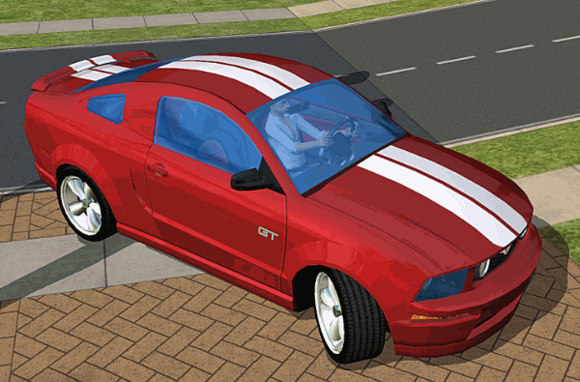
Rasterization
Notes:
Let’s see what is the visual difference between rasterization and ray tracing.
We can see at this picture typical rasterization result and it does not looking very realistic.

Slide 4
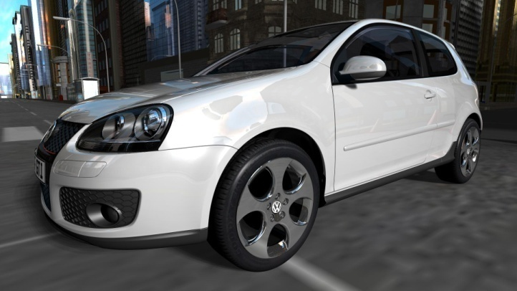
Ray Tracing
Notes:
With ray tracing we get a picture which looking much more realistic and also show effects like reflection and refraction. And this is without any additional effort like multi-pass rendering.

Slide 5
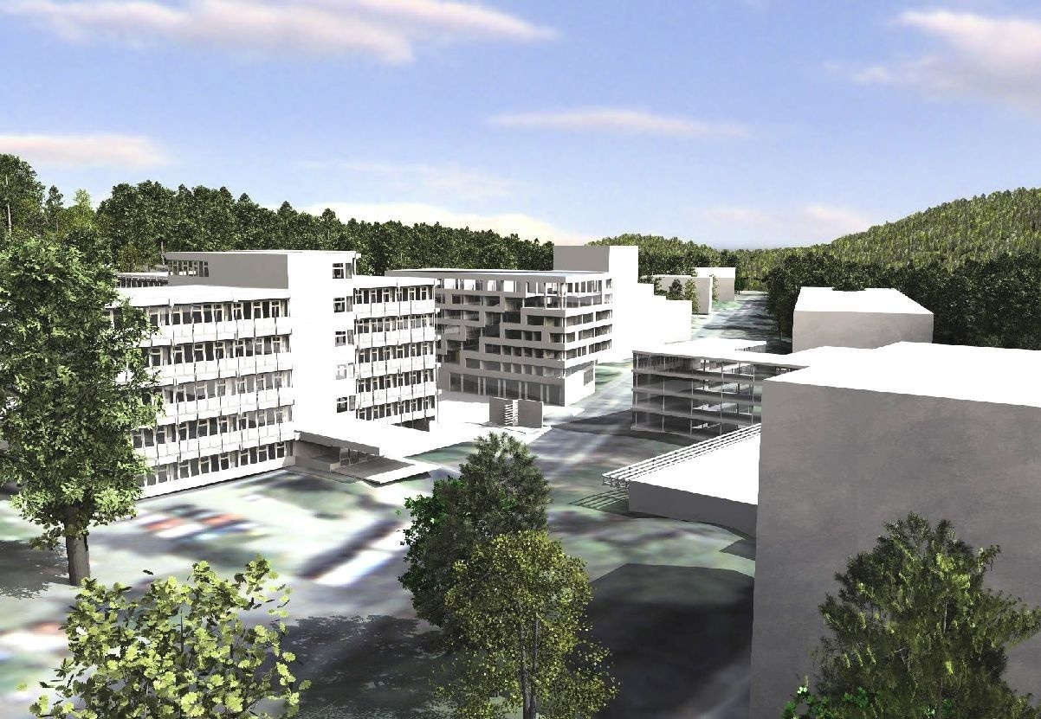
Ray Tracing
Notes:
Also ray tracing is well suited for large scenes like this one, and it is a model of a campus of the Saarland university.

Slide 6
Rasterization for X3D
X3D is often implemented by using rasterization-based scene graph libraries
OpenInventor
Performer
OpenSG
OpenSceneGraph
Rasterization-based rendering pipeline is used
APP – execute application logic
CULL – prepare all potentially visible geometry for rendering
DRAW – visualize visible geometry
Notes:
In order to understand our way of ray tracing integration into X3D system let’s speak first in which way X3D system is typically implemented.
Often it is done by using rasterization-based scene graph libraries like OpenInventor, Performer, OpenSG or OpenSceneGraph.
This means also that the APP-CULL-DRAW rasterization rendering pipeline with a fixed order of the execution of the application logic, culling and drawing steps is used.

Slide 7
Rasterization for X3D
APP-CULL-DRAW pipeline was designed for immediate drawing mode
Scene state is stored in main memory
Full scene state is sent every frame to the graphics card
Full scene graph traversal is required every frame even for minimal changes
Current graphics hardware operates in retained mode
Scene state is partially or fully stored in GPU memory
Only changes in the scene state are sent in every frame to the graphics card
Full scene graph traversal produces overhead
Notes:
But this pipeline was designed for immediate drawing mode where scene state is completely stored in the main memory and sent every frame to the graphics card.
In order to do this, full scene graph traversal is required every frame, even for minimal changes.
But current graphics hardware does not more operates primarily in this mode.
Scene state is partially or fully stored in the GPU memory and only changes in the scene state are sent in every frame to the graphics card.
This also means that full scene graph traversal produces overhead.

Slide 8
Ray Tracing for X3D
Ray Tracing operates in retained mode
Full scene state is sent once and stored in a ray tracer
Incremental updates every frame
Full scene graph traversal produces overhead
Notes:
This property is also true for ray tracing as it also operates in a retained mode.
Normally full scene state is sent once and is stored in a ray tracer.
And every frame only incremental updates are sent.
This means that for a ray tracing full scene graph traversal will produce overhead too.

Slide 9
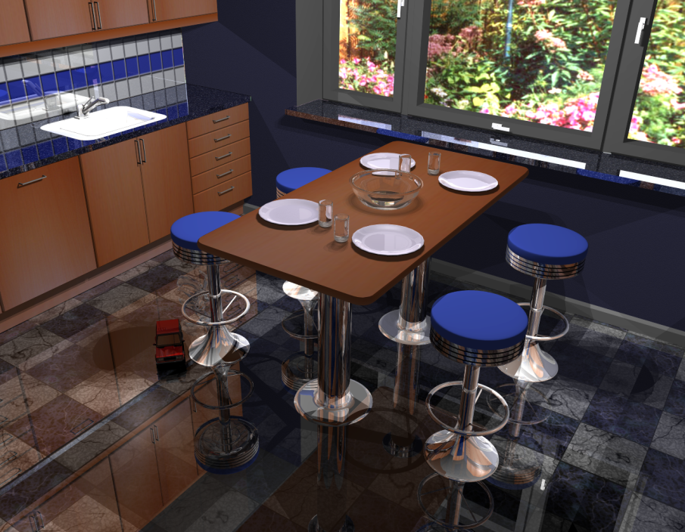
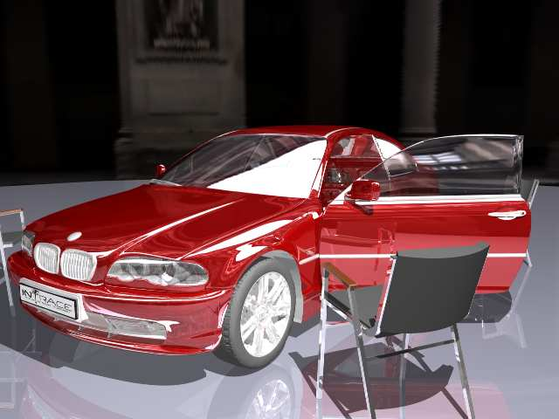
RTSG – Real Time Scene Graph
Scene graph library supporting VRML/X3D scene graphs
Designed with emphasis on real-time ray tracing rendering techniques
Independent of rendering backend
Notes:
Now about our system RTSG. RTSG means Real-Time Scene Graph.
And it is a scene graph library supporting VRML and X3D scene graphs.
It was designed with an emphasis on real-time ray tracing rendering techniques but it is also independent of the rendering backend.

Slide 10
RTSG
Overview
Application
RTSG
Core Library
VRML/X3D Node Set
Node Set Library
RTSG/RTfact
Rendering Library
RTSG/OGRE
Rendering Library
RTSG/OpenRT
Rendering Library
RTfact
Ray Tracing API
OGRE
Rasterization Scene Graph
OpenRT
Ray Tracing API
OpenGL
Rasterization API
DirectX
Rasterization API
Notes:
At this slide is a brief overview of RTSG components.
RTSG was designed to be modular, independent of the rendering backend and for optimal speed.
Application uses RTSG core and specific nodes from VRML/X3D node set library to describe the scene.
Independently, it creates, configures and attaches one or more renderers to the scene that read the nodes’ data and render it to a device or memory buffer.
Every RTSG rendering library use specific rendering framework which perform the actual rendering.

Slide 11
RTSG
Overview
RTSG Core
X3D Concepts (scene graph, nodes, fields, ROUTEs, etc.)
X3D Core Component
I/O infrastructure
C++ API for SAI
VRML/X3D Node Set
Node class hierarchy
Rendering independent
Rendering Libraries
Ray tracing
RTfact, OpenRT
Rasterization
OGRE (OpenGL, DirectX)
Notes:
Now in more detail.
The main component of our system is the RTSG core library.
It only implements basic X3D concepts like scene graph, nodes, field and ROUTEs.
Also X3D core component, input/output infrastructure and C++ API for Scene Access Interface are implemented in the core library.
All VRML/X3D nodes are in a separate library which has a node class hierarchy and is independent of the rendering subsystem.
For rendering we provide rendering libraries which visualize scene graph.
Currently we have two rendering backends for ray tracing one for our old OpenRT real-time ray tracer and another for Rtfact which is our new ray tracing system.
And also we have one rasterization backend which uses OGRE rendering engine.

Slide 12
Rendering with RTSG
APP-CULL-DRAW pipeline often not efficient for retained mode
CULL is useless for ray tracing
Avoid full scene graph traversal for updating small changes
Implementing multiple renderers
Single dispatch does not scale:
Double dispatch need to be used (OpenInventor)
class MyNode : public X3DNode {
public:
virtual void renderOpenGL();
virtual void renderRayTracing();
};
Notes:
Now let me explain how the rendering works in RTSG.
As I already mentioned the traditional rendering pipeline is often not efficient for retained mode.
Especially CULL step is useless for ray tracing and we want to avoid full scene graph traversal for updating small changes or changes which are not influenced by the transformation hierarchy like material changes.
Implementing of multiple rendering backends is also not easy.
The single dispatch approach where every node class has a virtual function render does not scale as one need to modify every node class in order to implement new rendering backend.
Our solution uses double dispatch technique which is similar to the one used in OpenInventor.
I will explain this feature in detail later.

Slide 13
Rendering with RTSG
EXTRA – Extensible Rendering Architecture
RTSG does not have fixed pipeline
// load and initialize the VRML/X3D scene
Scene* scene = new Scene;
scene->readFromURL(url);
scene->initialize(getCurrentTime());
// create and attach a renderer to the scene
Renderer* renderer = new MyRenderer();
renderer->attachToScene(scene);
// rendering loop
while (doRender)
{
// perform VRML/X3D event propagation (APP stage)
scene->newFrame(getCurrentTime());
// display the current frame to the output device
renderer->renderFrame();
}
Notes:
But first I want to describe in more detail how the rendering works in RTSG with our Extensible Rendering Architecture instead of fixed pipeline.
At this slide we see a RTSG rendering loop with three major steps.
First we load and initialize VRML or X3D scene.
Then renderer is created and attached to the scene.
Then in the loop X3D event propagation is performed with a call to newFrame.
And finally we display the current frame to the output device with.

Slide 14
Rendering with RTSG
EXTRA – Extensible Rendering Architecture
RTSG does not have fixed pipeline
Order of scene graph processing is defined by the renderer
User overrides attachToScene and renderFrame methods
attachToScene called once before rendering
renderFrame is called each frame after X3D simulation is finished
In both methods full or partial scene graph traversal can be started
Renderer can register callbacks and receive immediate notifications about scene graph changes
Event driven handling of scene changes
Notes:
The order of scene graph processing is defined by the renderer.
User can directly override attachToScene and renderFrame methods.
attachToScene is called once before rendering and renderFrame is called each frame after X3D simulation is finished.
In both methods full or partial scene graph traversal can be started
Renderer can additionaly register callbacks and receive immediate notifications about scene graph changes.
So our handling of scene changes is driven by events.

Slide 15
Rendering with RTSG
EXTRA – Extensible Rendering Architecture
RTSG does not have fixed pipeline
// load and initialize the VRML/X3D scene
Scene* scene = new Scene;
scene->readFromURL(url);
scene->initialize(getCurrentTime());
// create and attach a renderer to the scene
Renderer* renderer = new MyRenderer();
renderer->attachToScene(scene);
// rendering loop
while (doRender)
{
// perform VRML/X3D event propagation (APP stage)
scene->newFrame(getCurrentTime());
// display the current frame to the output device
renderer->renderFrame();
}
Notification through override
Notification by callback
Notes:
The order of scene graph processing is defined completely by the renderer.
User can directly override attachToScene and renderFrame methods.
attachToScene is called once before rendering and renderFrame is called each frame after X3D simulation is finished.
In both methods full or partial scene graph traversal can be started.
Renderer can additionally register callbacks and receive immediate notifications about scene graph changes.
So our handling of scene changes is driven actually by events and is not fixed.
You can easily customize how renderer process your scene by overriding the methods.
For example when you want to have full scene graph traversal in each frame you need only to override renderFrame method and start a full traversal.
Another possibility is to traverse the scene once in attachToScene method and register callbacks which are then triggered in the newFrame method.
Callback handlers can either process all changes directly or collect all of them and the actuall processing can be performed in the renderFrame method.

Slide 16
Rendering with RTSG
EXTRA – Extensible RenderingArchitecture
Node specific rendering code is implemented in renderer plug-in: NodeRenderer
Approach is similar to OpenInventor
root
Transform Node
RTfact Renderer
OGRE Renderer
Transform
NodeRenderer
Shape Node
Transform
NodeRenderer
Shape
NodeRenderer
Shape
NodeRenderer
Notes:
In order to allow rendering with multiple rendering backends we use an approach similar to OpenInventor.
Our Renderer classes provide only basic functionality and node specific rendering code is implemented in the renderer plug-ins called NodeRenderers.
So we attach to a single node multiple rendering plugins one per rendering backend.

Slide 17
Rendering with RTSG
Ray Tracing
X3D Scene graph traversed once
Second optimized scene graph for ray tracing is created (speed-up graph)
Callbacks are used to synchronize both scene graphs
RTSG
Ray Tracing Renderer
sync
Notes:
As already mentioned for ray tracing it is an overhead to fully traverse scene graph multiple times.
Our ray tracing backend traverse scene graph once and build second scene graph optimized for ray tracing that we call speed-up graph.
Also it register callbacks in order to incrementally synchronize both scene graphs.

Slide 18
Rendering with RTSG
Ray Tracing
Speed-up graph is used for ray tracing optimization
Detect largest static sub graphs in X3D graph
Collapse them into single objects in a speed-up graph
RTSG
Ray Tracing Renderer
sync
static
static
Notes:
Also speed-up graph is used for ray tracing optimizations as ray tracing can be much faster with large static objects.
In order to optimize X3D scene graph we search for largest static subgraphs and collapse them into single objects in a speed-up graph.
For this we look at the ROUTE graph and Script nodes with directOutput because it is the only possibility to modify scene graph.

Slide 19
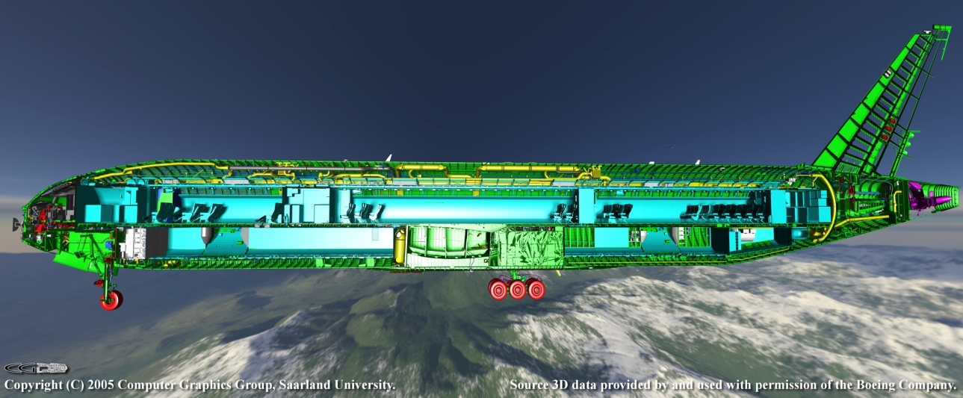
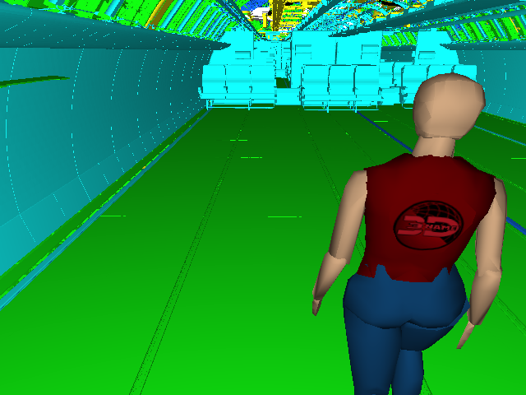
Rendering with RTSG
Ray Tracing – Animation in Large Models
Boeing 777 CAD model
12 GB of raw geometrical model data
Contains more than 350 million triangles
About 70000 scene graph nodes
Static geometry
…
Dynamic geometry
Notes:
Now I want to show some usage examples of our system.
RTSG was designed to work well with large models.
At this slide you can see an example where a standard HAnim animation Nancy runs inside of a full static CAD model of the Boeing with more than 350 million triangles. And it is 12 gigabyte of raw geometrical model data.
The scene consists of about 70000 scene graph nodes and is rendered in real-time.
The 70000 scene graph nodes are not geometric nodes, there are only 600 geometric nodes.
The majority of nodes describe different materials in the model but in full scene graph traversal they would be visited too.
Video?

Slide 20
Rendering with RTSG
Ray Tracing – Shading
Shading for Ray Tracers with AnySL infrastructure
Project with SB compiler group
No specific shading language: any language might be used
Low Level Virtual Machine (LLVM) is used as universal compiler infrastructure
Shader is compiled into platform-independent LLVM bitcode
Bitcode shaders are loaded, optimized, linked and compiled to target architecture at the runtime.
Additionally with our jitRT optimizer bitcode is automatically packetize in order to exploit SIMD instruction set for maximal speed
At runtime in ray tracer
LLVM
Shader
in
C++
Shader
in
bitcode
Loader
100100100
Executable
Shader
GCC-LLVM
C/C++ to LLVM bitcode compiler
100100100
Linker
Optimizer
jitRT Optimizer
Notes:
Since the paper was finished we did also additional work and added ray-tracing shading language support with a help of the compiler group at the Saarland university.
Instead of using specific shading language like GLSL, HLSL or Cg any language might be used in our system.
Currently we write our shaders in C++.
We use a Low Level Virtual Machine (LLVM) as universal compiler infrastructure where shader is compiled into platform-independent LLVM bitcode.
(You can see here this pipeline).
Bitcode shaders are loaded, optimized, linked and compiled to target architecture at the runtime.
Additionally with our just-in-time optimizer jitRT we automatically packetize bitcode in order to exploit SIMD instruction set for maximal speed which is required for real-time ray tracing.
This allow us to write our shaders in traditional way like in RenderMan Shading Language where shading code is executed for single rays.
And our jitRT optimizer automatically transform the single ray bitcode into the packet bitcode which uses SIMD instructions.

Slide 21
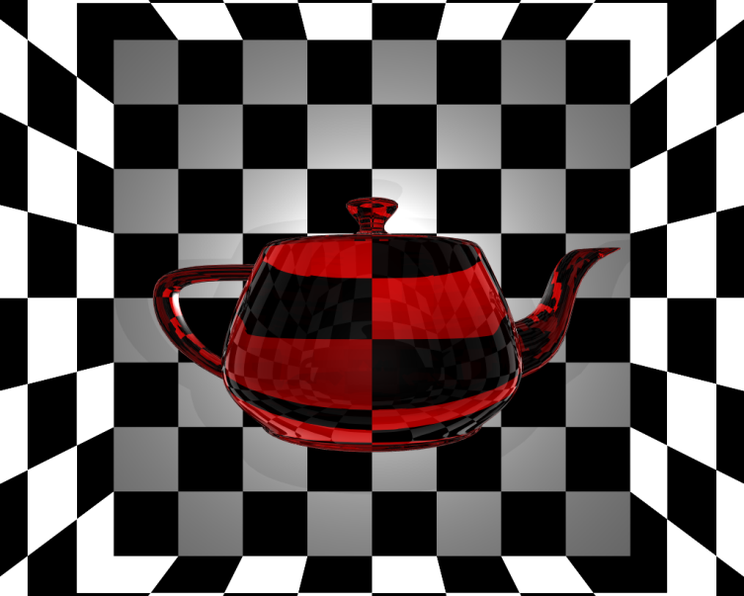
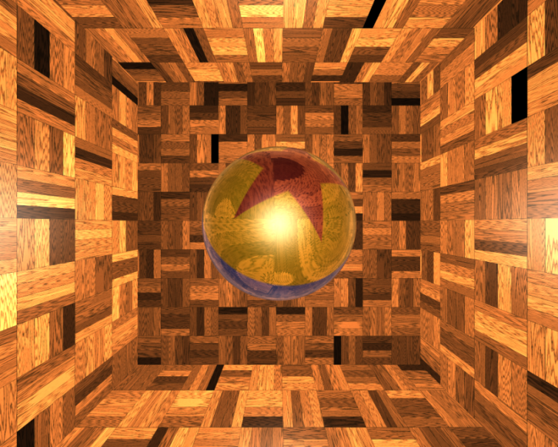
Rendering with RTSG
Ray Tracing – Shading
Ray Tracing Shaders with X3D
Transform {
children Shape {
appearance Appearance {
shaders PackagedShader {
inputOutput SFFloat Ka 0.0
inputOutput SFFloat Kd 0.0
inputOutput SFFloat Ks 0.5
inputOutput SFFloat Kr 1.0
...
url "rtfact:JIT:GlassShader.bc“
}
material Material { }
}
geometry IndexedFaceSet {
…
}
}
}
Notes:
For specifying shaders in our X3D system we use PackagedShader with a specific url which refer to the bitcode file.
Here are two examples of our shaders which are modified RenderMan shaders.

Slide 22
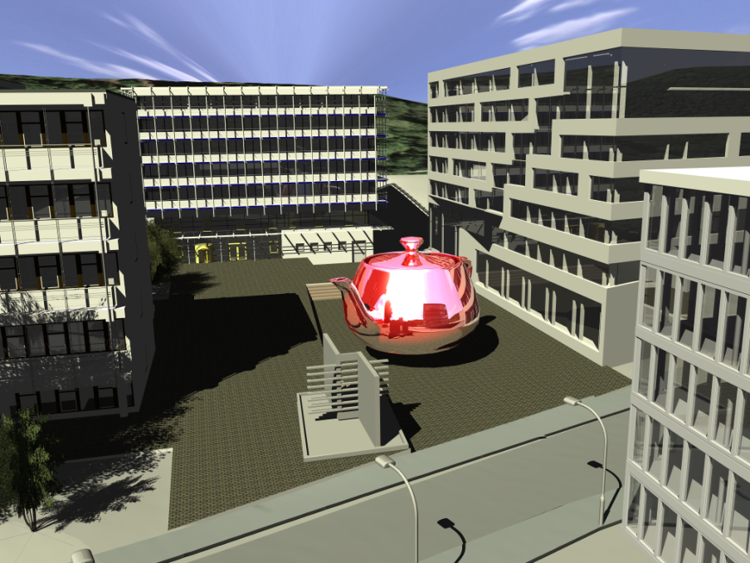
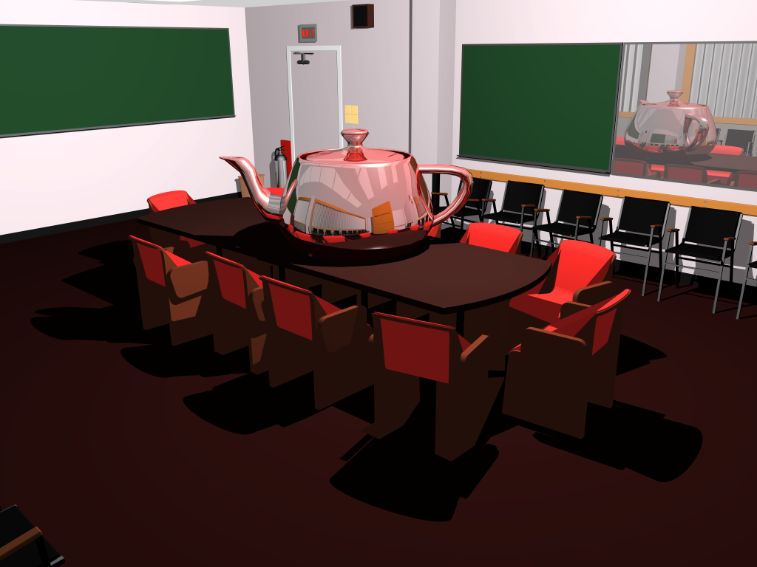
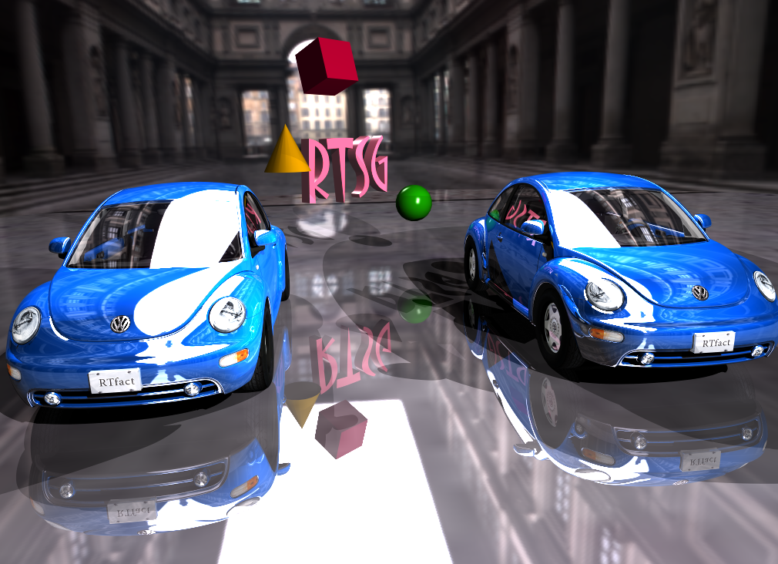
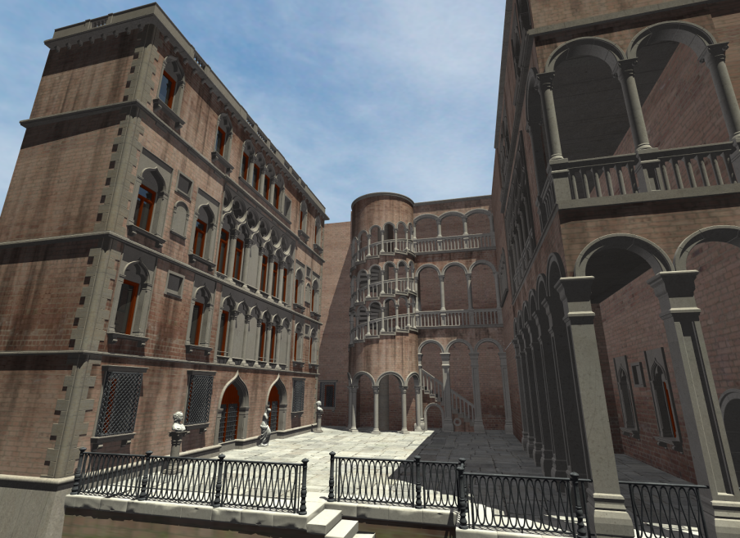
Rendering with RTSG
Ray Tracing
Campus (4.3Mtri)
Conference (280ktri)
Beetles (2.7Mtri)
Venice (1.2M tri)
Notes:
Here also some nice ray traced pictures rendered with our system.
Our campus scene with 4.3 million triangles and it is a massive architectural model.
A conference scene with 280 (two hundred eighty) thousand triangles is popular for ray tracing benchmarks
Beetles scene with 2.7 million triangles has a lot of detailed static geometry.
And Venice scene consists of 1.2 million triangles.

Slide 23
Rendering with RTSG
Rasterization with OGRE
X3D Scene graph traversed once
OGRE scene graph is created
Callbacks are used to synchronize both scene graphs
RTSG
OGRE Renderer
sync
Notes:
In order to demonstrate that RTSG is well suited for rasterization as for ray tracing we have implemented a rasterization-based renderer using OGRE rendering engine.
The design is similar to the ray tracing backend and OGRE maintains its own internal graph structure which we create in the first traversal.
Then we use callbacks to synchronize both scene graphs.
It works like the ray tracing backend.

Slide 24
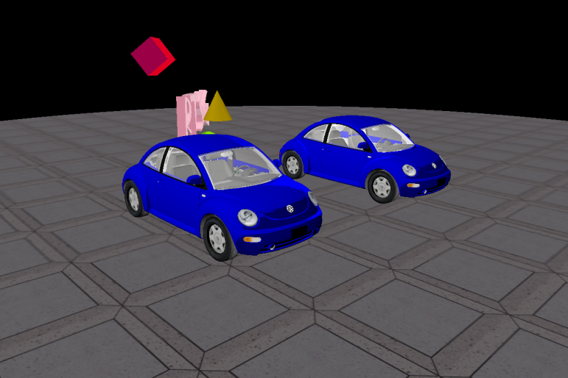
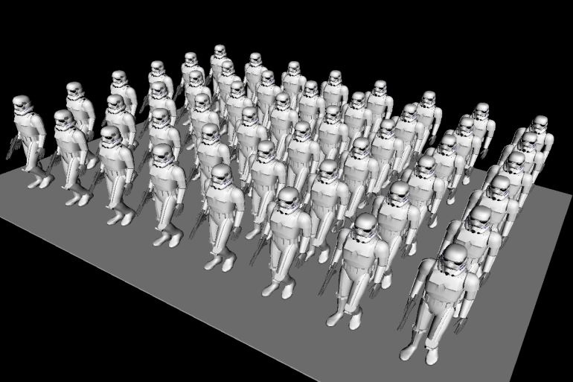
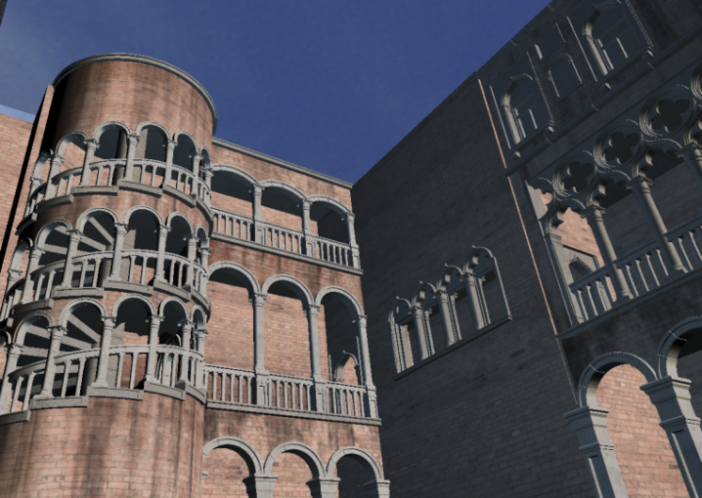
Rendering with RTSG
Rasterization with OGRE
Beetles (2.7M tri)
Troopers (1M tri)
Performance (FPS)
 | Beetles | Troopers | Venice
BS Contact (GL) | 14.8 | 11.6 | 151.6
Octaga Player | 38.2 | 14.0 | 64.2
Flux Player | 30.4 | 9.2 | 24.7
InstantReality | 64.2 | 32.3 | 11.6
Xj3D | 26.8 | 27.2 | 123.4
RTSG/OGRE | 113.7 | 51.6 | 631.2
Venice (1M tri)
Notes:
We compared performance of our rasterization backend with other freely available rasterization-based X3D browsers and we outperform all of them in all of the scenes shown here.
This additional troopers scene consists of 48 rigid body animated figures and consists 1 million triangles.
With its many routes and changing transformations this scene is a good performance test for the event processing of a VRML/X3D browser.
However currently not everything is faster, for example our coordinate interpolation is slower than in other browsers.

Slide 25
Future Research
Multi-threading with EXTRA
Optimizing X3D scene graph is hard when SAI is used, restrictions on scene graph modification would help
Common appearance model for ray tracing and rasterization
Descriptive like Appearance and Material nodes
Or imperative like user-defined shaders
Notes:
Let’s finally talk about our future research.
We plan to extend our extensible rendering architecture to support multi-threading as RTSG is currently single threaded system.
This is also a problem with a X3D specification as it does not define how the event propagation can be done in parallel.
One of the problems that we had when optimizing X3D scene graph for ray tracing is also the identification of static subgraphs.
StaticGroup in the X3D standard is not used often, and additionally Script node with a directOutput can access full scene which makes good optimization a complex task.
But most important research need to be done in order to develop common appearance model for ray tracing and rasterization as the current one is limited to the rasterization.
Either descriptive like Appearance and Material nodes or imperative like user-defined shaders.
And last but not least our full system will be available as open source.
Thank you for your attention.
Please ask me questions.

Slide 26
Thank you ! Questions ?

