Slide 1
Object Partitioning Considered Harmful: Space Subdivision for BVHs
Stefan Popov, Iliyan Georgiev,
Rossen Dimov, and Philipp Slusallek

Slide 2
Motivation
Classical BVH construction is not perfect
  Looks only at primitive’s centroids
How much more performance is there?

Slide 3
Background
SAH:
Cost based BVH construction: Top-down
  Partition set of N’s primitives into N_{L} and N_{R}
  Take partition with minimal cost
Exhaustive search: O(2^{N})

Slide 4
Classical BVH Construction
Assumes finely tessellated geometry
  Primitive → point

Slide 5
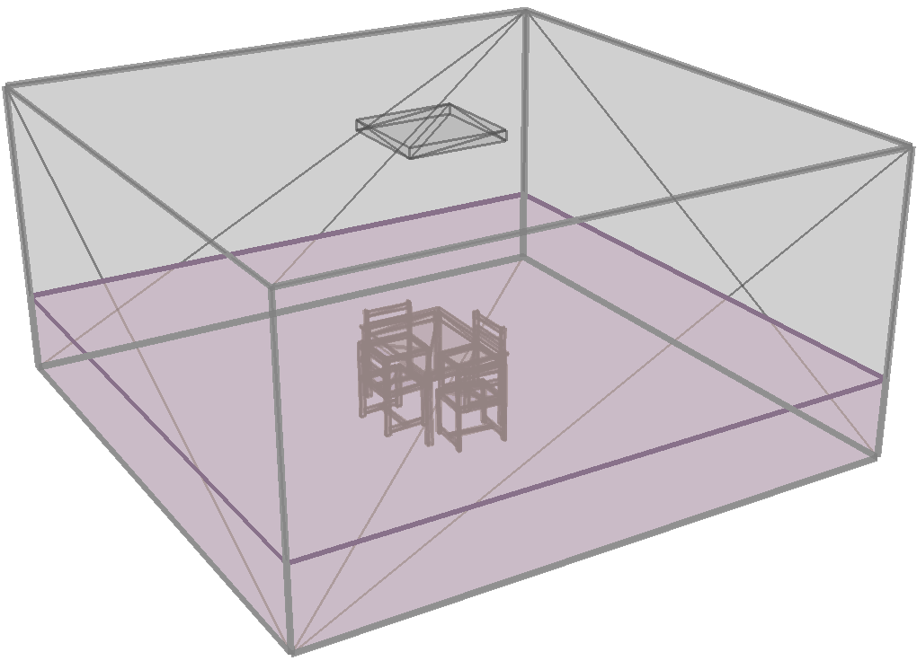
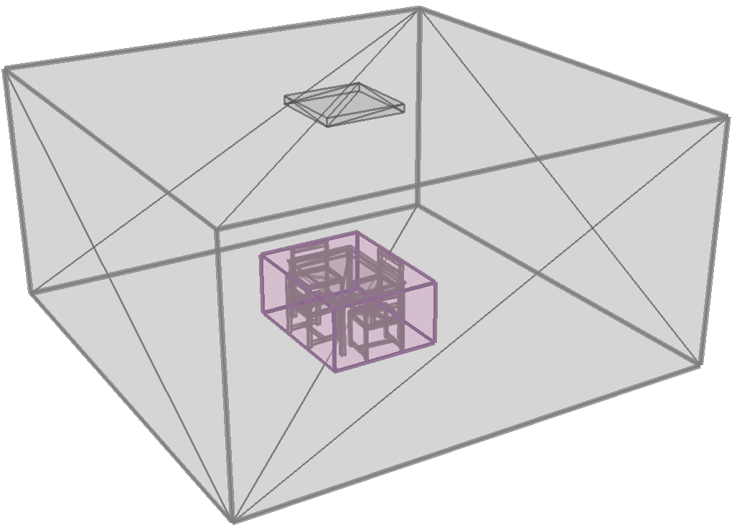
Can We Do Better?
CBVH split
  Cost ≈ 700
Optimal partition
  Cost ≈ 100

Slide 6
Geometric Partitioning
Regular approach: Partition N’s primitives
  Evaluate AABBs, and use to compute cost
  O(2^{N}) partitions to test
Geometric partitioning:
  Fix child AABBs and put primitives according to SAH
  Some configurations are infeasible
  Child AABB boundaries ≡ boundaries of primitives
  O(N¹²) configurations to test

Slide 7
Geometric Partitioning Example
Boundaries of N_{L or R} incident with dotted lines
P₄ shared → put into node with smaller SA

Slide 8
Geometric Partitioning Example
Configuration infeasible
  P₂ is not covered

Slide 9
Practical Considerations
O(N¹²) is actually O(N⁶)
  Each side of the parent AABB is inherited by a child
Select child AABBs on a regular grid
  Run-time: O(G⁶N^{0.5}) including cost calculation
    Choosing G=RN^{1/6} yields O(N^{1.5})
  Look at CBVH configurations as well

Slide 10
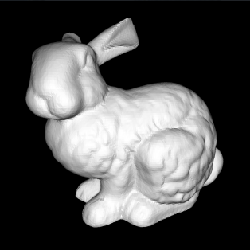
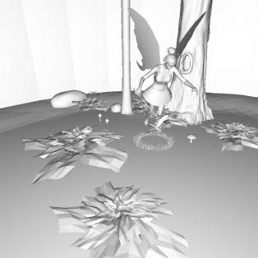
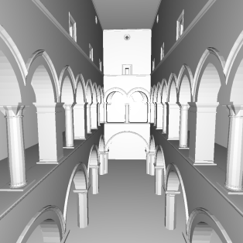
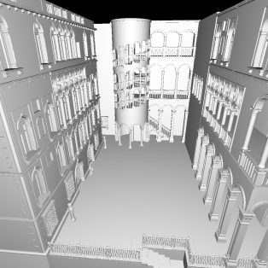
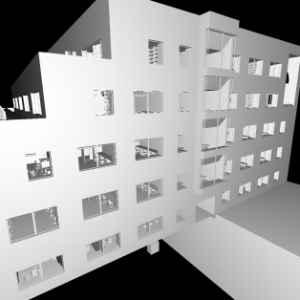
Results: FPS Random Rays
Higher is better

Slide 11
Results: Surface Area Cost
Lower is better

Slide 12
Result Analysis
Suspect: SAH
  Overlap + locally minimizing SAH has adverse effect
Experiment: Use recursive cost evaluation
  Tree cost better than CBVH but slower FPS!
Hypothesis: SA model needs space partitioning
  Intuition: Early ray termination
New algorithm
  Penalize overlap in cost function
  Refine search space by allowing primitive splitting

Slide 13
Splitting Primitives
Feasible and infeasible configurations
Two possible ways to split a primitive
  SAH cost is the same

Slide 14
Search Spaces
Child AABBs ∈ continuum inside parent’s AABB
  Not limited to boundary of primitives anymore
Limit search to a grid for practical purposes
Augment with search space of other algorithms
  CBVH & KD-tree construction search spaces

Slide 15
Penalizing Overlap
Bias SAH to account for overlap
C_{O} – the overlap penalty
  Standard SAH: C_{O} = 0
  Standard SAH with space partitioning: C_{O} → ∞

Slide 16
The Generic Algorithm
Parameters:
  Search space
  Overlap penalty
Algorithm
  Take configuration ∈ search space with lowest cost
Interesting parameters
  CBVH: BVH, C_{O} = 0
  Full: Grid + KD tree + BVH, C_{O} → ∞
  KDBVH: KD tree, C_{O} irrelevant

Slide 17
Results: FPS Random Rays
Higher is better

Slide 18
Results: FPS Frustum Traversal
Higher is better

Slide 19
Comparison to Pre-Splitting
Higher is better

Slide 20
Role of Overlap Penalty

Slide 21
Spatial Build Algorithm
Implement KDBVH using sweep plane
Extensions:
  Combine with CBVH to control size using C_{O}
  Sampling of cost function
Issues: Might miss cost minimum
  Cost is quadratic between split plane positions

Slide 22
Conclusion & Future Work
SAH inadequate without space partitioning!
Generic framework to study BVH construction
  Can explore full 2^{N} search space
Spatial build algorithm
  Fast with near optimal results
Research early termination aware cost function

Slide 23
Thank you!

