Slide 1
Unbiased Light Transport Estimators for Inhomogeneous Participating Media
László Szirmay-Kalos, I. Georgiev, M. Magdics, B. Molnár, D. Légrády
Budapest University of Technology and Economics, Solid Angle

Slide 2
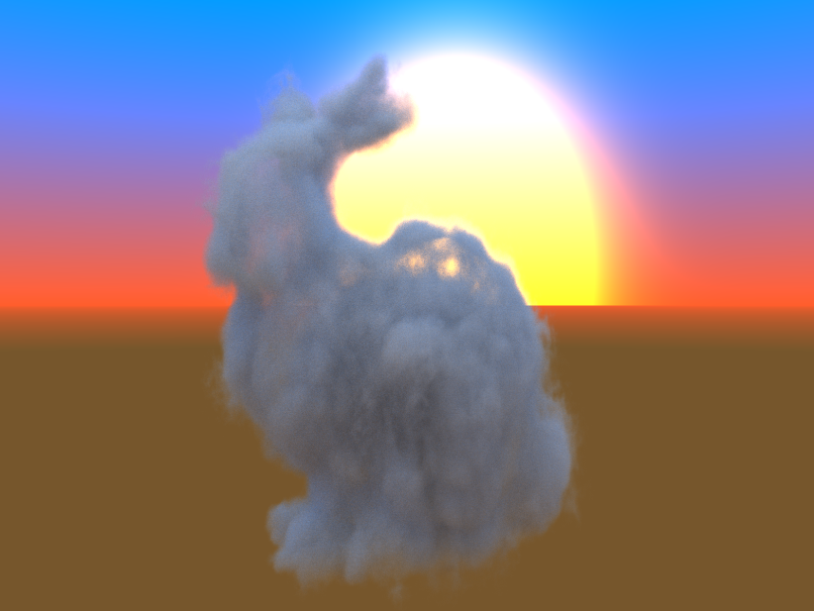
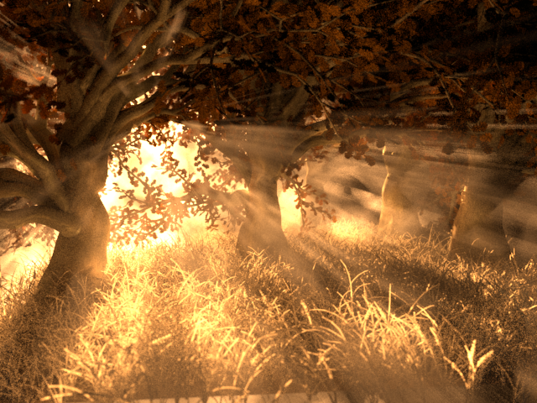
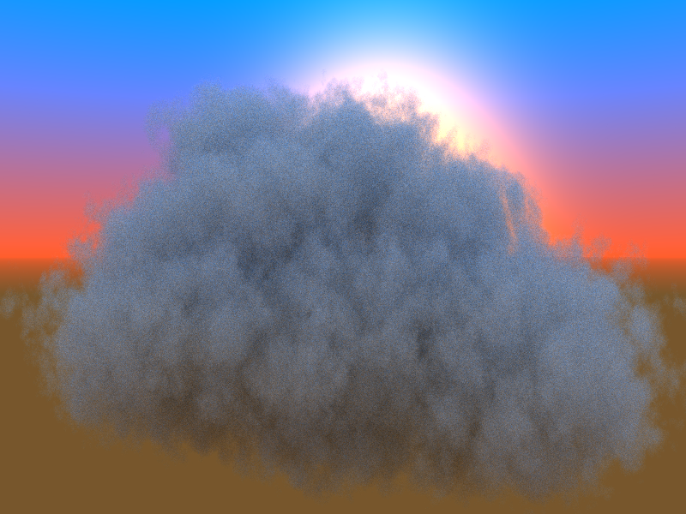
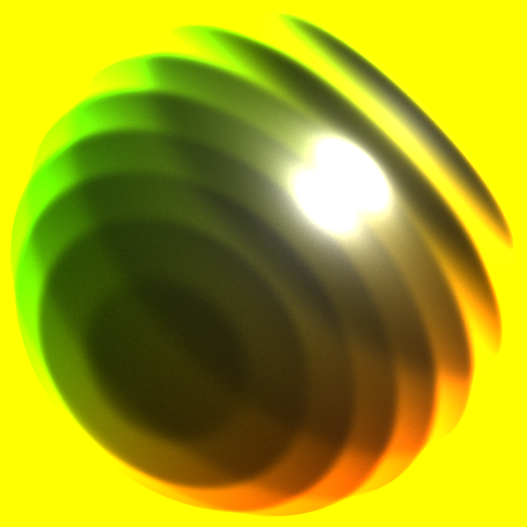
Rendering inhomogeneous participating media
Notes:
Procedural participating medium rendering is a challenging problem since it can modify the radiance anywhere and the medium parameters can be the result of the evaluation of a complex shader program, implementing, for example, many-octave Perlin noise or fluid dynamics. To get quality images in reasonable time, accurate estimators are needed that evaluate medium properties not too many times, because of the computation cost.

Slide 3
Participating media: Microstructure
$$E$$
$$ds$$
$${E[E}^{scat}]$$
$$E$$
$${E[E}^{tran}]$$
$$ds$$
No Interaction
Scattering
Absorption
$$E^{scat}=E$$
$$E$$
$$E^{tran}=E$$
$$E$$
$$E$$
Prob: ${1−σ}_{t}ds$
Prob: ${aσ}_{t}ds$
Prob: ${(1−a)σ}_{t}ds$
$σ_{t}:$ Extinction
$a$: Albedo
Notes:
On microscopic level, a participating medium is a collection of material particles with which photons may collide. In a differential step, the photon may have no interaction, may scatter in a new direction, or may be absorbed. The probability density of interaction is the extinction coefficient that is proportional to the density of material particles and the probability of the survival is the albedo. The expected values of the transmitted and scattered energies can be expressed using the respective probabilities, so we can obtain a model that describes the behavior of the medium taking a infinitesimal step.

Slide 4
Participating media: Macrostructure and Monte Carlo Simulation
Transmittance:
PDF of scattering:
Ray marching:
$$T\left(S\right)=e^{−\int_{0}^{S}{σ_{t}(s)ds}}$$
$$≈e^{−\sum_{i}{σ_{t}(s_{i})∆s}}$$
$$pdf\left(S\right)=σ_{t}(S)e^{−\int_{0}^{S}{σ_{t}(s)ds}}$$
Ray marching is biased and also slow if fetching is expensive.
Notes:
During Monte Carlo Simulation we need the macroscopic transmittance that is the probability that a light particle flies through a finite interval, and we should sample with the free flight density. Both of them contain the exponential of the integral of the extinction.
If the extinction is such that the transmittance can be analytically evaluated and we can generate random samples with the real free flight density, the medium is analytically tractable. However, in practical cases when the medium is inhomogeneous, this is usually not the case, and some numerical quadrature should be used, which advances on the ray with ray marching and fetches the medium at many points.
Ray marching makes the sampling biased, and more importantly slow especially in procedural media.

Slide 5
Previous work and problem statement
Woodcock tracking + constant majorant [Woodcock1965]
Alternative to ray marching [Raab,Seibert,Keller2008]
Kd-tree majorant [Yue,Iwasaki,Chen,Dobashi,Nishita2010]
Arbitrary majorant + minorant control variate [Szirmay,Tóth,Magdics2011]
Particle weighting + minorant control variate [Novák,Selle,Jarosz2014]
Problem: majorant and minorant in procedural medium!
Solution:
Medium manipulation to make it analytically tractable
Unbiased rendering without majorant and minorant (impossible)
Approximate information helps reduce the variance (free)
Notes:
Concerning the most related previous work, we should mention Woodcock tracking that advances in the medium with random steps sampling with a constant majorant value of the extinction, and then decides whether a real or fictitious interaction happens. The main problem of Woodcock tracking and its related methods is that a majorant function is needed for sampling and a minorant for control variates. Majorants and minorants are difficult or even impossible to get for procedural media where the extinction is the output of a complex shader program, and if the majorant and minorant are not tight, the sampling becomes prohitively inefficient.
To attack this problem, we propose a method that makes the free flight sampling and transmittance calculation analytically tractable but without requiring majorant or minorant information. The method is unbiased and requires no preprocessing. However, approximate information can reduce the variance. Such information can be gathered on the fly at negligible added cost.

Slide 6
Medium manipulation: Double Particle Model
Original medium
$$σsamp$$
Modified medium
$$σ_{t}$$
$$E^{scat}$$
$$E$$
$$E$$
$$E$$
$${E[E}^{scat}]$$
$$E^{tran}$$
$$E$$
$${ σ}_{samp}ds$$
$${1−σ}_{samp}ds$$
$${E[E}^{tran}]$$
$$r=σ_{t}/σ_{samp}$$
$$ds$$
$$E^{tran}=(1−r)E$$
$$E^{scat}=arE$$
Notes:
To make sampling analytically tractable, we modify the medium on microscopic level changing the density from the original extinction to a sampling extinction that is good for analytic sampling, either adding new particles or removing existing particles.
In our first model, called the double particle model, two light particles, a scattered and a transmitted are created at an interaction. When there is no interaction, the light particle flies through without changing its energy and direction. For unbiased estimates, we should guarantee the same expectations of the scattered and transmitted energies on this differential step, which is possible by setting the transmitted and scattered energies in this way, where r denotes the ratio of the original and the sampling extinctions.

Slide 7
Analysis of the transmitted energy
$$E^{tran}=(1−r)E$$
$$r=\frac{σ_{t}}{σ_{samp}}<1$$
$$r=\frac{σ_{t}}{σ_{samp}}>1$$
Adding particles:
Removing particles:
Negative!
$$E^{tran}$$
$$E^{tran}$$
Notes:
In the original medium, the energy remains constant until an interaction happens, when the light particle is either absorbed and changes its direction, thus the energy in this direction becomes zero.
In the new model, the transmitted energy is multiplied by 1-r, which is in the [0,1] interval if the real extinction is smaller than the sampling extinction, that is, we have added particles. In this case, the energy will go to zero gradually. On the other hand, if the real extinction is larger, that is, we removed particles to obtain the sampling density, the energy changes its sign, so negative energy particle may show up during the simulation.
Note that negative energy is indeed necessary to compensate interactions that are missing because of removing material particles from the original model.

Slide 8
Control variates for the extinction
$$σ_{t}$$
$$σ_{dif}$$
$$σ_{main}$$
$$\int_{0}^{s}{σ_{t}(s)ds=\int_{0}^{s}{σ_{main}(s)ds+\int_{0}^{s}{σ_{dif}(s)ds}}}$$
Negative!
$$s$$
Analytic
Monte-Carlo
$$T(s)$$
$$T_{main}$$
$$T\left(S\right)=e^{−\int_{0}^{s}{σ_{t}(s)ds}}$$
$${ =e}^{−\int_{0}^{s}{σ_{main}ds}}∙e^{−\int_{0}^{s}{σ_{dif}ds}}$$
$$s$$
Analytic
Monte-Carlo
Notes:
Recall that the transmission is the exponential of the integral of the extinction, and the integral is estimated by Monte Carlo quadrature. Significant variance reduction can be obtained by the application of control variates that decomposes the integrand into a main part that can be analytically integrated and into a difference part for which Monte Carlo estimation should be used. The final transmittance is the product of the main transmittance and the Difference transmittance. If the main part can capture most of the extinction, the difference is small and flat, so it does not significantly modify the analytic result of the main extinction. Note that in contrast to the application of control variates for integrals, here even constant control variate can help since we insert the integral into an exponential function.
However, there is a problem. A good main part is the local average of the extinction, thus negative difference extinctions are inevitable. By definition, the extinction or cross section is a probability density so at a first glance, negative extinction does not make sense, and the steps of the derivation of rules for the manipulated medium become mathematically wrong.

Slide 9
Negative extinction
$$σ^{+}$$
$$σ=−σ^{+}$$
$$+$$
$$=$$
$$σ=0$$
$$E^{scat}=ar^{+}E$$
$$E^{scat}=arE$$
$$E^{scat}=0$$
$$E^{tran}=(1−r^{+})E$$
$$E^{tran}=(1−r)E$$
$$E^{tran}=E$$
$$r=\frac{σ_{t}}{σ_{samp}}<0$$
$$E^{tran}$$
Notes:
To find appropriate rules for negative extinction material, we exploit the additive property of
The extinction, which means that mixing two materials the extinction becomes the sum of the two extinctions. Let us mix material of positive extinction and material obtained by multiplying the extinction everywhere by -1. We get a material of zero extinction everywhere, which is the empty space. We know the rules of positive and zero extinction material, from which the rules of negative extinction material can be obtained by subtraction.
Interestingly, the same rules remain valid also for this case. However, now r, the ratio of the real and sampling extinctions is negative. As a result, the transmitted energy grows along a ray since the material exhibits a chain reaction instead of absorbing and outscattering light particles. Additionally, the scattered energy becomes negative.

Slide 10
Transmittance Computation with No Preprocessing
$$σ_{samp}$$
$$T≔e^{−\int_{0}^{S}{σ_{main}(s)ds}}$$
$$r≔σ_{dif}/σ_{samp}$$
$$σ_{t}(s)$$
$$T≔\left(1−r\right)T$$
$$σ_{dif}$$
$$σ_{main}$$
$$s$$
Variance improvement if
$$σ_{dif}r=\frac{{\left(σ_{dif}\right)}^{2}}{σ_{samp}}<σ_{t}$$
$$T(s)$$
$$s$$
Notes:
We apply the proposed medium manipulation to compute transmittance. To get a control variate, point samples are taken along a ray and extinction is estimated. Note that these estimations should not be precise, so we can use a simplified procedural model or even borrow the samples generated by a neighboring ray. The control variate is then the piece-wise linear function fit to these samples, and the main transmittance can be analytically calculated. The Monte Carlo simulation advances with random steps determined by the sampling extinction, with which the free flight can be analytically calculated. At each interaction point, the difference of the actual extinction and the control variate is obtained and the main transmittance is updated according to the rules of interaction in the modified medium.

Slide 11
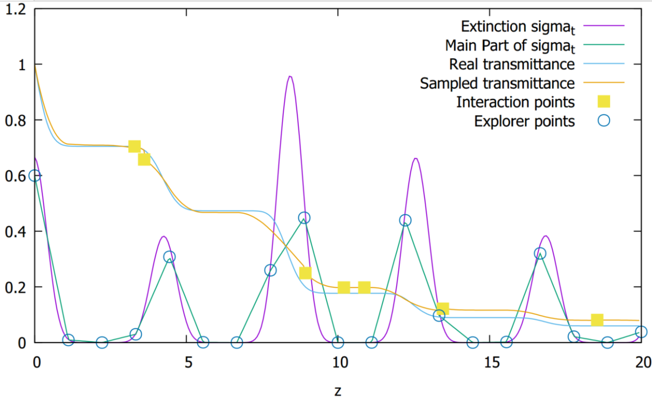
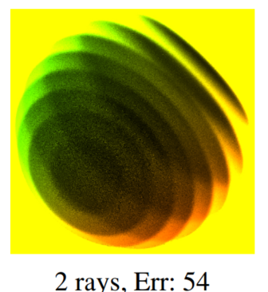
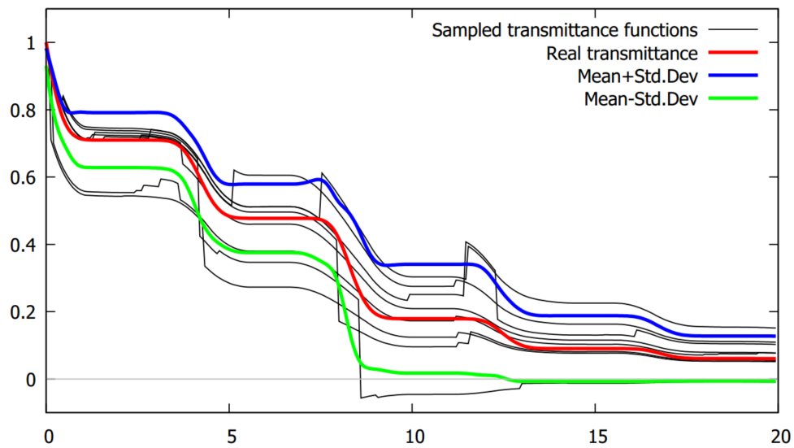
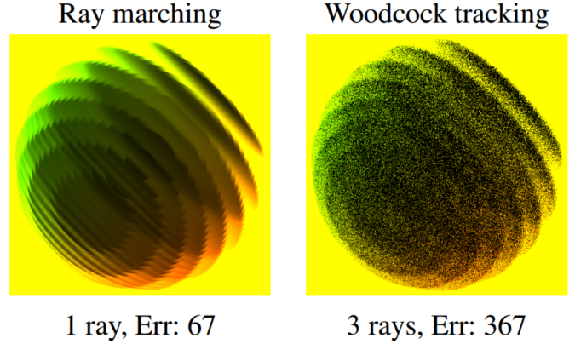
Procedural volume transmittance
10 medium
fetches per pixel
Notes:
To test the algorithm we take a strongly inhomogeneous volume where the extinction is a modulated sine wave. The piece-wise linear control variate and the real and sampled transmittance are also shown. Points for the control variate are generated only once for a group of pixels. The method provides a transmittance estimate not only at the end of the ray but in any point along it. In the lower image we show random transmittance functions, their mean, which is the real transmittance, and the bounds speficied by the standard deviation. The rendered image is of low variance even when we fetched the volume only by 10 times per pixel, and much better than that of ray marching and Woodcock tracking.

Slide 12
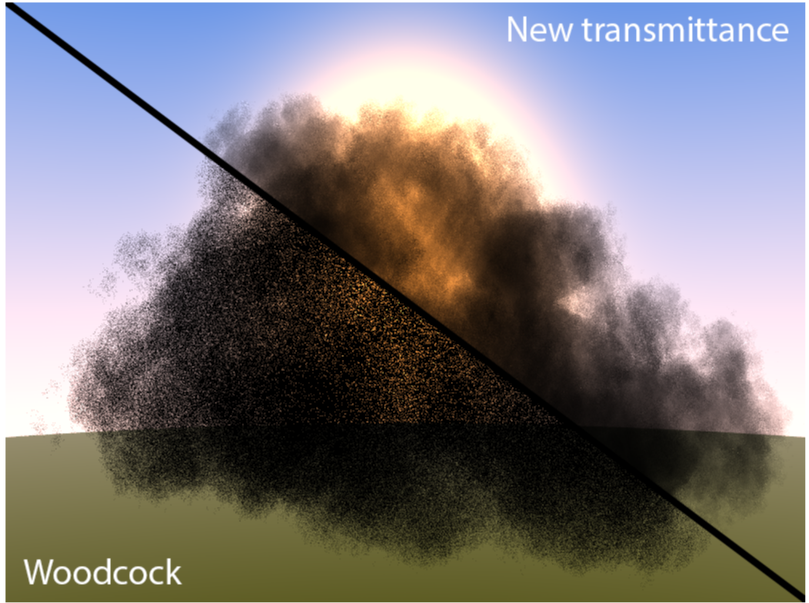
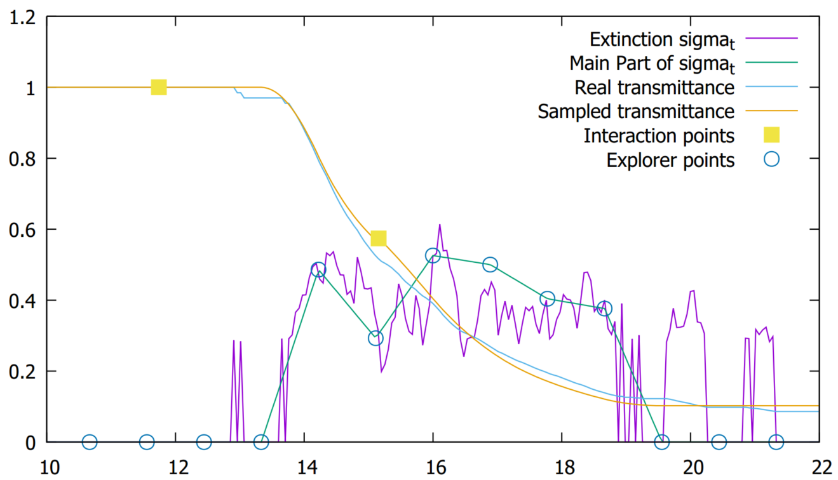
12-octave Perlin noise
Notes:
Another test with 12 octave Perlin noise. The extinction is strongly fluctuating, but transmittance can be well approximated from the control variate.

Slide 13
Single Scattering
Attenuation-driven sampling
Sampled Importance Resampling (SIR)
$$T(s)$$
$$s$$
Notes:
Having the possibility to estimate the transmittance function along a ray, single scattering can also be solved. First, the unscattered contribution is estimated by the discussed method. Then the single scattering of a point source needs to be added, which requires the transmittance between the point source and sampled scattering points. We could directly use the sample points generated for transmittance also for these scattering locations, but this is not the only and fairly poor alternative. These points mimic neither the incident radiance nor the scattering extinction, so they do not provide low variance estimators, which can be slightly improved by importance resampling.

Slide 14
Single Scattering
Source-driven: Equiangular sampling [Kulla,Fajardo 2012]
Scatter-driven: Free path with the scattering cross section approximation
MIS using any combination
$$T(s)$$
$$s$$
Notes:
Thanks to the fact that our estimation method provides the transmittance values not only at discrete points but anywhere along the ray, scattering points can be sampled with independent strategies. For example, we can mimic the indident radiance with equi-angular sampling, use approximate scattering cross section driven sampling, multiple importance sampling etc.

Slide 15
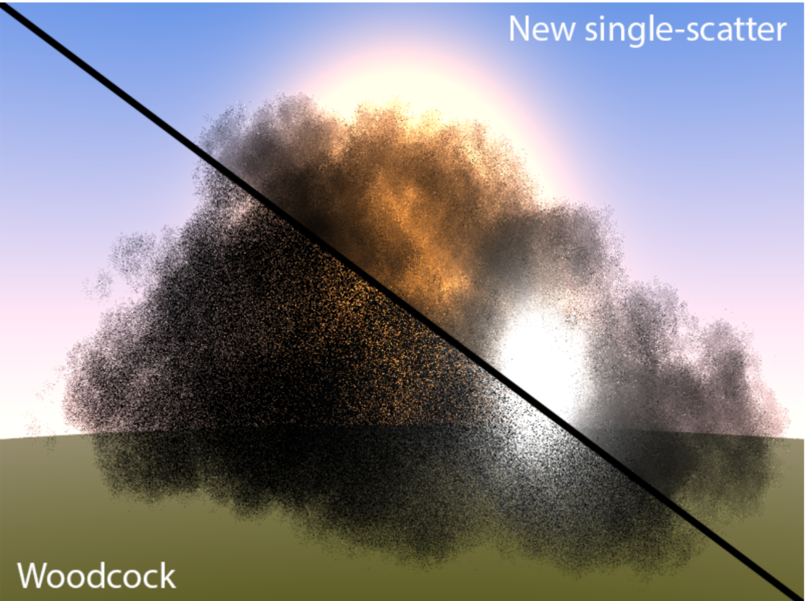
Single scattering results
Notes:
This figure compares single scattering rendering of a cloud illuminated by an environment map and an enclosed light source with Woodcock tracking and the combination of equi-angular sampling and approximate scattering cross section driven sampling. Rendering the analytic medium with the same number of fetches we can observe that ray marching has sampling artifacts, Woodcock tracking is noisy and combining the transmittance function with equi-angular sampling or scattering driven sampling provides accurate results.

Slide 16
Single Particle Model
Prob. $q^{scat}$
Scattering
$$E^{scat}=\frac{arE}{q^{scat}}$$
$$E$$
$$E^{scat}=arE$$
$$E$$
Prob. $q^{tran}$
No Interaction
$$E^{tran}=\frac{\left(1−r\right)E}{q^{tran}}$$
$$E^{tran}=(1−r)E$$
$$E$$
Prob. ${{1−q}^{scat}−q}^{tran}$
Absorption
$$E$$
Notes:
The double particle model discussed so far creates two light particles at an interaction, thus their number may grow rapidly if multiple scattering is simulated. To address this, we randomize their creation without by dividing the energy with the generation probability which preserves expected values.
The probabilities are set to keep the variance small, that is, we force the scattered and transmitted particles to have the same energy. Further variance reduction can be obtained if the probability of the absorption is set to zero. We call this version as the non-terminating model.

Slide 17
Particle Tracing using the Single Particle Model
$$σ_{samp}$$
$$σ_{t}$$
$$E$$
$$\frac{arE}{q^{scat}}$$
prob. $q^{scat}$
$$E$$
$E$ prob. $a$
$$\frac{\left(1−r\right)E}{q^{tran}}$$
prob. $q^{tran}$
Notes:
The application of the single particle model in multiple scattering particle tracing is straightforward. Instead of sampling the free flight with the original extinction, we sample it with the analytically tractable sampling extinction and at an interaction we decide whether the particle is transmitted or scattered applying the derived rules to update their weight or energy.

Slide 18
Multiple scattering results
Differential variance:
$$σ_{t}\left(\left|r\right|+a|1−r|\right)$$
Notes:
These are results obtained with different sampling extinctions where the maximum extinction is 1. Note that increasing the sampling extinction the error first decreases and then stops improving when the sampling extinction gets close to the maximum value. This is also shown by the variance analysis that states that the variance depends on the exponential of the integral of this function, which in turn involves r, the ratio of the real and sampling extinctions in the following way. In high albedo media, inreasing the sampling extinction has minor benefits while the cost increases. The optimal value is slightly below the maximum extinction a ray can see.

Slide 19
Conclusions
Method to manipulate participating media to make the sampling analytically tractable
Variance analysis and reduction
Can be used for transmittance, single scattering and multiple-scattering simulation
Control variate can significantly reduce the variance
Approximate control variate is easy to get especially for transmittance and single-scattering (coherent rays)
Do not be afraid of negative energy and negative cross section
Notes:
This paper proposed a medium manipulation method to make the sampling process analytic and also evaluating and reducing the variance of the estimators. We note that control variate for the extinction is especially powerful and has low extra cost. As we do not require majorant and minorant information, negative energy and extinction may also show up but they can be our friends.

