Slide 1


Variance-Aware MIS
P. Grittmann, I. Georgiev, P. Slusallek, and J. Křivánek

Slide 2
Goal: The ultimate rendering algorithm
Algorithm
Technique 1
Technique 2
Technique 3

Slide 3
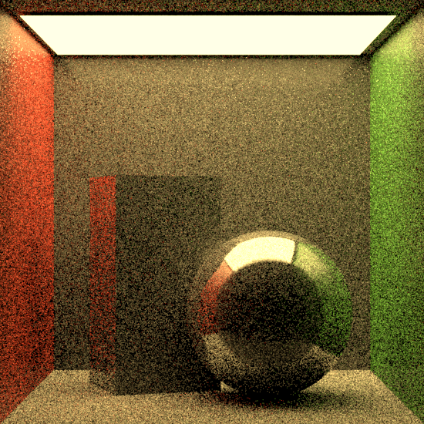
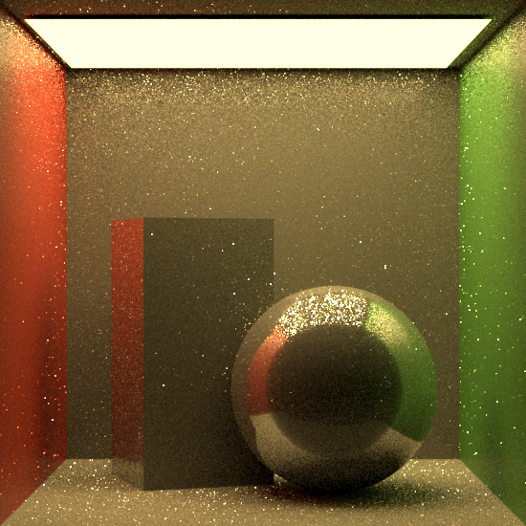

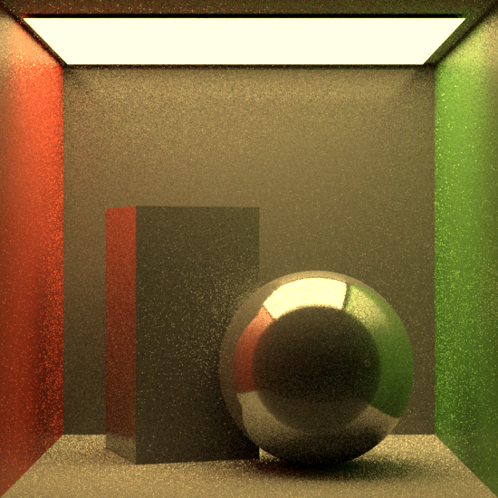
Key ingredient: MIS
Multiple importance sampling (MIS) [Veach & Guibas ‘95]
Meh.
Nice!
Nice!
Meh.

Slide 4
A use-case: bidirectional path tracing
Difficult indirect illum.
Simple direct illum.

Slide 5
A failure case: bidirectional path tracing
Path tracer
Path tracer + Bidir.
(Balance heuristic)

Slide 6


Our contributions
Variance reduction effects ignored by MIS
  Example: stratification
A new heuristic: MIS + variance estimates

Slide 7
Background

Slide 8
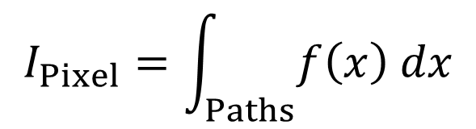

Monte Carlo integration in rendering
$$x$$
$$I_{Pixel}=\int_{Paths}{f\left(x\right) dx}$$
Pixel

Slide 9
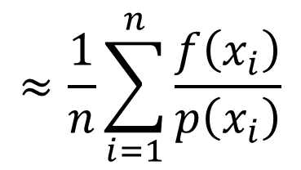
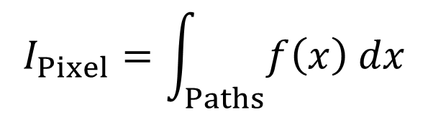
Monte Carlo integration in rendering
$$≈\frac{1}{n}\sum_{i=1}^{n}{\frac{f\left(x_{i}\right)}{p\left(x_{i}\right)}}$$
$$I_{Pixel}=\int_{Paths}{f\left(x\right) dx}$$

Slide 10
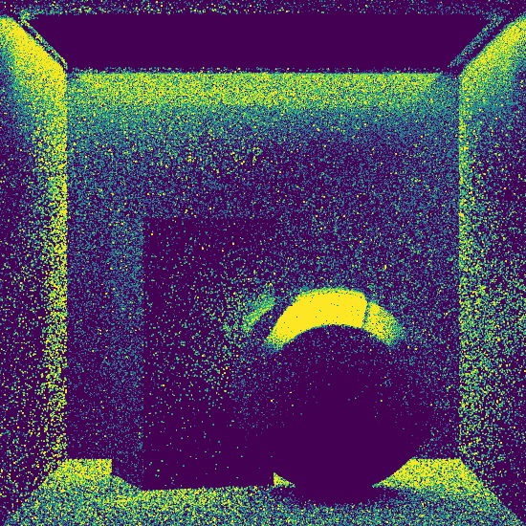
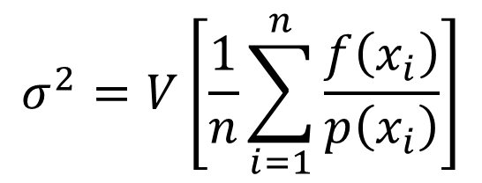

Variance determines error
$$σ^{2}=V\left[\frac{1}{n}\sum_{i=1}^{n}{\frac{f\left(x_{i}\right)}{p\left(x_{i}\right)}}\right]$$
Rendered image
Estimated variance ($σ^{2}$)

Slide 11
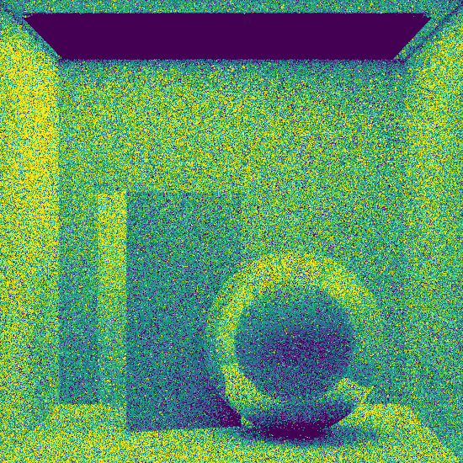


Combining estimators
First technique
Estimated variance ($σ^{2}$)
Second technique
Estimated variance ($σ^{2}$)

Slide 12
Combining estimators
First technique
Second technique

Slide 13
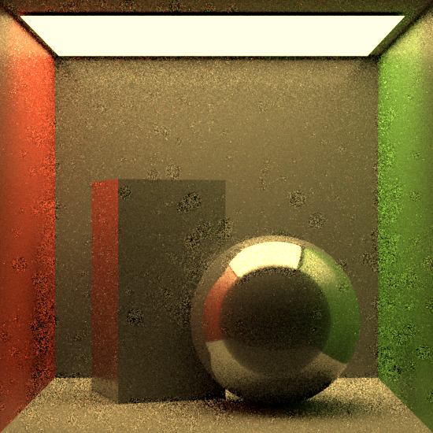
Combining estimators
First technique
Second technique
Combined image

Slide 14
Combining estimators
Pros
  Simple
  Never worse than the best technique alone
Cons:
  Coarse, weights whole estimators
  Relies on estimates

Slide 15
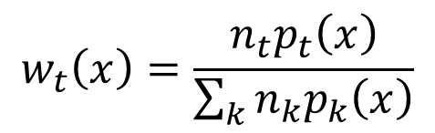

Multiple importance sampling
Per-sample weights
Balance heuristic
$$\frac{1}{n_{t}}\sum_{i=1}^{n_{t}}{w_{t}\left(x_{i,t}\right)\frac{f\left(x_{i,t}\right)}{p_{t}\left(x_{i,t}\right)}}$$
$$w_{t}\left(x\right)=\frac{n_{t}p_{t}\left(x\right)}{\sum_{k}{n_{k}p_{k}\left(x\right)}}$$

Slide 16
Previous work on weighting functions
Original heuristics [Veach and Guibas 1995]
  Balance, power, maximum, cut-off
  All based on effective densities
Tailored solutions for special cases [Georgiev et al. 2012]
  Still relies on effective densities

Slide 17
Optimal MIS weights
[Kondapaneni et al. 2019]
Can be negative and much better!
Quite expensive…

Slide 18
Two simple heuristics
Coarse
Relies on estimates
Accounts for all effects on the variance
Fine grained
Uses exact values
Ignores some variance altering effects
Variance-based
Balance heuristic MIS

Slide 19
MIS ignores stratification
(and other effects)

Slide 20
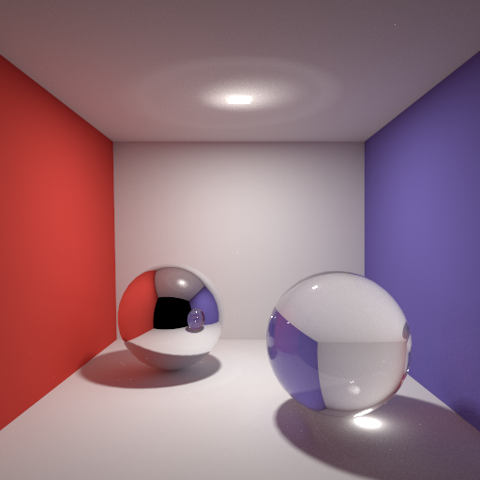
Image plane stratification
One sample per pixel

Slide 21
No image plane stratification (e.g. BDPT)
One sample per pixel
Sample over entire image

Slide 22
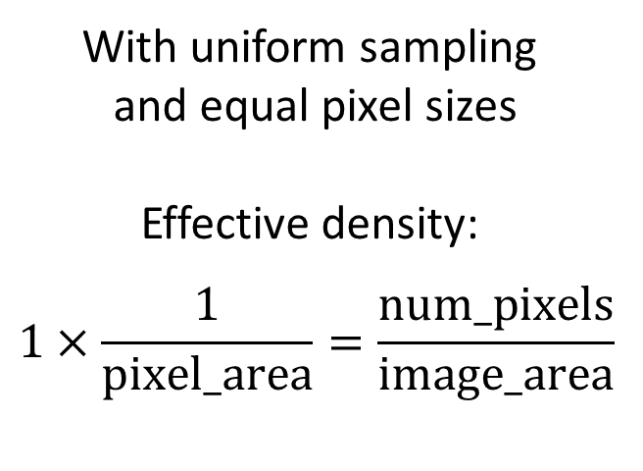
Effective density with stratification
One sample per pixel
With uniform sampling
and equal pixel sizes
Effective density:
$$1×\frac{1}{\text{pixel}\text{_}\text{area}}=\frac{\text{num}\text{_}\text{pixels}}{\text{image}\text{_}\text{area}}$$

Slide 23
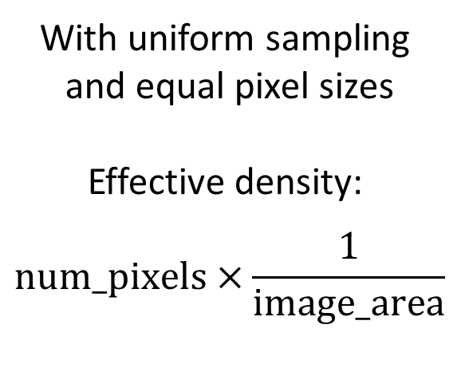
Effective density without stratification
Sample over entire image
With uniform sampling
and equal pixel sizes
Effective density:
$$num_pixels×\frac{\text{1}}{\text{image}\text{_}\text{area}}$$
The same!

Slide 24
Our new heuristic

Slide 25
Our new heuristic

Slide 26
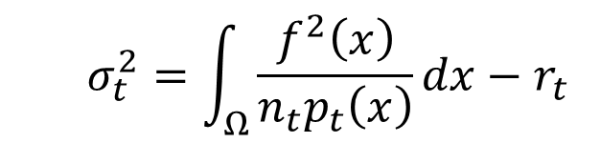

Variance and the balance heuristic
Consider the variance of one technique $t$:
The balance heuristic ignores a residual $r_{t}$
Minimized by optimal weights
  $$σ_{t}^{2}=\int_{Ω}{\frac{f^{2}\left(x\right)}{n_{t}p_{t}\left(x\right)}}dx−r_{t}$$
Minimized by balance

Slide 27

The residual differs between techniques
Simplest case: $r_{t}=\frac{1}{n_{t}} μ_{t}^{2}$
With stratified samples: $r_{t}=\sum_{strata}{μ_{t,s}^{2}}$
With correlated samples: $r_{t}=Cov+\frac{1}{n_{t}}μ_{t}^{2}$

Slide 28

When is the balance heuristic optimal?
When the residual is tiny:
i.e., when variance is high
$$\int_{Ω}{\frac{f^{2}\left(x\right)}{n_{t}p_{t}\left(x\right)}}dx≫r_{t}$$

Slide 29
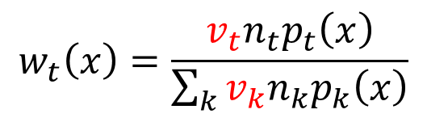

Variance factor
We compute the ratio between the considered term and the whole variance:
And modify the balance heuristic with it:
$$v_{t}=\frac{\int_{Ω}{\frac{f^{2}\left(x\right)}{n_{t}p_{t}\left(x\right)}}dx}{σ_{t}^{2}}$$
$$w_{t}\left(x\right)=\frac{v_{t}n_{t}p_{t}\left(x\right)}{\sum_{k}{v_{k}n_{k}p_{k}\left(x\right)}}$$

Slide 30



Behaviour of our weights
Low variance: increase weight
  Where balance is known to perform poorly
High variance: balance heuristic
  Where balance works well
$$v_{t}$$
$$1$$
$$σ_{t}^{2}$$

Slide 31
Implementation

Slide 32
One of many ways to use our weights
Split rendering in two stages
First stage:
  Uses balance heuristic
  Estimates variance factors
Second stage:
  Uses our heuristic

Slide 33

Simple variance estimation
Divide image into tiles
Estimate variance in each tile
Result: one $v_{t}$ per tile

Slide 34
Results: BDPT

Slide 35


Bidirectional path tracing
Path tracing is stratified on the image plane
Light tracing is not

Slide 36
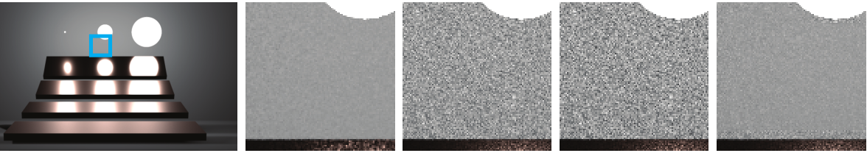


Results: improvement in failure cases
Path tracing
Balance
Power
Ours
$40\%$ worse
$3×$ better

Slide 37
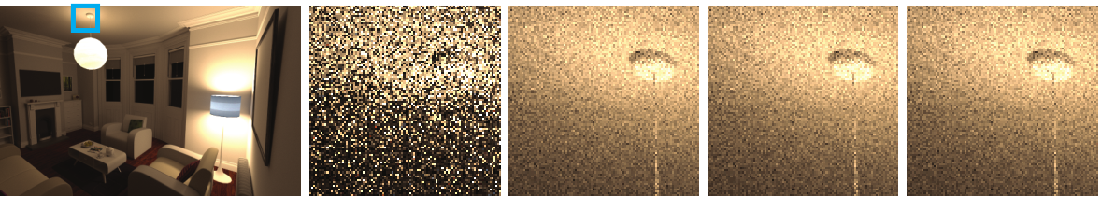


Results: no harm done otherwise
Path tracing
Balance
Power
Ours
$20\%$ worse
$1\%$ better

Slide 38
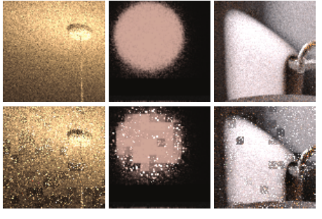
Results: more robust than variance alone
Ours
Variance-only

Slide 39
Summary

Slide 40
Limitations and future work
We still use estimates (but don’t rely on them)
Limited to positive weights
How to apply to biased techniques?

Slide 41
A cheap and effective heuristic
Moderate overhead
  Memory to store variance estimates
Trivial to implement
  A few extra multiplications
Robust
  Reverts to the balance heuristic with increasing variance

Slide 42

Source code
https://github.com/pgrit/var-aware-mis-pbrt

Slide 43
Thank you
P. Grittmann, I. Georgiev, P. Slusallek, and J. Křivánek

Slide 44
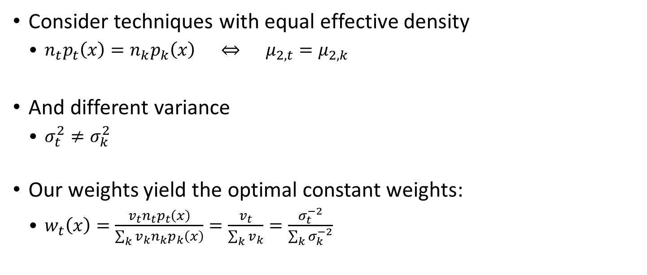
Discussion: equal balance weights
Consider techniques with equal effective density
  $n_{t}p_{t}\left(x\right)=n_{k}p_{k}\left(x\right) ⇔ μ_{2,t}=μ_{2,k}$
And different variance
  $σ_{t}^{2}≠σ_{k}^{2}$
Our weights yield the optimal constant weights:
  $w_{t}\left(x\right)=\frac{v_{t}n_{t}p_{t}\left(x\right)}{\sum_{k}{v_{k}n_{k}p_{k}\left(x\right)}}=\frac{v_{t}}{\sum_{k}{v_{k}}}=\frac{σ_{t}^{−2}}{\sum_{k}{σ_{k}^{−2}}}$

Slide 45
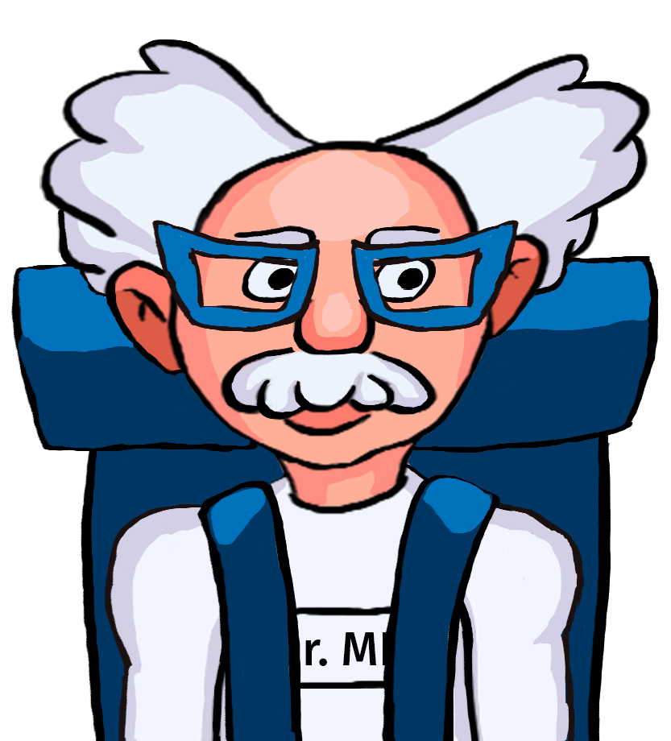
Results: Defensive sampling

Slide 46
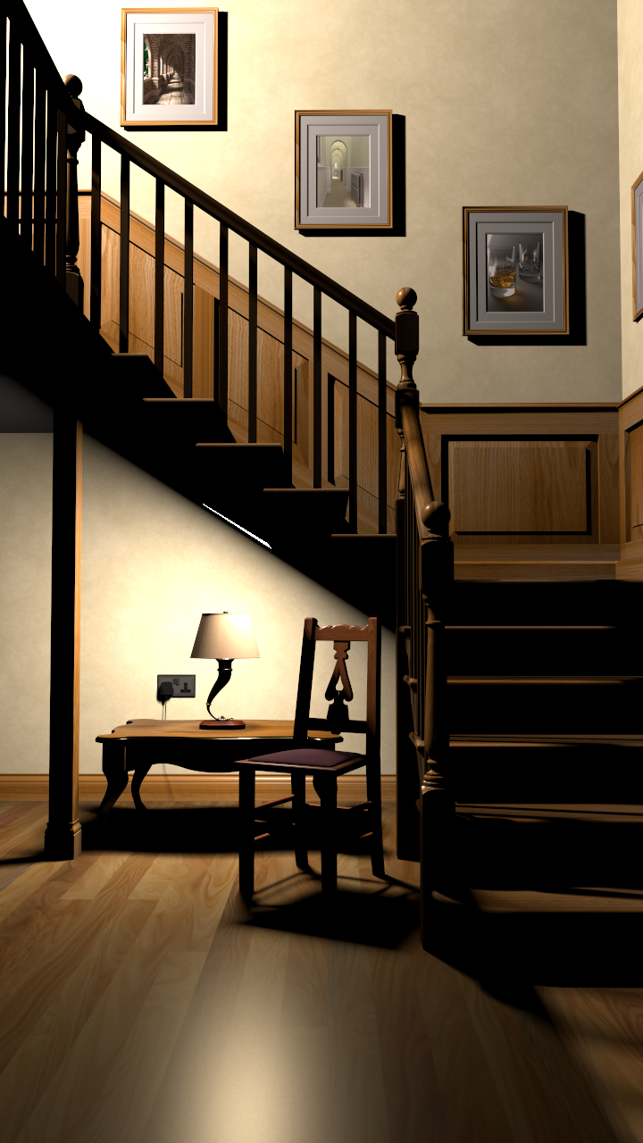
Defensive sampling
For light source selection
We combine:
  Importance sampling based on unoccluded contribution
  Uniform selection (defensive distribution)
Equivalent setting to [Kondapaneni et al. 2019]

Slide 47
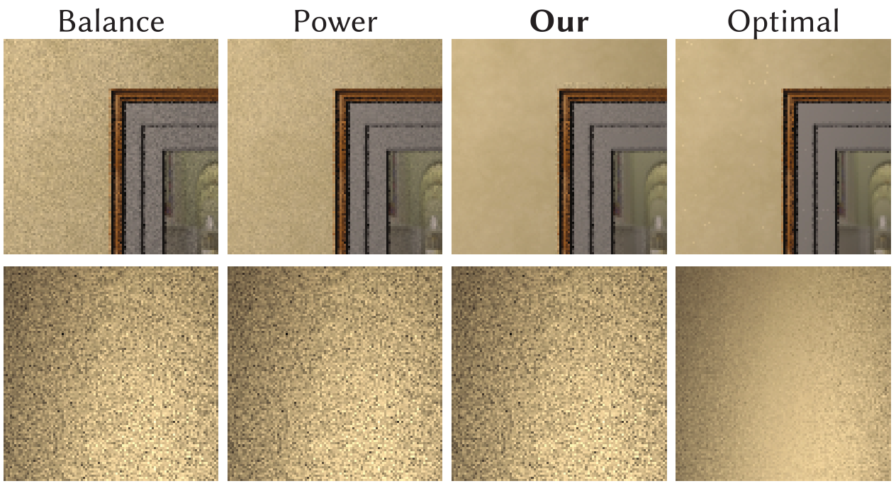
We improve low-variance combinations

Slide 48
Optimal MIS can be even better

Slide 49
Comparison to [Kondapeneni et al. 2019]
Optimal weights
Optimal
With many techniques:
  Complicated
  Expensive
Requires exact pdfs
Our heuristic
Heuristic
With many techniques:
  Still simple
  But some memory overhead
Can handle approximated pdfs

