Slide 1
Light Transport Simulation with
Vertex Connection and Merging
Iliyan Georgiev
Jaroslav Křivánek Tomáš Davidovic Philipp Slusallek

Slide 2
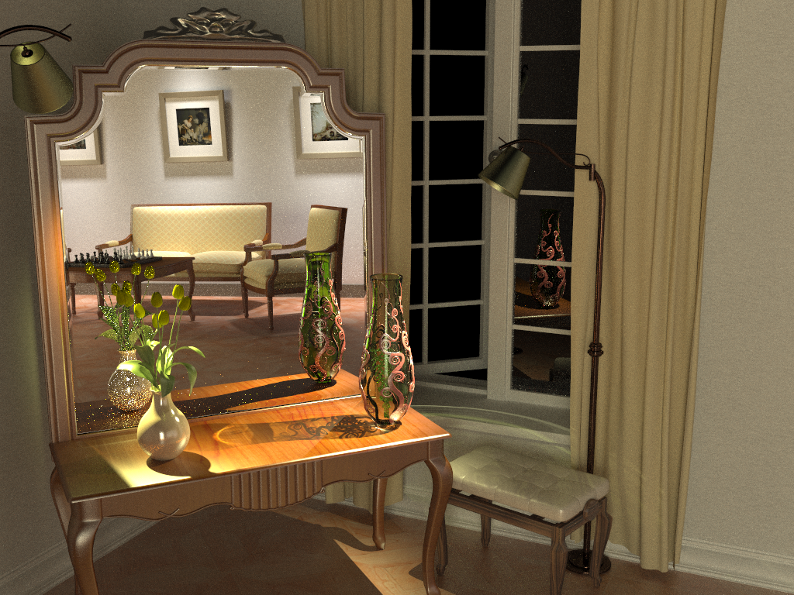
Bidirectional path tracing

Slide 3
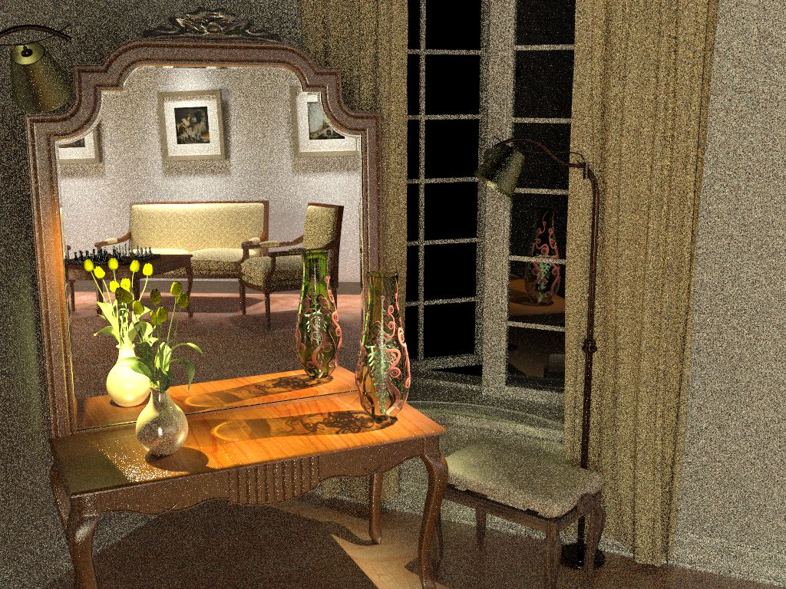
Stochastic progressive photon mapping

Slide 4
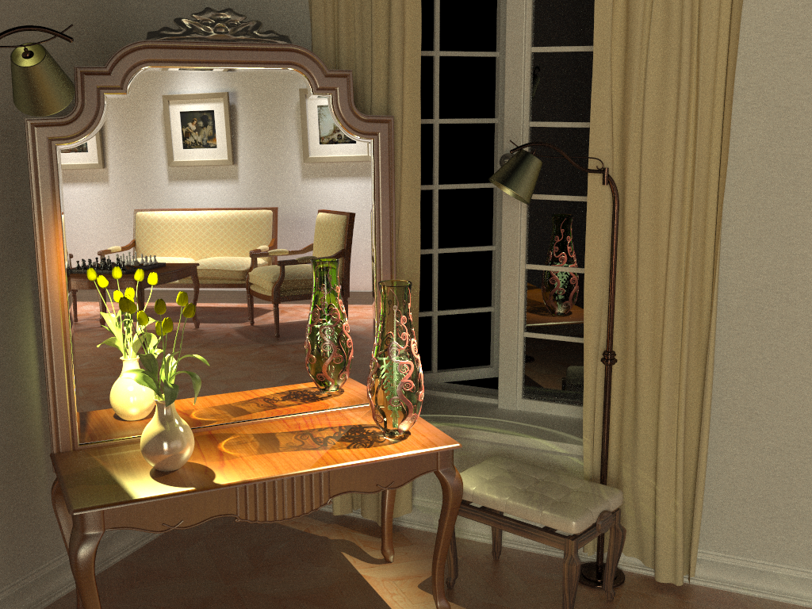
Our vertex connection and merging

Slide 5
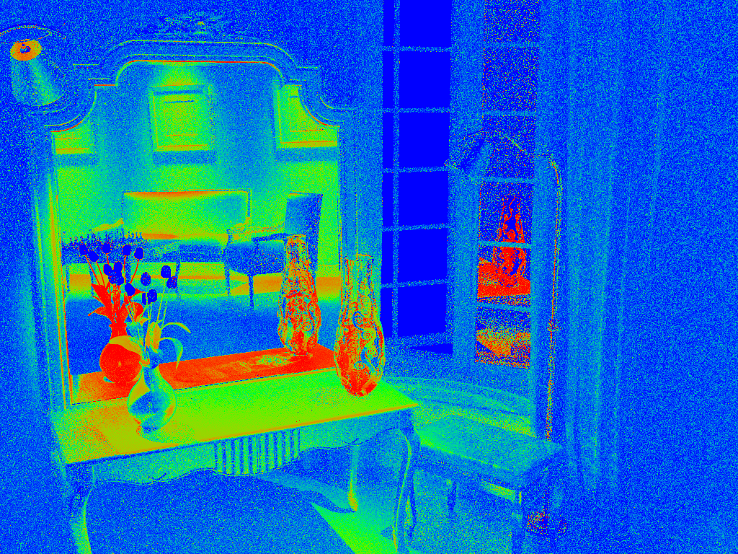

VM
Our vertex connection and merging
VC

Slide 6
Overview
Problem: different mathematical frameworks
  BPT: Monte Carlo integration
  PM: Density estimation
Key idea: Reformulate photon mapping in Veach’s path integral framework
  Formalize as path sampling technique
  Derive path probability density
Understand efficiency of BPT and PM
Combine them via MIS

Slide 7




Bidirectional MC path sampling
$${\text{x}}_{1}$$
$${\text{x}}_{3}$$
$${\text{x}}_{0}$$
$${\text{x}}_{2}$$

Slide 8
Bidirectional MC path sampling
Light vertex
Camera vertex
$${\text{x}}_{1}$$
$${\text{x}}_{3}$$
$${\text{x}}_{0}$$
$${\text{x}}_{2}$$

Slide 9
Bidirectional MC path sampling
Light vertex
Camera vertex
$${\text{x}}_{1}$$
$${\text{x}}_{1}$$
$${\text{x}}_{3}$$
$${\text{x}}_{3}$$
$${\text{x}}_{0}$$
$${\text{x}}_{0}$$
$${\text{x}}_{2}$$
$${\text{x}}_{2}$$
Bidirectional path tracing
Photon mapping

Slide 10



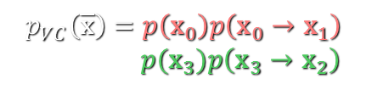









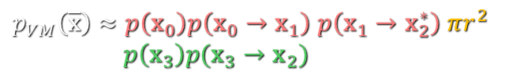
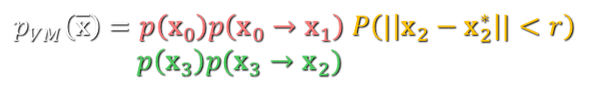
Bidirectional MC path sampling
Light vertex
Camera vertex
$${\text{x}}_{1}$$
$${\text{x}}_{1}$$
$${\text{x}}_{3}$$
$${\text{x}}_{3}$$
$${\text{x}}_{0}$$
$${\text{x}}_{0}$$
$$r$$
$${\text{x}}_{2}$$
$${\text{x}}_{2}$$
$${\text{x}}_{2}^{∗}$$
$${\text{x}}_{2}^{∗}$$
Vertex connection
Vertex merging
Bidirectional path tracing
Photon mapping
$$p_{VC}\left(\overline{\text{x}}\right)=p\left({\text{x}}_{0}\right)p\left({\text{x}}_{0}→{\text{x}}_{1}\right)$$
$p({\text{x}}_{3})p\left({\text{x}}_{3}→{\text{x}}_{2}\right)$
$p_{VM}\left(\overline{\text{x}}\right)=p\left({\text{x}}_{0}\right)p\left({\text{x}}_{0}→{\text{x}}_{1}\right)$ $P\left(|\left|{\text{x}}_{2}−{\text{x}}_{2}^{∗}\right||<r\right)$
$p\left({\text{x}}_{3}\right)p({\text{x}}_{3}→{\text{x}}_{2})$
$p_{VM}\left(\overline{\text{x}}\right)≈p\left({\text{x}}_{0}\right)p\left({\text{x}}_{0}→{\text{x}}_{1}\right)$ $p\left({\text{x}}_{1}→{\text{x}}_{2}^{∗}\right) πr^{2}$
$p\left({\text{x}}_{3}\right)p({\text{x}}_{3}→{\text{x}}_{2})$
$$p_{VM}\left(\overline{\text{x}}\right)=$$

Slide 11
















Sampling techniques
Light vertex
Camera vertex
$${\text{x}}_{4}$$
$${\text{x}}_{0}$$
Unidirectional
2 ways
$${\text{x}}_{3}$$
$${\text{x}}_{1}$$
$${\text{x}}_{2}$$
$${\text{x}}_{4}$$
$${\text{x}}_{0}$$
Vertex connection
4 ways
$${\text{x}}_{3}$$
$${\text{x}}_{1}$$
$${\text{x}}_{2}$$
$${\text{x}}_{4}$$
$${\text{x}}_{0}$$
Vertex merging
5 ways
$${\text{x}}_{3}$$
$${\text{x}}_{3}^{∗}$$
$${\text{x}}_{1}$$
$${\text{x}}_{2}$$
Total
11 ways

Slide 12
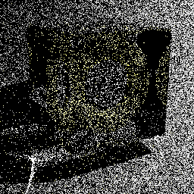
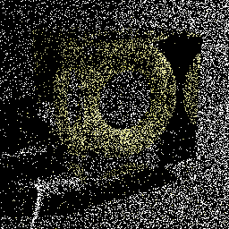
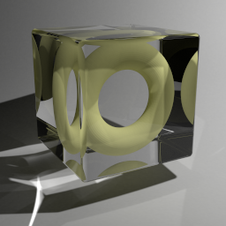


Technique comparison
SDS paths
Diffuse light
Diffuse surface
Mirror surface
Unidirectional sampling
Vertex merging
Vertex merging (reuse)
$$A$$
$$A$$
BPT: Unidirectional sampling
PM: Vertex merging
Roughly equal path sampling probabilities
Roughly same total number of rays per image!
10k paths/pixel
10k paths/pixel
1.2 billion paths/pixel

Slide 13
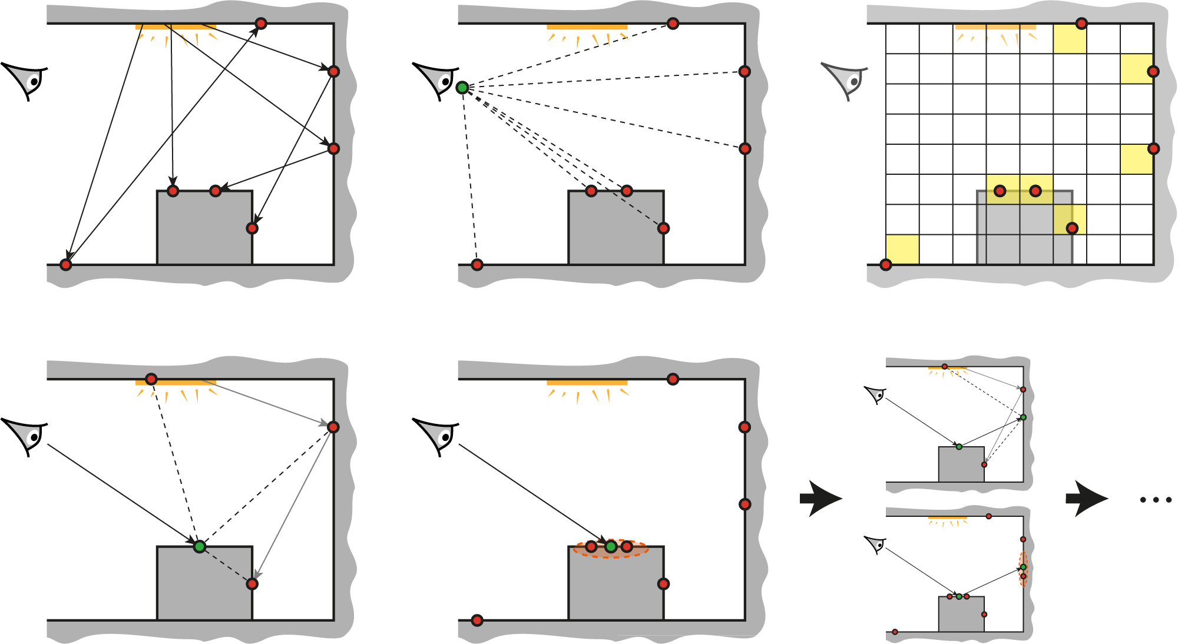
Vertex connection & merging (VCM)
Stage 1: Light sub-path sampling
a) Trace sub-paths
b) Connect to eye
c) Build search structure
Stage 2: Eye sub-path sampling
VC
VC
VM
VM
a) Vertex connection
b) Vertex merging
c) Continue sub-path

Slide 14
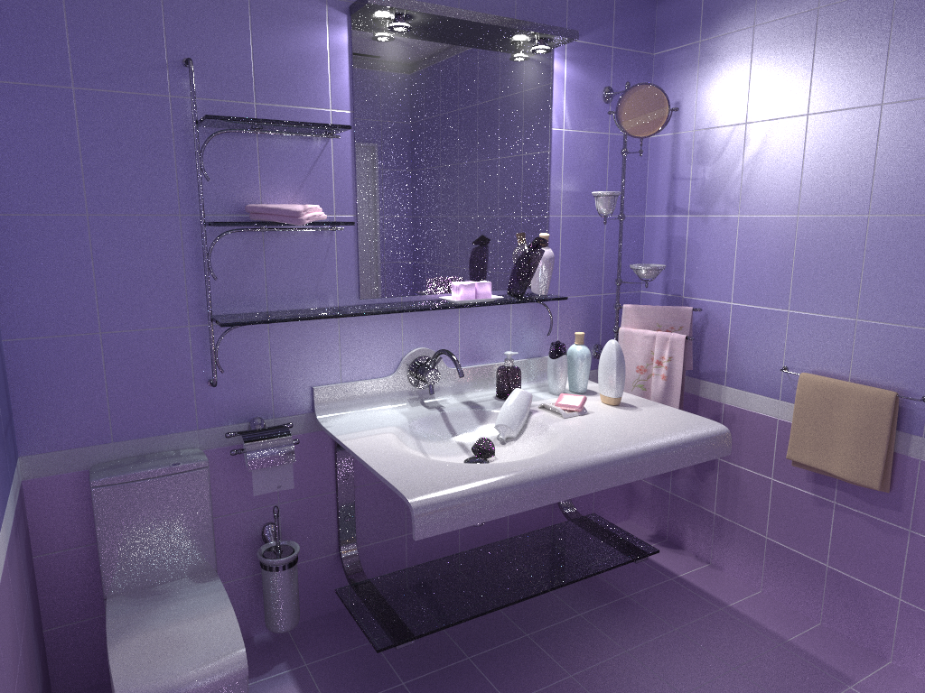
Bidirectional path tracing

Slide 15
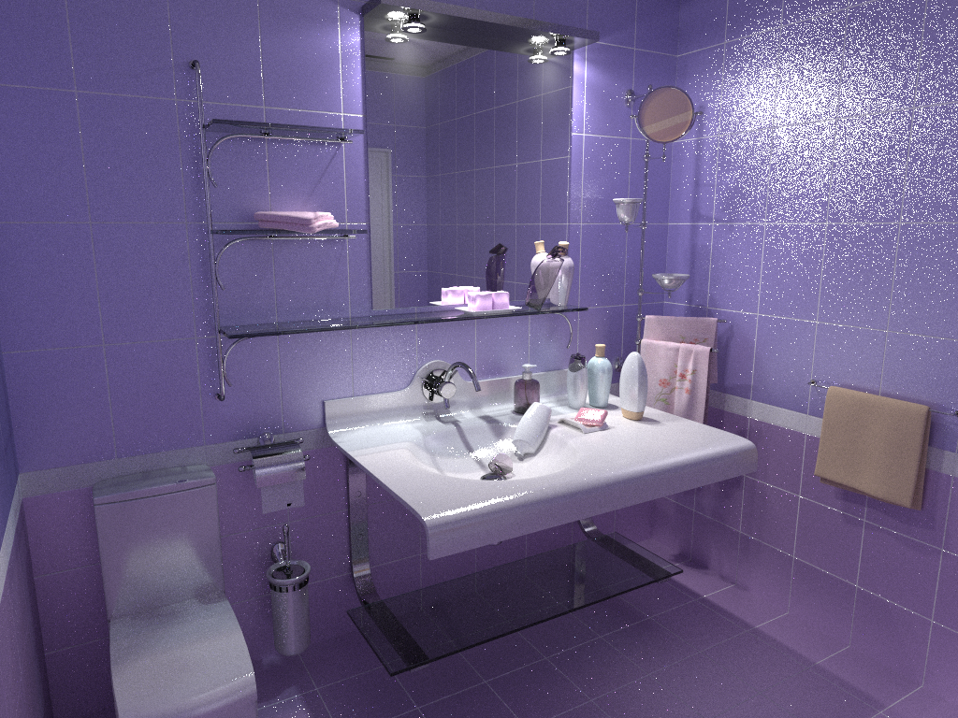
Stochastic progressive photon mapping

Slide 16
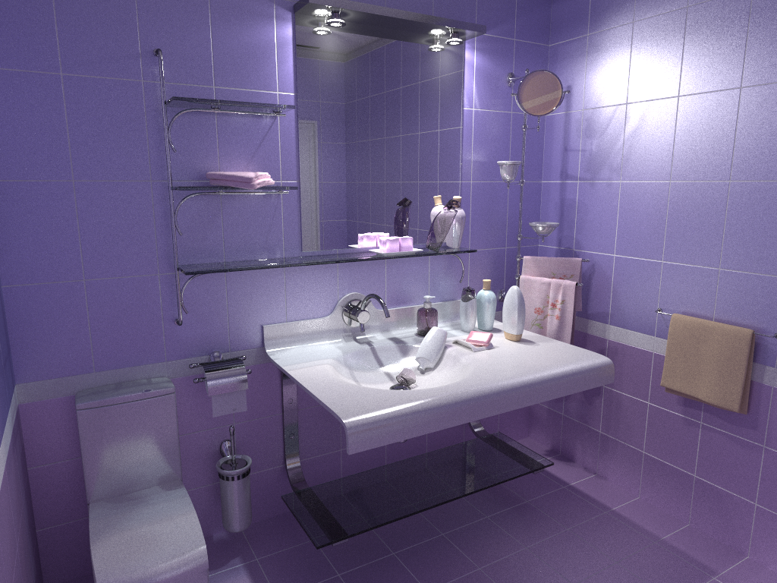
Our vertex connection and merging

Slide 17
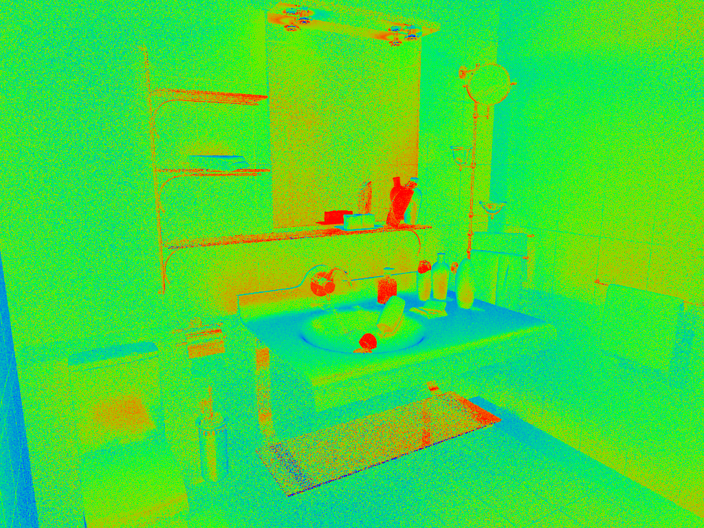
VM
Our vertex connection and merging
VC

Slide 18
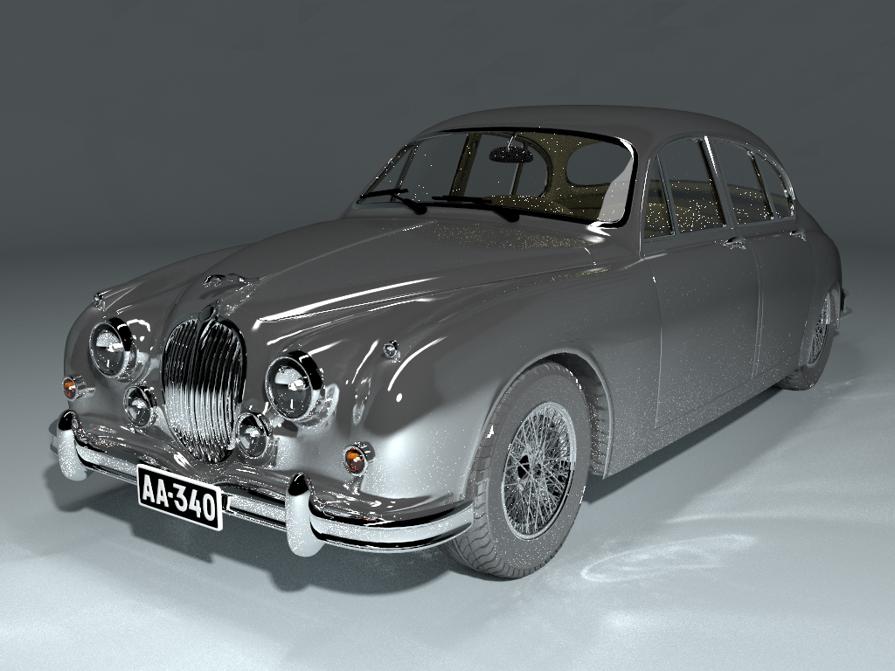
Bidirectional path tracing

Slide 19
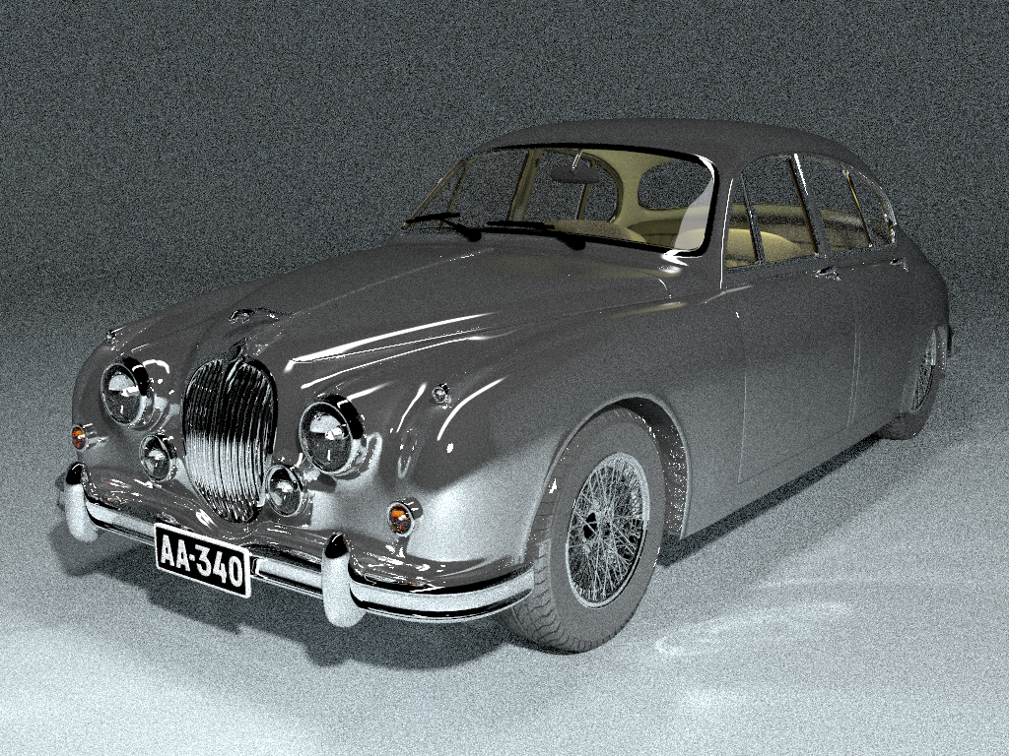
Stochastic progressive photon mapping

Slide 20
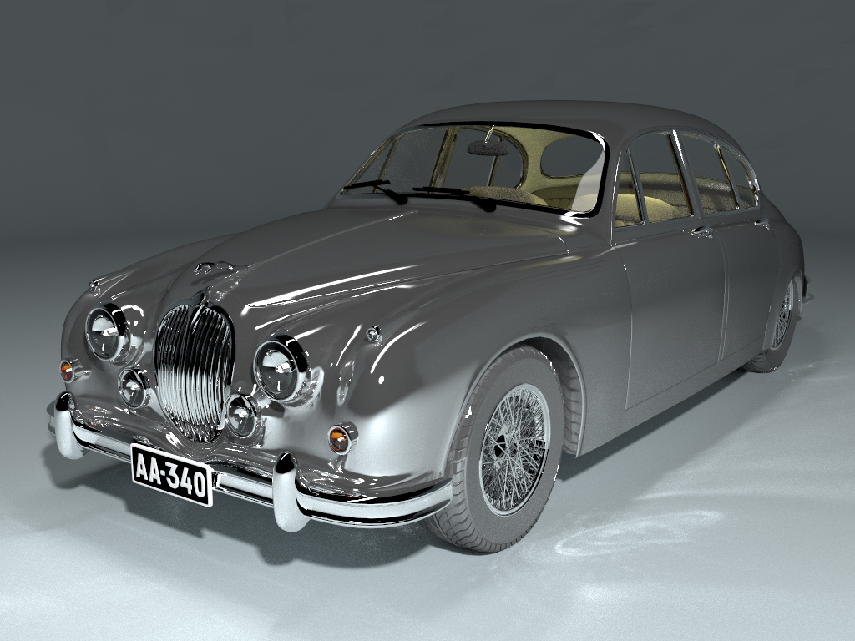
Our vertex connection and merging

Slide 21
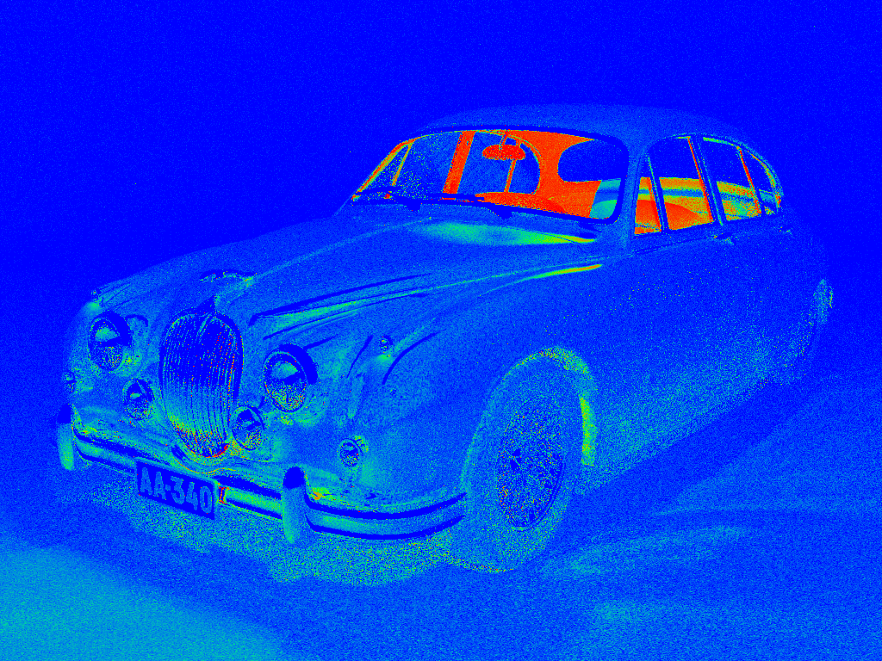
VM
Our vertex connection and merging
VC

Slide 22
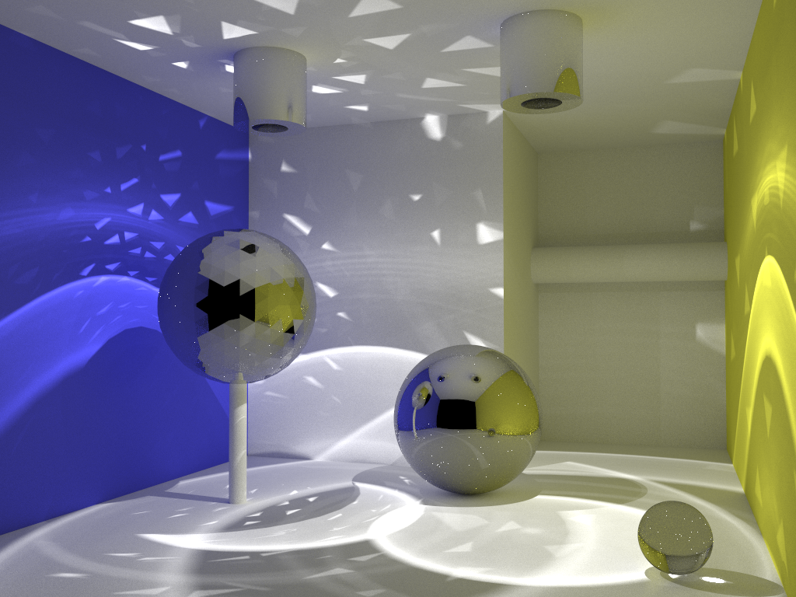
Bidirectional path tracing

Slide 23
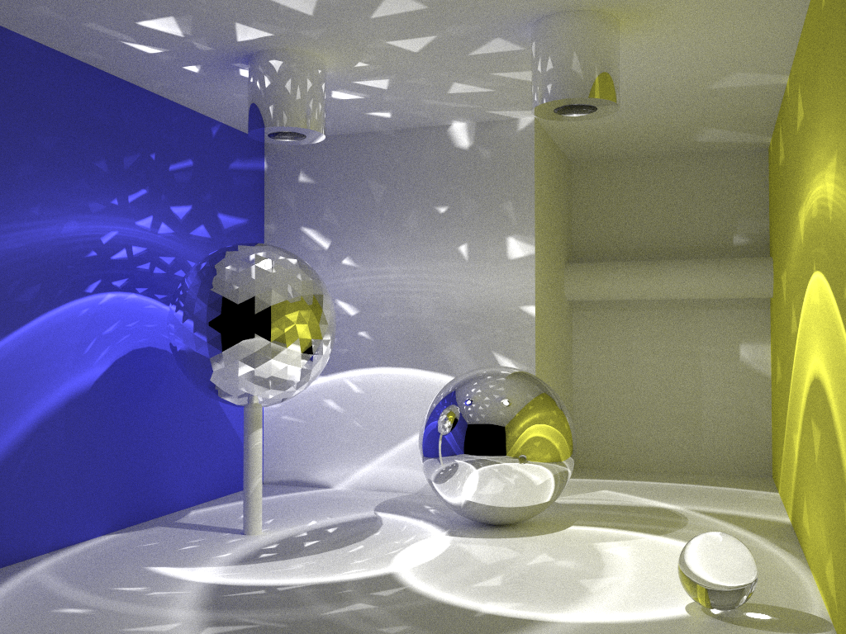
Stochastic progressive photon mapping

Slide 24

Our vertex connection and merging

Slide 25
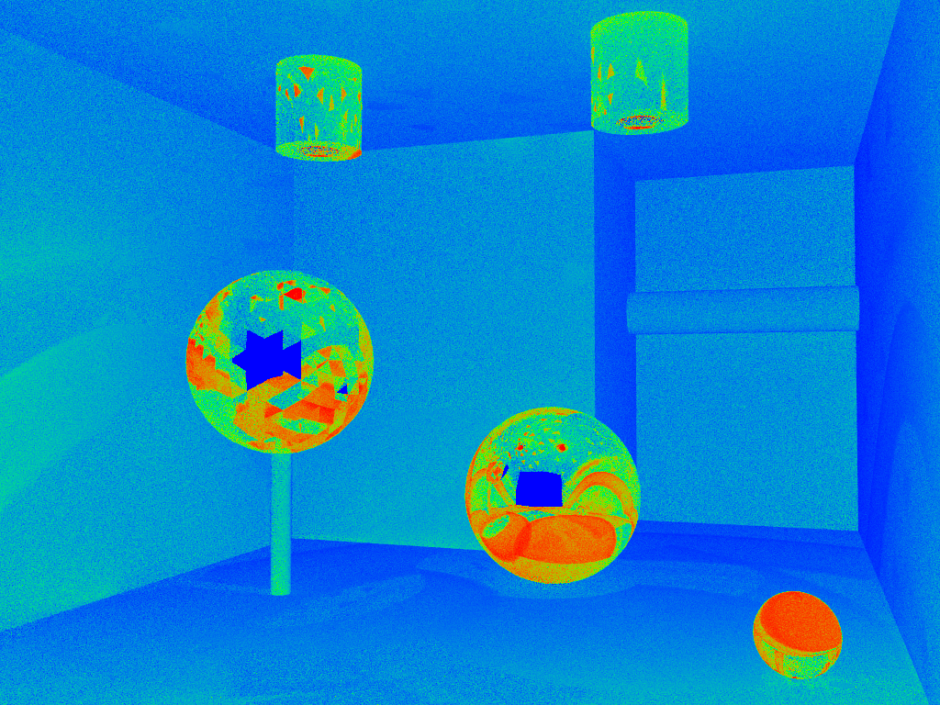
VM
Our vertex connection and merging
VC

Slide 26
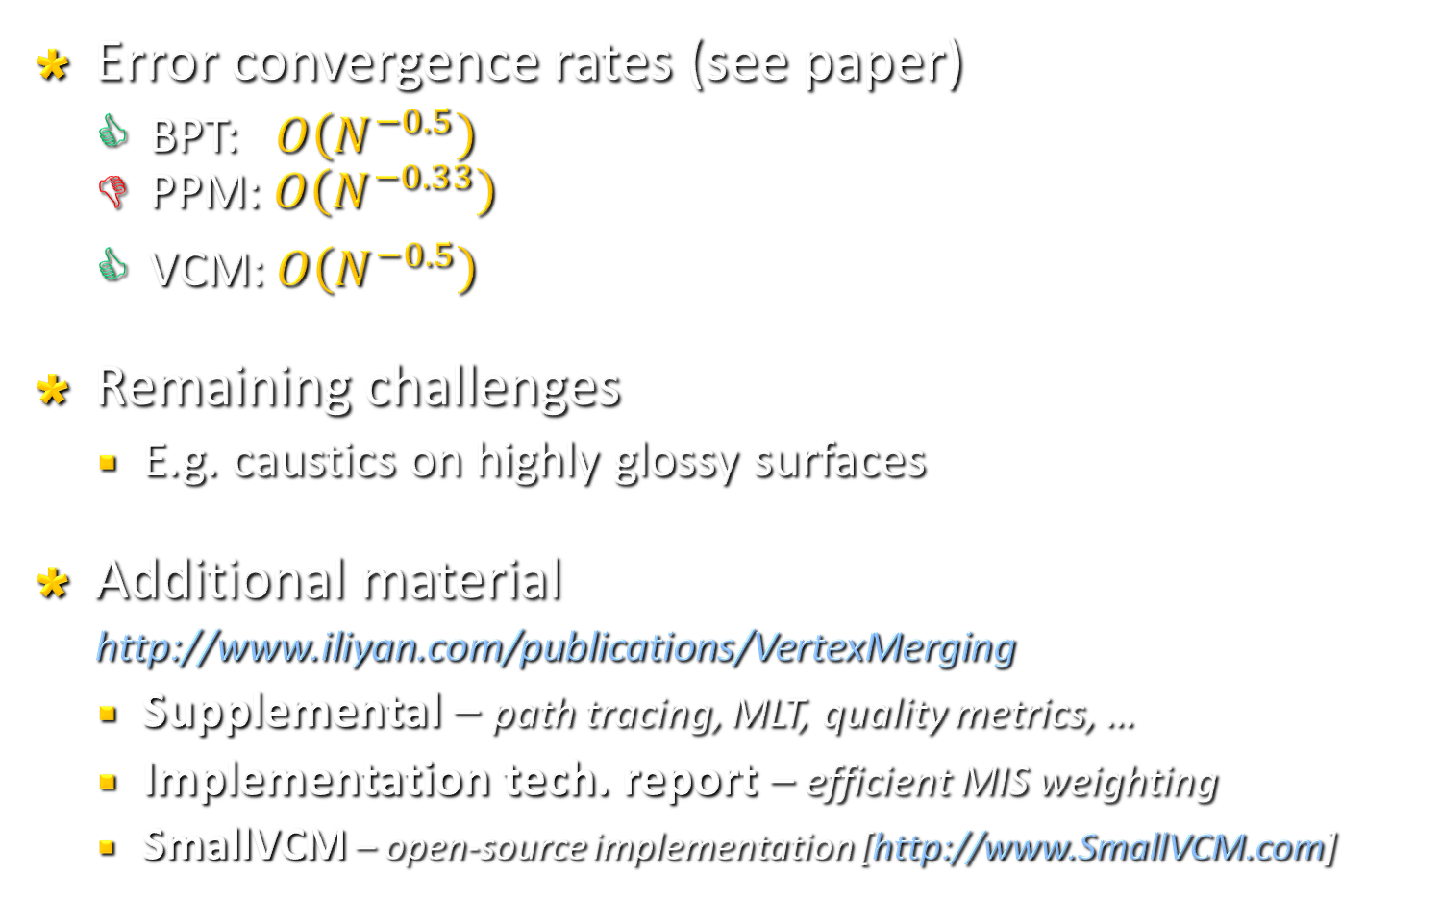
Final notes
Error convergence rates (see paper)
  BPT: $O\left(N^{−0.5}\right)$
  PPM: $O\left(N^{−0.33}\right)$
  VCM: $O\left(N^{−0.5}\right)$
Remaining challenges
  E.g. caustics on highly glossy surfaces
Additional material
http://www.iliyan.com/publications/VertexMerging
  Supplemental – path tracing, MLT, quality metrics, …
  Implementation tech. report – efficient MIS weighting
  SmallVCM – open-source implementation [http://www.SmallVCM.com]

Slide 27
Thank you
谢谢
Terima kasih
நன்றி

