Slide 1
Adaptive Quantization Visibility Caching
Stefan Popov Iliyan Georgiev Philipp Slusallek Carsten Dachsbacher

Slide 2
Motivation
Visibility is a common bottleneck in rendering
Accelerate by approximating it
Trade quality for speed (commonly acceptable)
Prominent example: shadow mapping
A universal solution?
Even in BiDi path tracing?
Intuitive error control in screen space?
Reference
Ours 7x faster

Slide 3
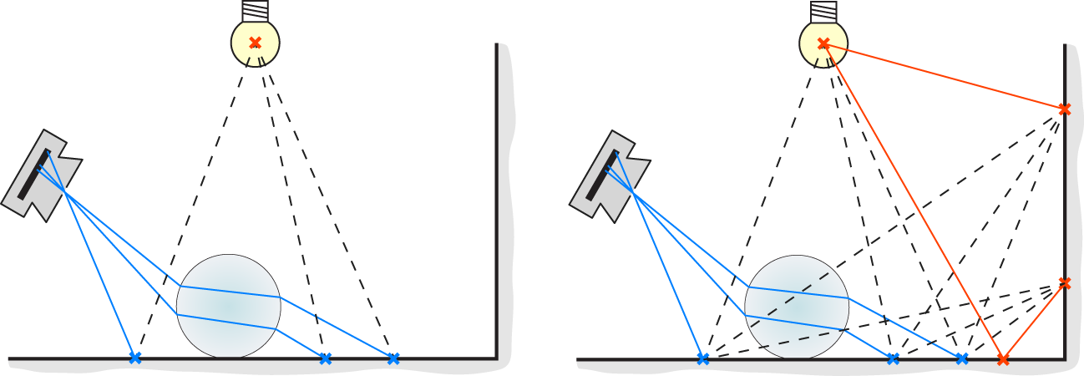
Path-Based Rendering Algorithms
Connect camera to light source with a path
Build two sub-paths: 1 from eye and 1 from light
Connect their last vertices (x - - - x)
Test for visibility
Whitted-style ray tracing
Instant Radiosity

Slide 4
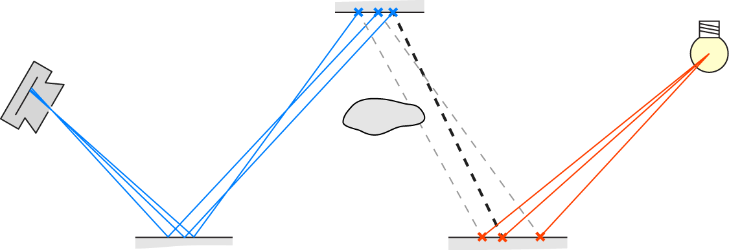
Visibility Reuse
Idea: Reuse visibility for $C_{E}$close paths
Speed: $C_{E}$ times less visibility tests
Error: Contribution can change up to $C_{E}$ times
Assuming same un-occluded contribution in group
Unlikely to reach upper bound as paths are close

Slide 5
Visibility Caching
Quantize path space
To compute visibility for path
Find index $j$ of quantization cluster
Lookup visibility for cluster $j$ in global cache $V^{C}$
If $V^{C}\left(j\right)$ uninitialized, compute and store visibility
Trade-off achieved if each clusters contains
$0$ or $≈C_{E}$ paths used in rendering (speed + error)
Only close paths (error)

Slide 6
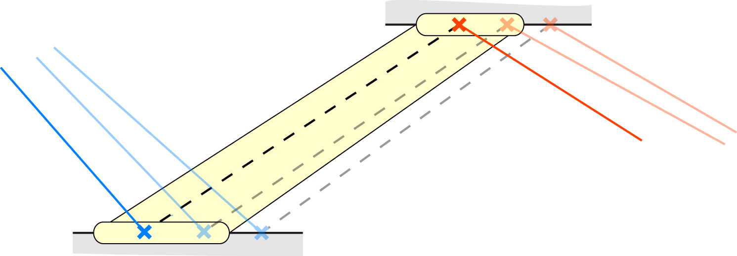
Quantization in Path Space
Define clusters using two surface patches
Pick patches around last eye and light vertices
Cluster $≡$ all close paths that end on same patches
Pick same patches for any path in cluster (stable)
Notes:
Patches can be shared, but no need to disambiguate

Slide 7
Counting Paths
Sub-path with end vertex $X$
Generated by local path sampling
Interpret $P(X)$ as density of close paths
$P\left(X\right)≈\frac{Close−Paths}{m^{2}}$ (assume const. prob. in neigh.)
Number of close sub-paths ending on patch $A_{X}$?
$≈N_{all−paths} P\left(X\right)\left|A_{X}\right|$
Number of close paths in cluster $A_{Y}↔A_{Z}$ ?
$≈N_{all−paths} P\left(Y\right)\left|A_{Y}\right| P\left(Z\right)\left|A_{Z}\right|$

Slide 8
Patch Size
Target cluster size is $C_{E}$, thus
$\left|A_{Y}\right|\left|A_{Z}\right|≈\frac{C_{E}}{P\left(Y\right) P\left(Z\right) N_{all−paths}}=T$ (undetermined)
Least total area: $\left|A_{Y}\right|=\left|A_{Z}\right|=\sqrt{T}$
Pixel exact (if All-Paths = Eye x Light)
$\left|A_{Z}\right|=\frac{\sqrt{C_{E}}}{P\left(Z\right)N_{eye}}$ and $\left|A_{Y}\right|=\frac{\sqrt{C_{E}}}{P\left(Y\right)N_{light}}$
Cluster affects $≈C_{E}$ samples on screen
Error control: largest artifact limited in screen space

Slide 9
Defining the Surface Patches
Parameterize scene’s surface?
Robust parameterization expensive and hard
Idea: Implicit patches as intersection w/ flat grid
Roughly aligned to surface, voxel size ≈ patch size
Decoupled from the actual geometry representation
Error prone, but we already control the error
Notes:
Roughly aligned to a reasonably smooth surface

Slide 10
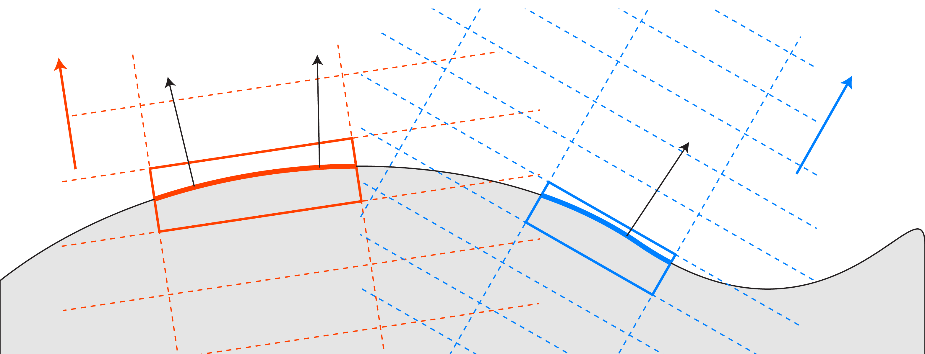
Surface-Oriented Multi-Resolution Grids
Patches can have different orientation and size
Approximate using set of grids
Different quantized orientations and resolutions
Encompassing whole scene

Slide 11
Quantizing a Path
Derive patch quantization index from the grids
Sub-path with end vertex $X$ and patch $A_{X}$
Choose grid family w/ closest orientation to $N_{X}$
Choose grid w/ voxel base area closest to patch’s
Find index of voxel containing $X$
Quantize path using patch grid indices
Result: Tuple of $7+7$ integers
Using grids also achieves quantization stability

Slide 12
Implementation I
Non $dA ↔dA$ connections
$dω→dA$: similar theory, 10-tuple (7+3)
Delta lights: identified by index, 8-tuple (7+1)
Prefix tuple with connection type (+1 integer)
Cache $V^{C}$ is 15 dimensional 3-state array
Use a hash map (derive hash key from tuple)
Store 31 bit digest of tuple + 1 bit payload
Lookup: return “uninitialized” if digests don’t match

Slide 13
Implementation II
Use the hash map as cache (overwrite)
Query to overwritten data will return “uninitialized”
Can lose efficiency due to re-computations
Fixed size; $O\left(1\right)$ access time; and parallel friendly
GPU implementation
Be careful to keep warps busy if((ret = Cache[ray]) == Uninitialized) Cache[ray] = ret = Trace(ray); //Warp divergence! return ret;
Pixel processing order important to avoid races

Slide 14
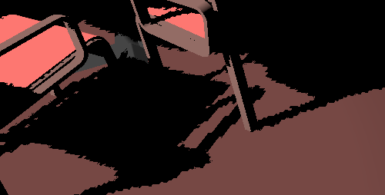
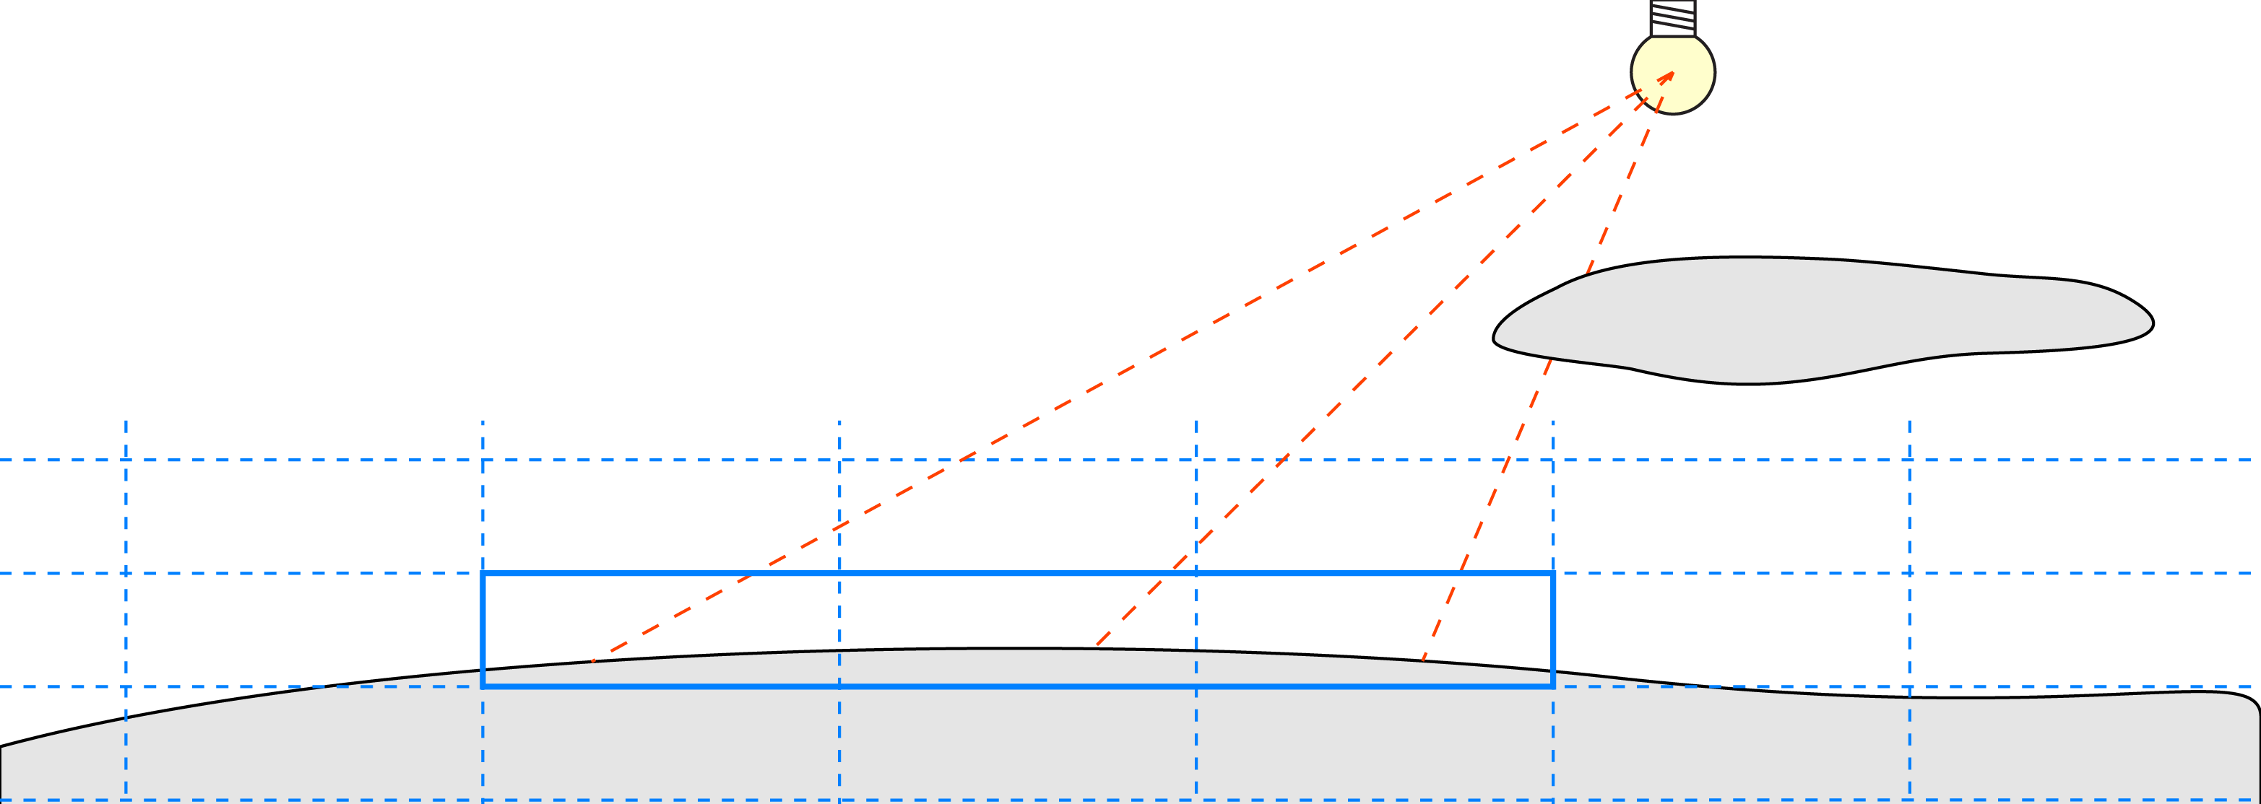
Adaptive Quantization
Basic Quantization
Adaptive Quantization
Detect clusters passing near caster edges
Adjacent clusters disagree on visibility
Ignore uninitialized clusters
Refine by reducing $C_{E}$
Visible
Vis/Refine
Occluded
Notes:
Mention that order is important, but details are in the paper

Slide 15
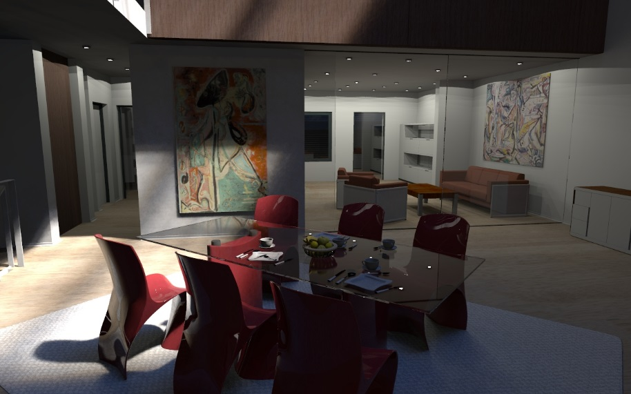
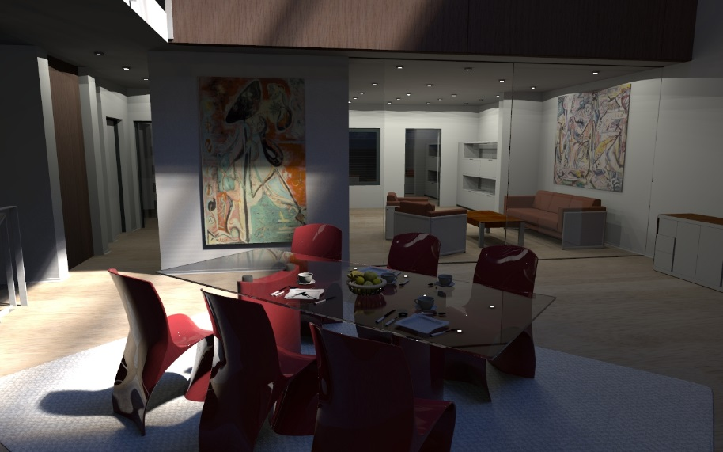
Results: Ray Tracing + MIS Env. Map + VPLs
Cache, $C_{E}=42$
4x faster
Reference

Slide 16
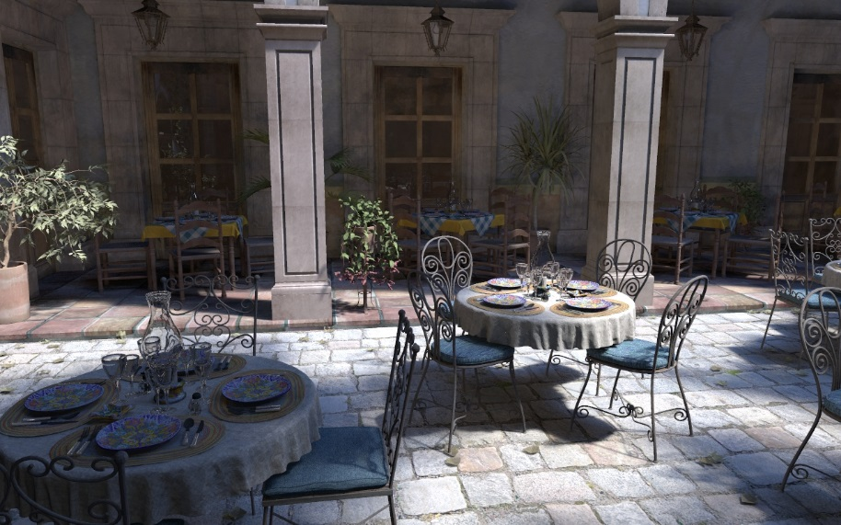
Results: Large Scene
Cache, $C_{E}=36$
6.4x faster
Reference

Slide 17
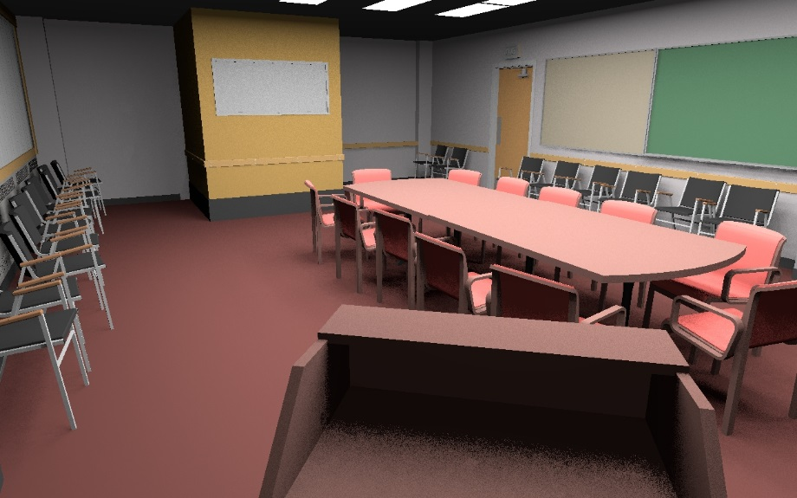
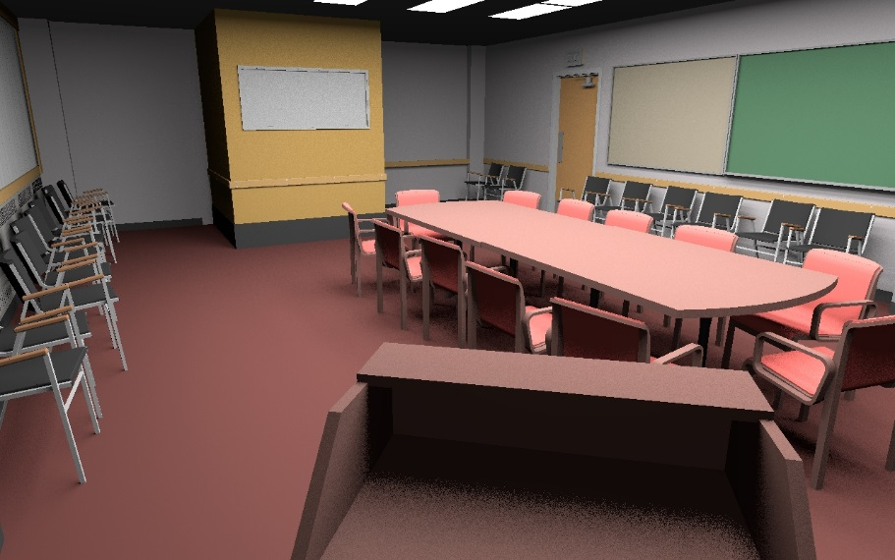
Results: Direct Sampling from Area Lights
Cache, $C_{E}=18$
2.1x faster
Reference
Notes:
Showing because of area lights +limitation

Slide 18
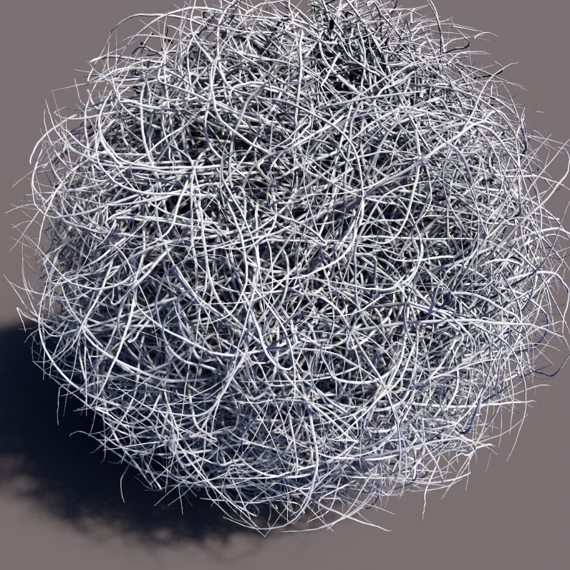
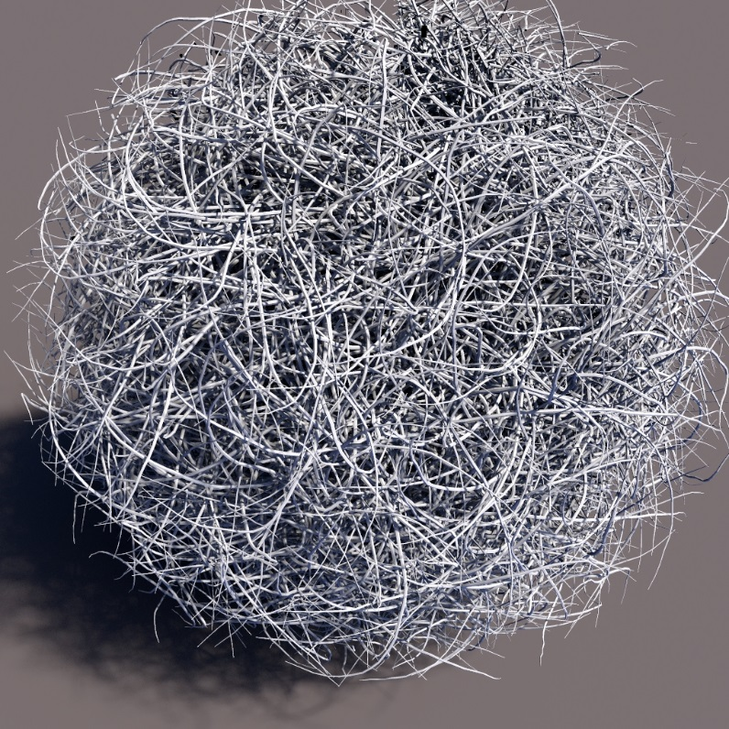
Results: Complex Geometry
ref
3.6x faster Cache, $C_{E}=28$
Reference
ref

Slide 19
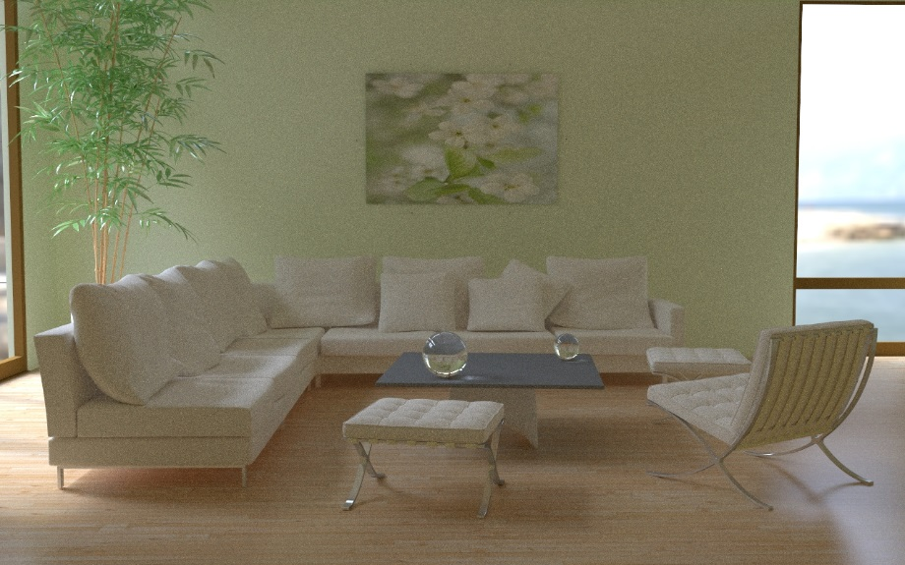
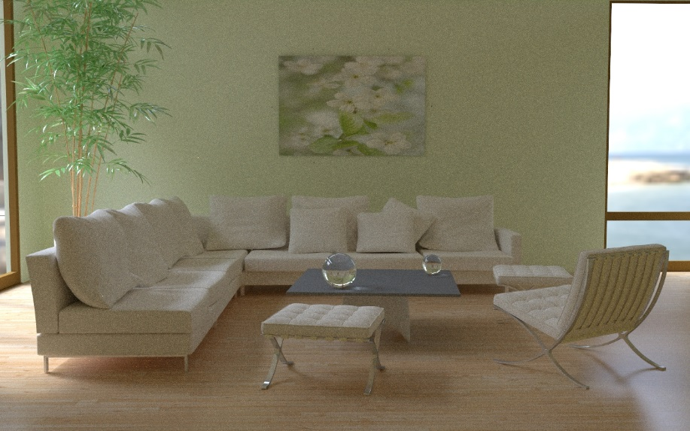
Results: Bi-Directional Path Tracing
Cache, $C_{E}=12$
6x ray reduction
Reference
Shadow computations cheap
Relative to the rest
No acceleration, but still 6x less visibility queries

Slide 20
Comparison to Shadow Maps
Reference, 1.0 sec
Cache, $C_{E}=6$, 0.4 sec
Sh. map, 1024², 0.5 sec
Reference, 0.38 sec
Cache, $C_{E}=6$, 0.2 sec
Sh. map, 1024², 0.5 sec

Slide 21
Interactive Results
Cache $C_{E}=20$ vs. Reference
Apartment, 640x400 on GTX680

Slide 22
Interactive Results
Cache $C_{E}=24$ vs. Reference
San Miguel, 640x400 on GTX680

Slide 23
Discussion
Visibility must be expensive in the first place
Main limitation
Leads to bad results on Conference + BDPT
Subsampled visibility, thus
Can miss small features
Small amount of flickering possible
Future work
Embed into other algorithms (e.g. light cuts)
Non-binary visibility

Slide 24
Thank You!

